Slide 1
Physical Geography
Geography - Module UnPlastic Geography Package
Geography - Module 1

Slide 2
Plastic Distribution
Currents
Ocean Gyres
Garbage Patches
Conclusion

Slide 3
1
How do movements in the ocean’s water occur?
Currents
Wind
Temperature and salinity
All of the above

Slide 4
1
How do movements in the ocean’s water occur?
Currents
Wind
Temperature and salinity
All of the above

Slide 5
2
What is the ocean conveyor belt?
Luggage belt on the ocean
Tool to collect waste
Circulation of water across the globe
Distribution of heat

Slide 6
2
What is the ocean conveyor belt?
Luggage belt on the ocean
Tool to collect waste
Circulation of water across the globe
Distribution of heat

Slide 7
3
What is the effect of the spin of the world called?
Global warming
A year
Coriolis Effect
Earth’s rotation

Slide 8
3
What is the effect of the spin of the world called?
Global warming
A year
Coriolis Effect
Earth’s rotation

Slide 9
4
How does plastic accumulate in circulating ocean currents?
Whirlpools
Ocean Gyres
Wind currents
People leaving trash

Slide 10
4
How does plastic accumulate in circulating ocean currents?
Whirlpools
Ocean Gyres
Wind currents
People leaving trash

Slide 11
7
How does plastic break down in the ocean?
Water density and friction
Deep ocean currents
Photodegradation and oxidation
All of the above

Slide 12
7
How does plastic break down in the ocean?
Water density and friction
Deep ocean currents
Photodegradation and oxidation
All of the above

Slide 13
Plastic Distribution
Currents
Ocean Gyres
Garbage Patches
Conclusion

Slide 14
Pause and think
Where does plastic that has been thrown away in nature end up?

Slide 15
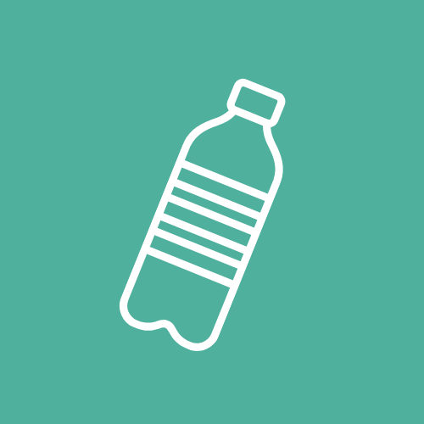
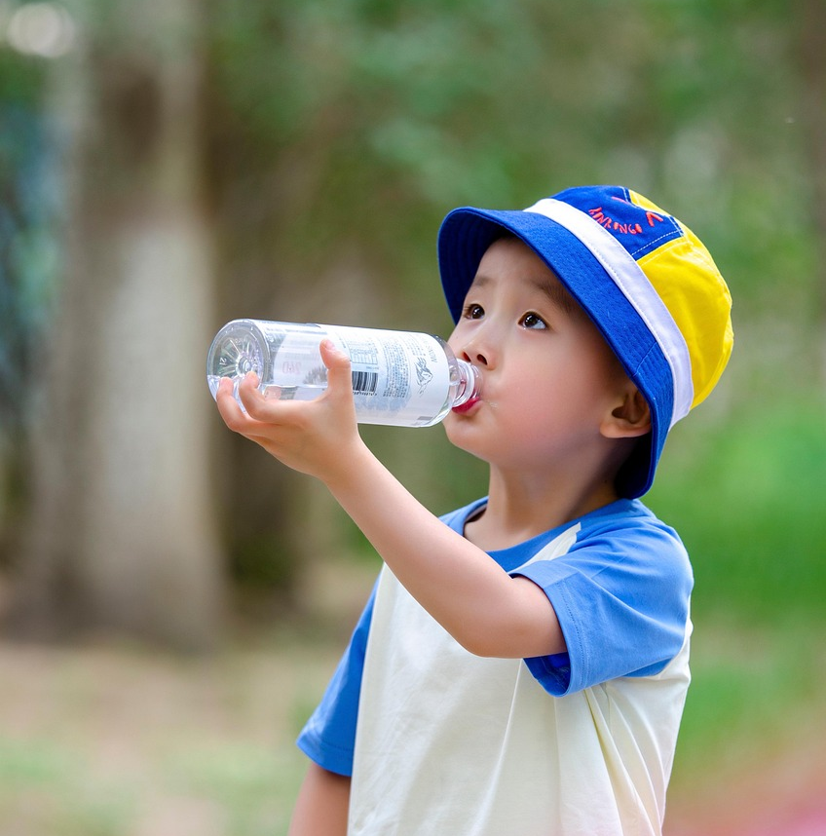
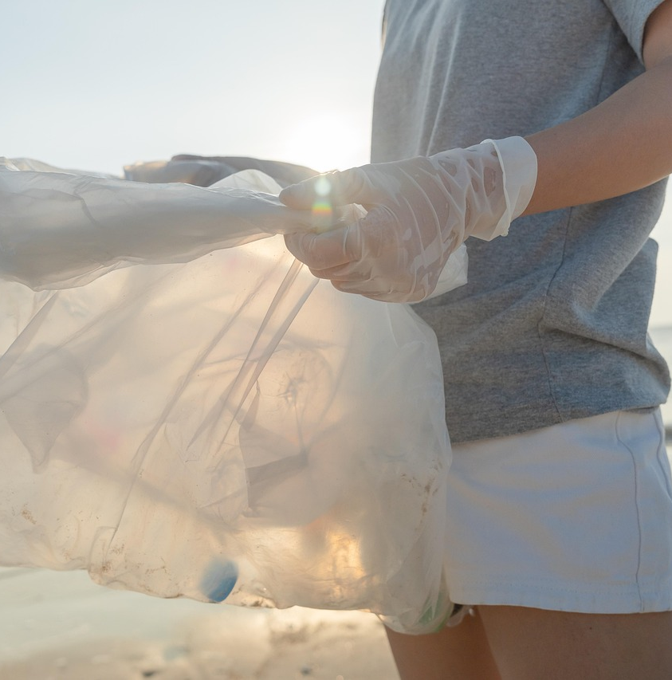
TRAVELS OF A PLASTIC BOTTLE
Notes:
Often it will find its way into water streams. Once in a river, the plastic will ultimately end up in the ocean. Plastic pollution near beaches also often ends up in the ocean: the plastic is transported by wind and the eb&flow of the sea
Today we are trying to trace a water bottle from its ‘source’ (where it was thrown away) to its final destination. To understand the journey our bottle will go on we first need to see if there are specific points where waste ends up in our oceans and where these places might be.

Slide 16
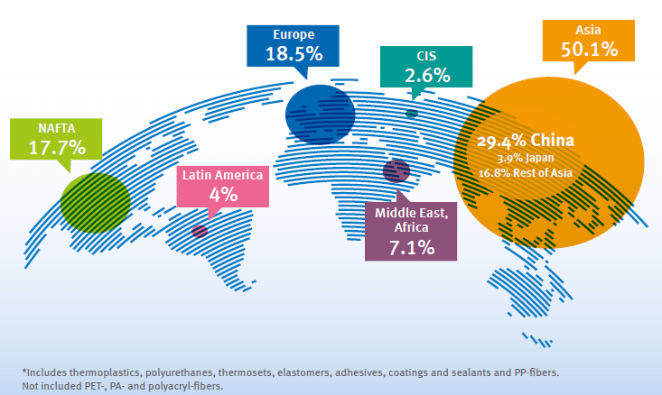
Global distribution of plastic pollution
Notes:
Image source: https://www.researchgate.net/publication/338150269_PLASTIC_FLOW_IN_WORLDWIDE_CONTEXT_MHSE11_-CIRCULAR_ECONOMY
This map shows that most of the plastic pollution is found in Asia. Keep this in mind, because while Asia might have the most plastic pollution, they are not solely responsible for all the plastic waste in the continent.

Slide 17
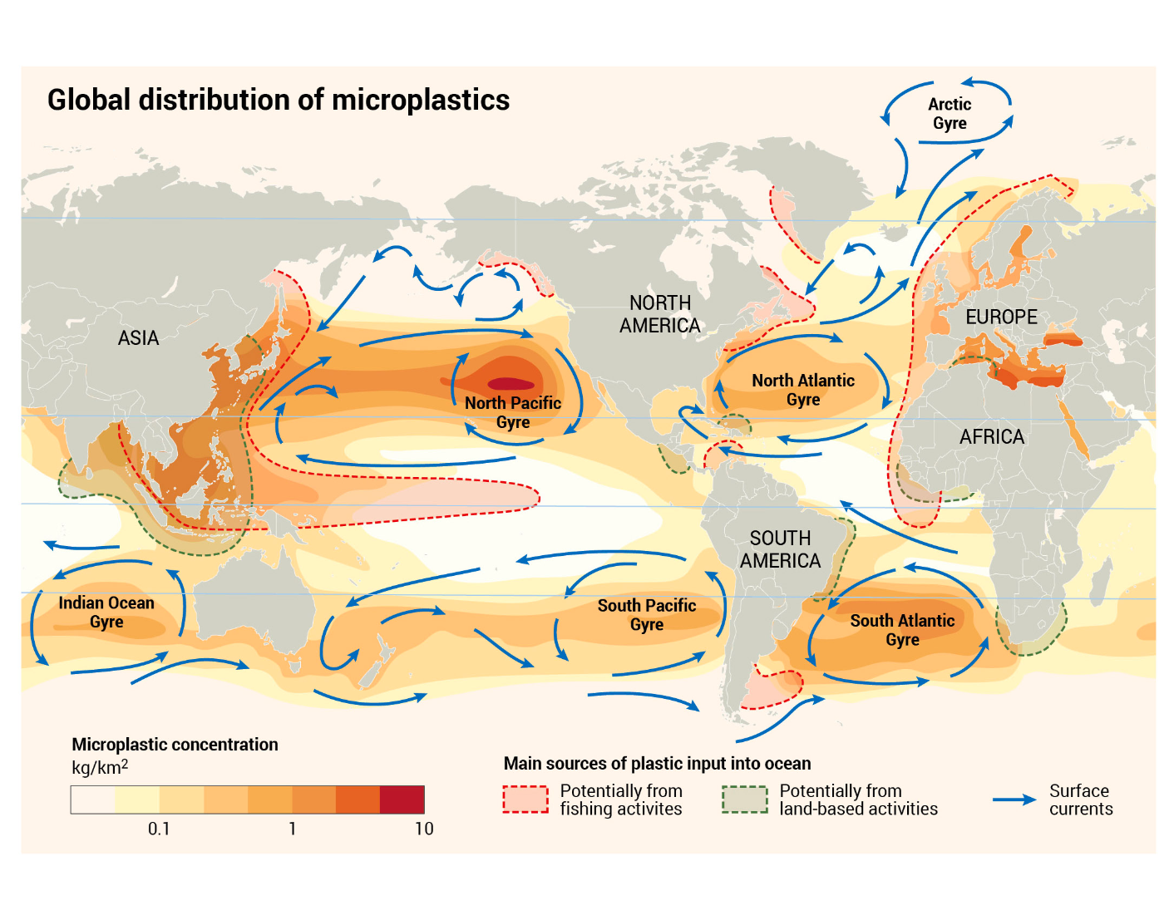
What can you tell by looking at this map?
How do you think the waste ended up there?
Notes:
This is a map that depicts the distribution of the pollution of microplastics in particular. What can you see?
The microplastics maps clearly shows that there are five identifiable areas of accumulation. The accumulations are not on coastlines but in the center of ocean basins.
It also shows that microplastic from the Indian Ocean Gyre could travel all the way up to the Arctic Gyre.

Slide 18
Plastic Distribution
Currents
Surface Currents
Duck Spill
Deep Ocean Currents ​​& The Ocean Conveyor Belt
Ocean Gyres
Garbage Patches
Conclusion

Slide 19
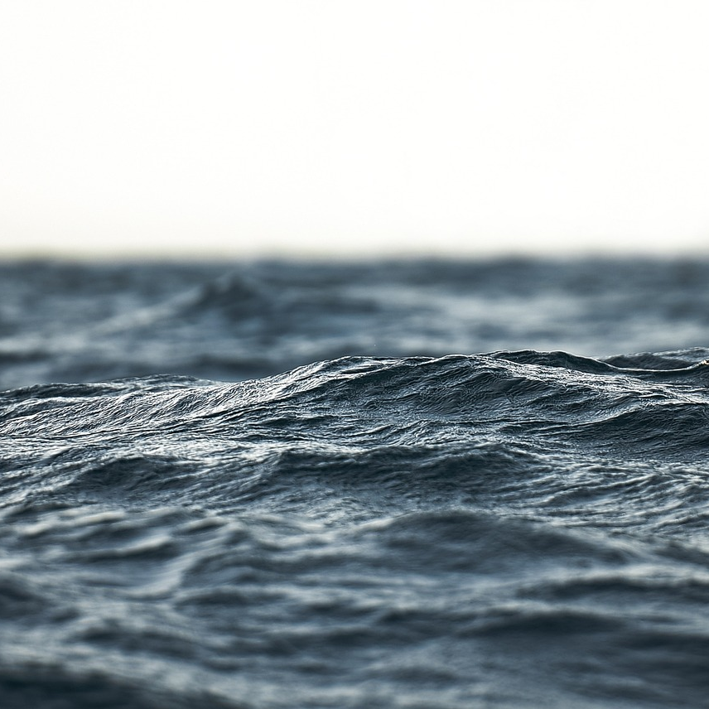
What are currents?
Surface Currents
Surface and deep ocean currents
Surface currents (affecting the top 10% of ocean) are movements of surface water that are driven by winds which pull on the surface.
Water up to 400m below the surface is still impacted by the movement of wind, and on the coastline also by the tides
Image 2
Notes:
There are two main types of ocean currents: surface currents and deep ocean currents.
Surface currents affect the top 10% of the ocean and are primarily driven by wind.
Wind can influence water movement up to 400 meters deep, especially near coastlines and through the effects of tides.
These currents can transport objects (like a water bottle) and heat—e.g., the Gulf Stream moves warm water from the equator to the poles.
Oceanographers have used floating objects, like rubber ducks, to better understand how currents move materials across the ocean.

Slide 20
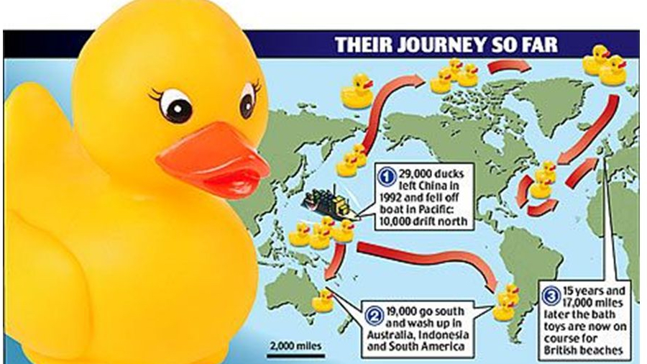
Image 3
Path of rubber ducks
Notes:
In 1992, a cargo ship accidentally released almost 30 thousand rubber ducks into the Pacific Ocean. After having left Hongkong, and heading for the United States of America, a shipping crate full of these plastic yellow bath toys fell overboard in a heavy storm. At the time, not much was thought of this accident. The news simply covered the event solely as a commercial loss. However, today the ducks are known as ‘Friendly Floatees’ and have helped revolutionize our understanding of ocean currents, as well as plastic pollution. Not long after the incident, some of these ducks were found in remote places such as Alaska. Based on these washed ashore ducks scientists were able to determine a steady pattern the ducks moved in.
These are the paths the ducks were observed to move in and in which year they were observed at these locations:

Slide 21
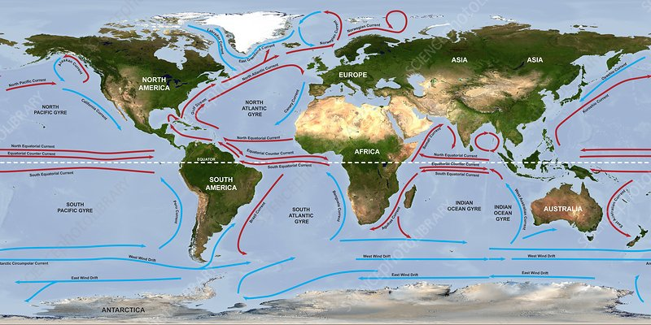
Image 4
Global currents
Notes:
Modern day understanding of currents

Slide 22
Why are some red and some blue?
What are some patterns you notice and how are they connected to warm/cold currents?
Notes:
Discussion question: Why are some orange and some blue?
Answer: the orange currents are warm water and the blue currents are cold water.
Discussion question: What are some patterns you notice and how are they connected to warm/cold currents?
Answer: Warm currents flow from the equator, where they are warmed up towards the poles. Cold currents flow from the poles, where they are cooled down towards the equator.

Slide 23
Why are some red and some blue?
Warm currents and cold currents
What are some patterns you notice and how are they connected to warm/cold currents?
Warm currents flow from the equator towards the poles
Cold currents flow from the poles towards the equator

Slide 24
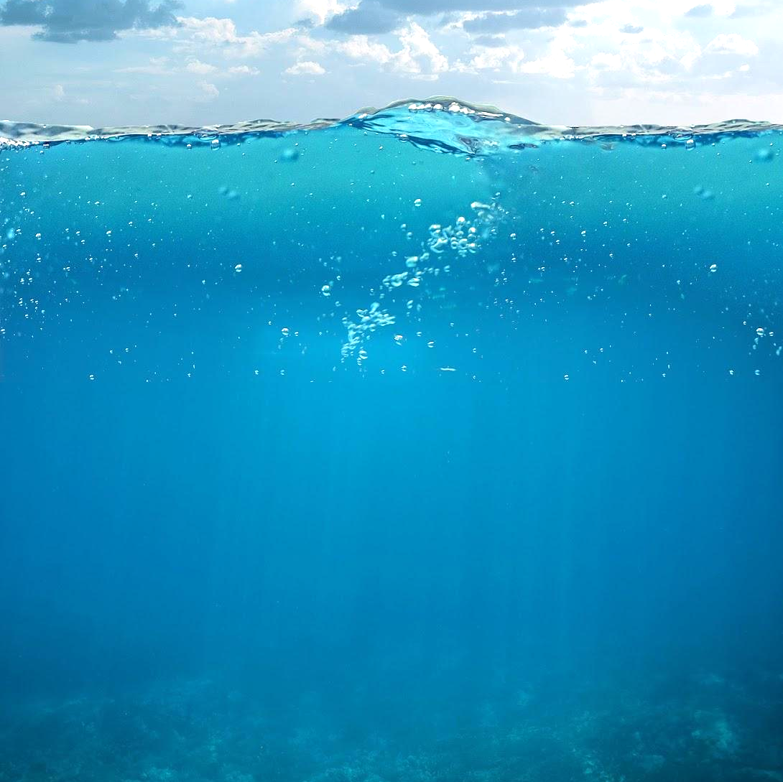
The Ocean Conveyor Belt
Deep Ocean Currents
Deep ocean currents are driven by the density of seawater → Downwelling - sinks and pushes up warm surface water
Winds blow away warm surface water → Upwelling - rise of deep, cold and nutrient rich water.
Changes between warm surface water and cold deep water create thermohaline circulation
= the ocean conveyor belt
Image 5
Notes:
Deep ocean currents are driven by differences in water density, which is affected by temperature and salinity.
At the poles, water becomes colder and saltier, making it denser and causing it to sink (downwelling).
In other areas, wind can push warm surface water away, causing cold, nutrient-rich water to rise (upwelling).
This movement of sinking and rising water drives thermohaline circulation, a global system of ocean currents.
The resulting “ocean conveyor belt” moves water around the entire planet, playing a key role in climate and nutrient distribution.

Slide 25
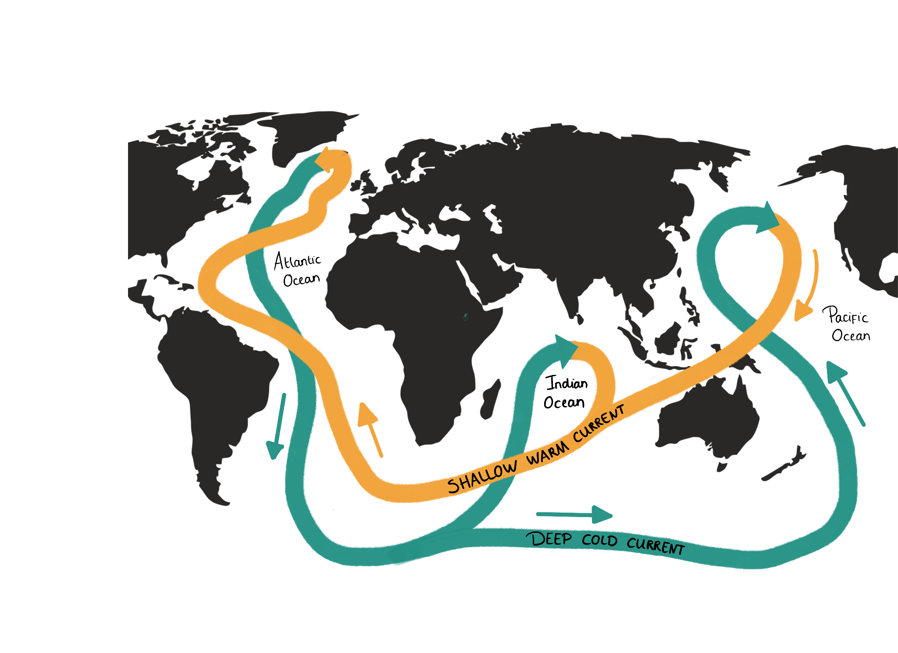
Ocean Conveyor Belt
Currents
Thermohaline circulation:
Thermo = heat
Haline= salt
Circulation: surface and deep ocean water circulate from bottom to top
Ocean conveyor belt: movements caused by thermohaline circulation create one big current around the globe
Image 6
Notes:
Thermohaline = "thermo" (heat) + "haline" (salt); circulation involves the movement of ocean water based on temperature and salinity.
This circulation includes both surface and deep ocean water moving between top and bottom layers.
The resulting global movement is known as the ocean conveyor belt, a massive, continuous current system.
Upwelling within this system brings nutrient-rich water to the surface, supporting marine biodiversity.
A single full loop of the ocean conveyor belt is estimated to take around 1,000 years.

Slide 26
What could be a reason for arctic water to be more salty?
Why are most nutrients found in deep ocean water?
Notes:
Discussion Questions
Q: What could be a reason for arctic water to be more salty?
Answer: Water around the poles freezes but salt is left behind in water - thus concentration/density of salt is higher
Q: Why are most nutrients found in deep ocean water?
Answer: Because it is far from the sun, there is little to no bacterial activity. Due to less photosynthesis of plant plankton, less consumption of nutrients and much organic decomposition, many nutrients can be found in deep ocean water. Luckily, due to upwelling these nutrients can be brought back up to the surface

Slide 27
Plastic Distribution
Currents
Ocean Gyres
Garbage Patches
Conclusion

Slide 28
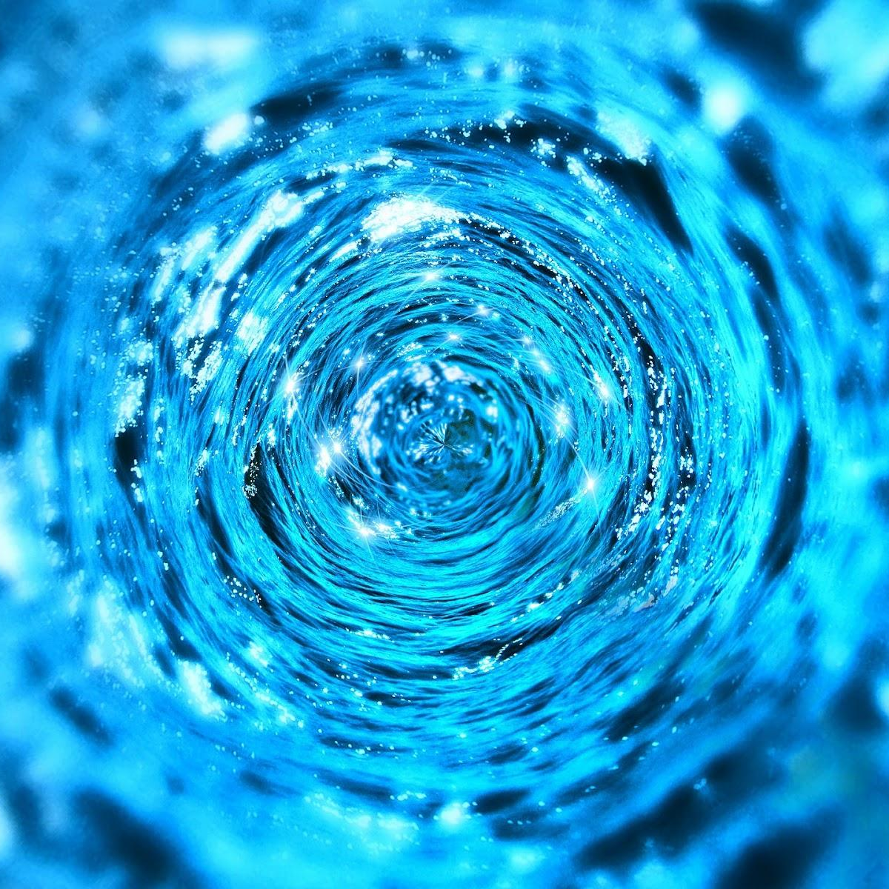
What are ocean gyres?
Ocean Gyres
A system of ocean currents
They transport water from the equator, the poles (either North or South depending on the gyre), back to the equator...
How are they formed?
  The interaction between wind, the coriolis effect, geological features, and gravity
Image 7

Slide 29

Explaining the Coriolis Effect

Slide 30
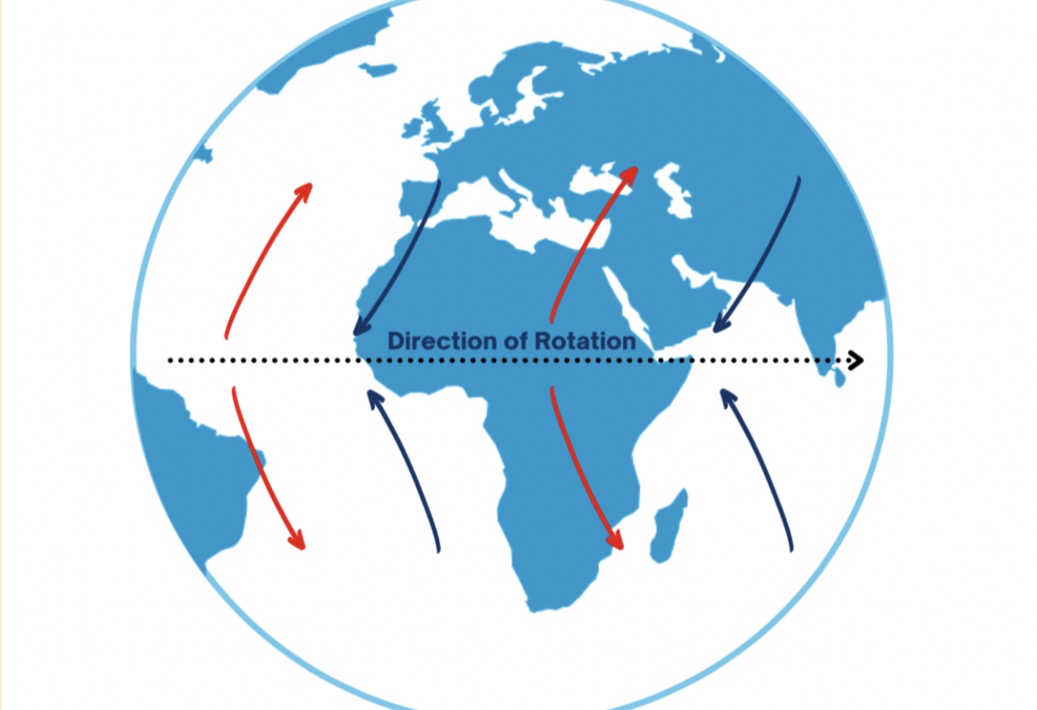
Gravity and Slope
Notes:
Ocean surface currents are mainly driven by wind energy, transferred to water through friction.
The direction of water movement is influenced by the Coriolis effect, other currents, and the shapes of continents and islands.
Gyres are large, circular current systems found in the center of each ocean basin.
These gyres form due to a complex interaction of wind patterns, Earth’s rotation, and gravity—not just direct wind influence.
This movement is known as geostrophic flow, where the Coriolis effect and gravity balance out to create circular current paths.
The Coriolis effect causes currents to curve rather than move in straight lines, especially over large distances like across oceans.

Slide 31
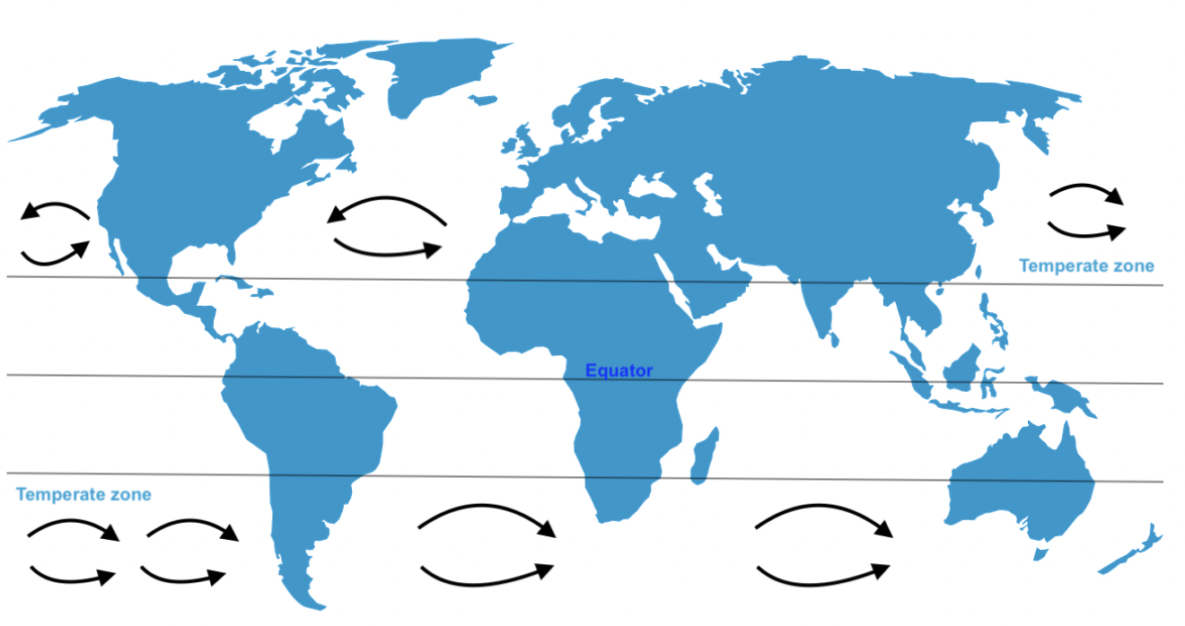
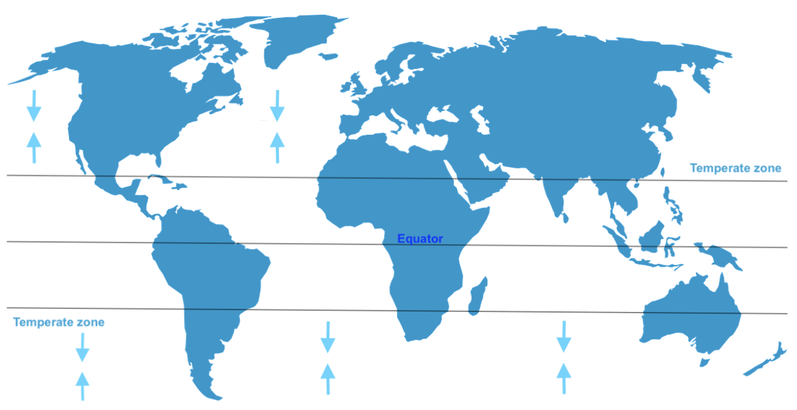
Effect of Coriolis Deflection
Ocean gyres
The surface currents created by these winds are turned 90 degrees by coriolis deflection.
Notes:
Imagine a ball on a slope: gravity would typically pull it straight down.
On a shallow, large-scale slope, the Coriolis effect becomes stronger than gravity, causing the ball (or water) to move sideways instead.
If the slope is circular and shallow, the ball would roll around the hill—similar to how ocean currents flow in gyres.
Ocean flow requires very gentle slopes extended across large areas to function this way.
Though the ocean looks flat, wind pressure creates slight “hills” of water in temperate zones, contributing to circular current flow.
The surface currents drive the formation of regions of convergence where water piles up to form small hills. Although they are only approximately a metre in height, this change in elevation is enough to generate a difference in pressure where the centre of the basin is at slightly higher pressure than surrounding areas.

Slide 32
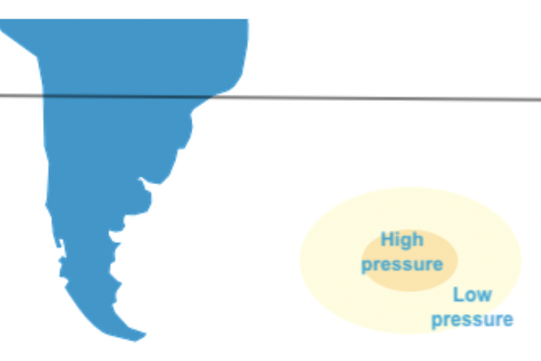
Formation of hills creating a pressure gradient
Notes:
Surface currents cause convergence zones where water piles up to form small "hills" in the ocean, about a meter high.
These hills create a pressure difference, with slightly higher pressure at the center of the basin than at the edges.
This pressure gradient acts like a gentle slope, prompting water to move outward—similar to a ball rolling on an incline.
Because the gradient is weak and spread across a vast area, geostrophic flow occurs: water flows around the hill instead of down it.
This circular motion traps debris and plastic in the center, preventing it from spreading evenly across the ocean.

Slide 33
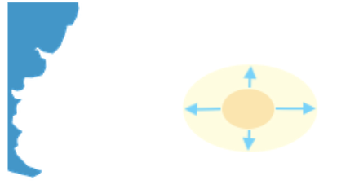
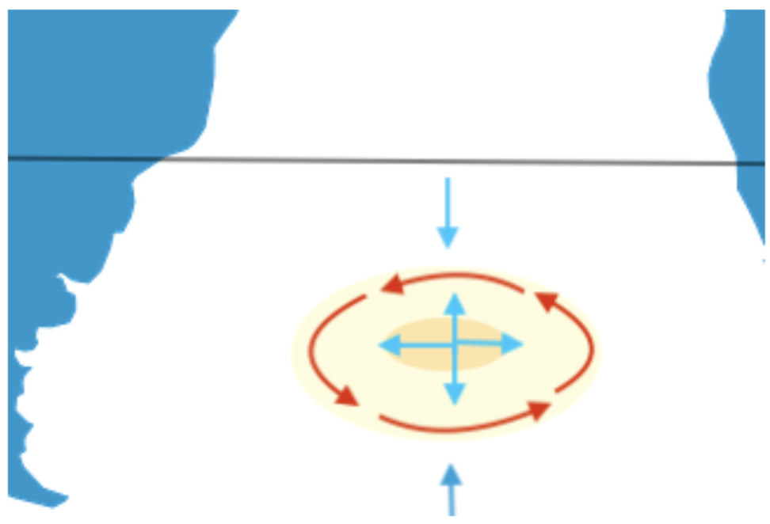
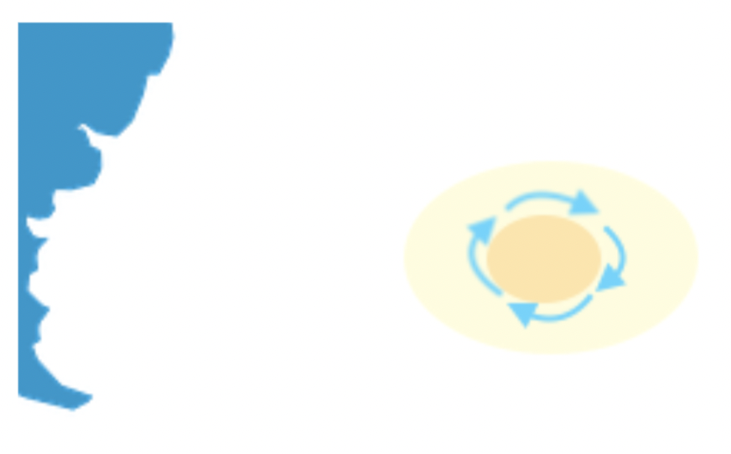
Notes:
To summarize:
Ocean currents pull water toward the center of a basin, forming a small elevated “hill” of water.
This elevation creates a pressure gradient that would typically push water outward, from high to low pressure.
Due to Earth’s rotation (Coriolis effect), the outward flow is deflected, causing the water to circulate around the center.
This circulation forms gyres, large rotating systems of ocean currents.
The balance of internal and external pressure maintains a stable, steady flow around the gyre.

Slide 34
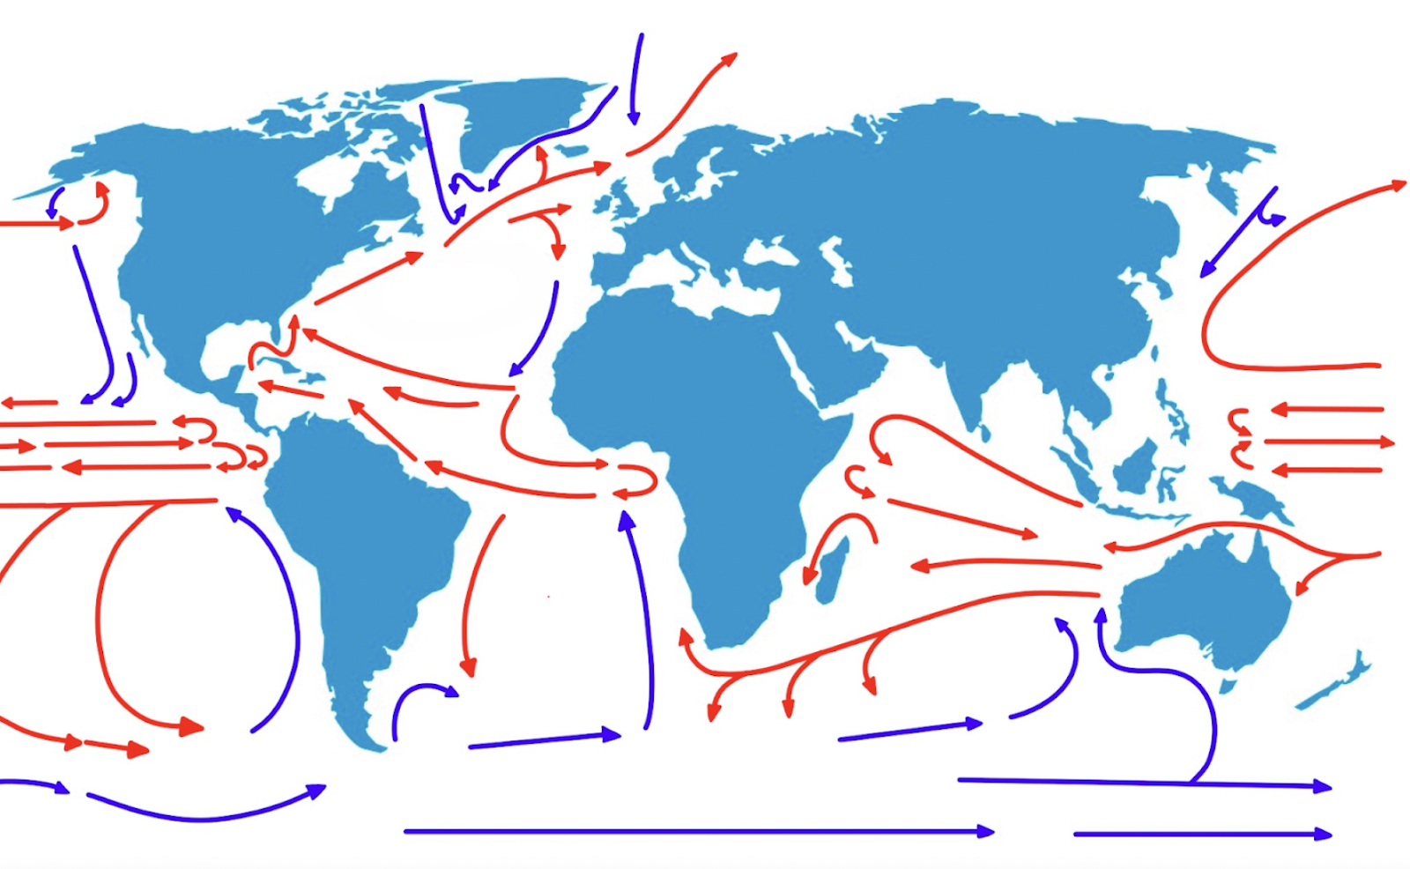
Class activity
Identify where the ocean gyres are located

Slide 35
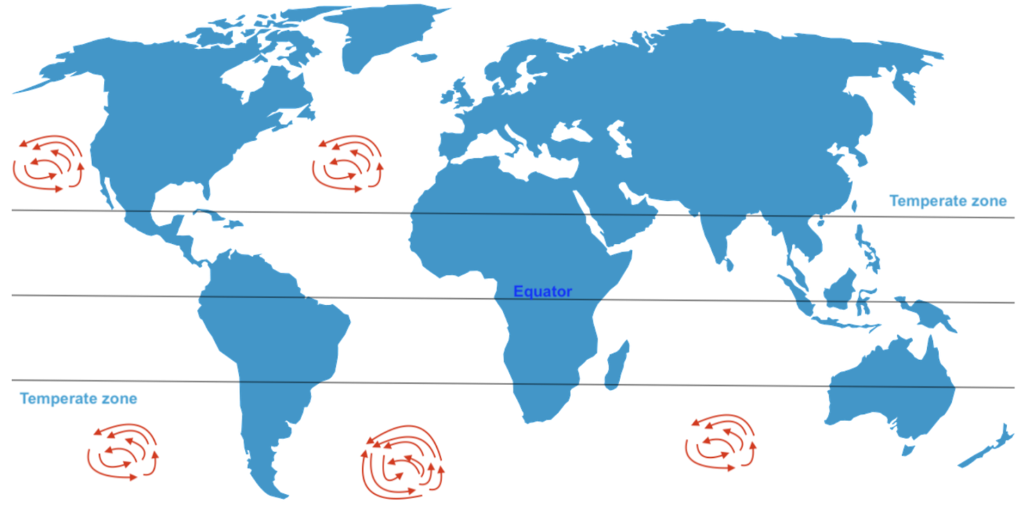
Where there are differences in temperatures and a circular motion

Slide 36
Plastic Distribution
Currents
Ocean Gyres
Garbage Patches
Conclusion

Slide 37
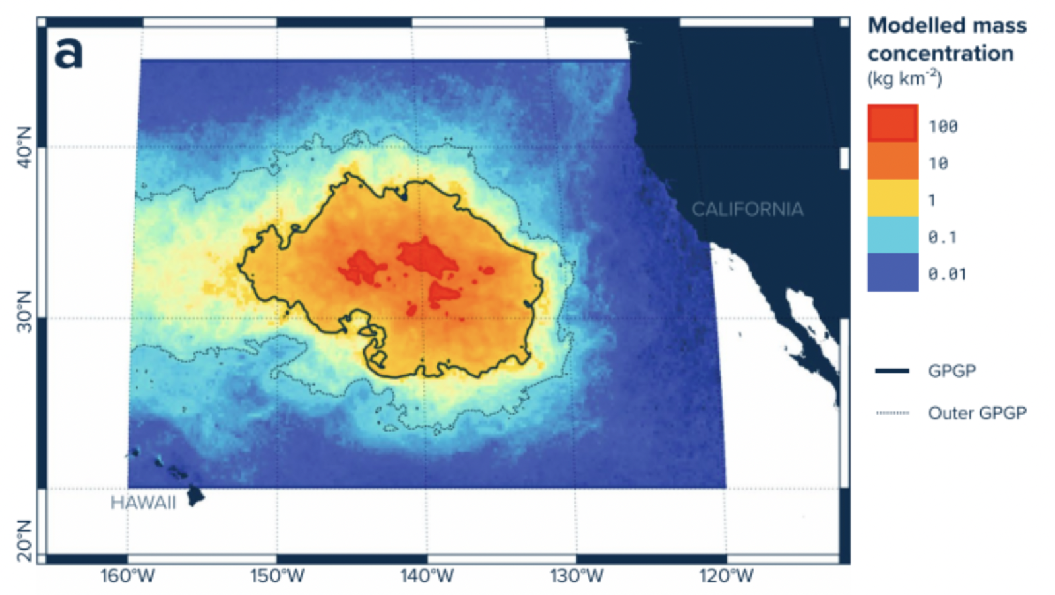
Great Pacific Garbage Patch
Garbage Patches
A massive cluster of floating debris, mostly plastic, accumulated and stirred by gyres
Most of it consists of tiny plastic fragments and chemical sludge
Image 8
Notes:
The North Pacific Gyre contains the Great Pacific Garbage Patch (GPGP)—a vast accumulation of floating plastic debris.
The GPGP is not a solid island, but a diffuse cluster of plastic pieces of various sizes stirred by ocean currents.
While famous examples like rubber ducks raised awareness, most debris consists of tiny plastic fragments and chemical sludge.
Items in the patch range from microplastics to larger floating trash—anything buoyant and discarded can end up there.
The gyre acts like a giant pot, constantly circulating and concentrating this plastic “soup.”

Slide 38
Can anyone recap the entire journey travelled by our plastic bottle?

Slide 39
Can anyone recap the entire journey travelled by our bottle?
It enters the ocean
Surface and deep-ocean currents move the bottle around our oceans
The bottle gets caught in a gyre, undergoes photodegradation, and sinks to the ocean floor

Slide 40
Plastic Distribution
Currents
Ocean Gyres
Garbage Patches
Conclusion

Slide 41
It is clear that the garbage patches are a problem. So why isn’t more being done to clean it up?

Slide 42
It is clear that the garbage patches are a problem. So why isn’t more being done to clean it up?
Too far away
Too expensive
Too complicated

Slide 43
What do you think that you can personally do to address the issue of plastic pollution in the ocean?

Slide 44
Plastic pollution is a worldwide problem, and oceanic geospatial processes aggravate the problem.
However, there are solutions! And these are currently being innovated and implemented.

