Slide 1
Power of political art
UnPlastic Art Package
Art - Module 2

Slide 2
Introduction: what is political art and power?
Propaganda
Protest Art
Conclusion

Slide 3
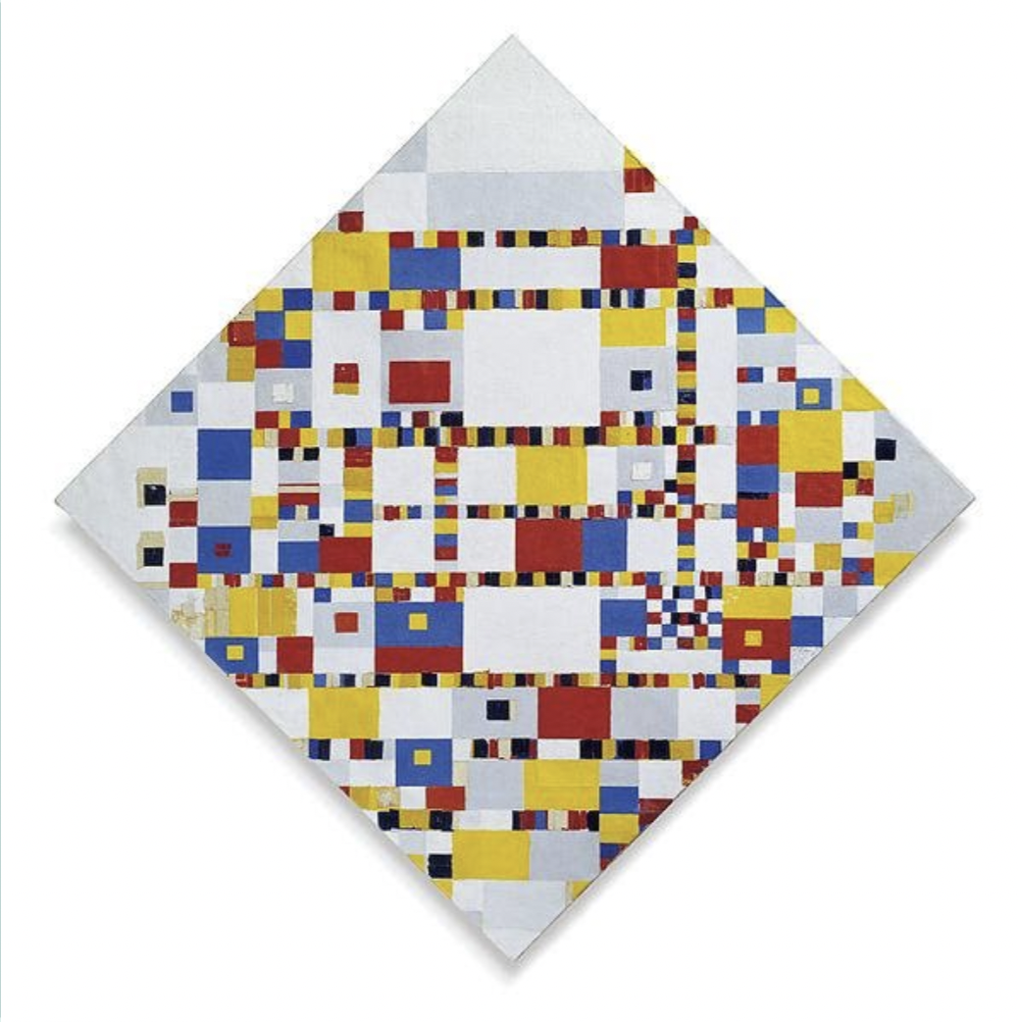
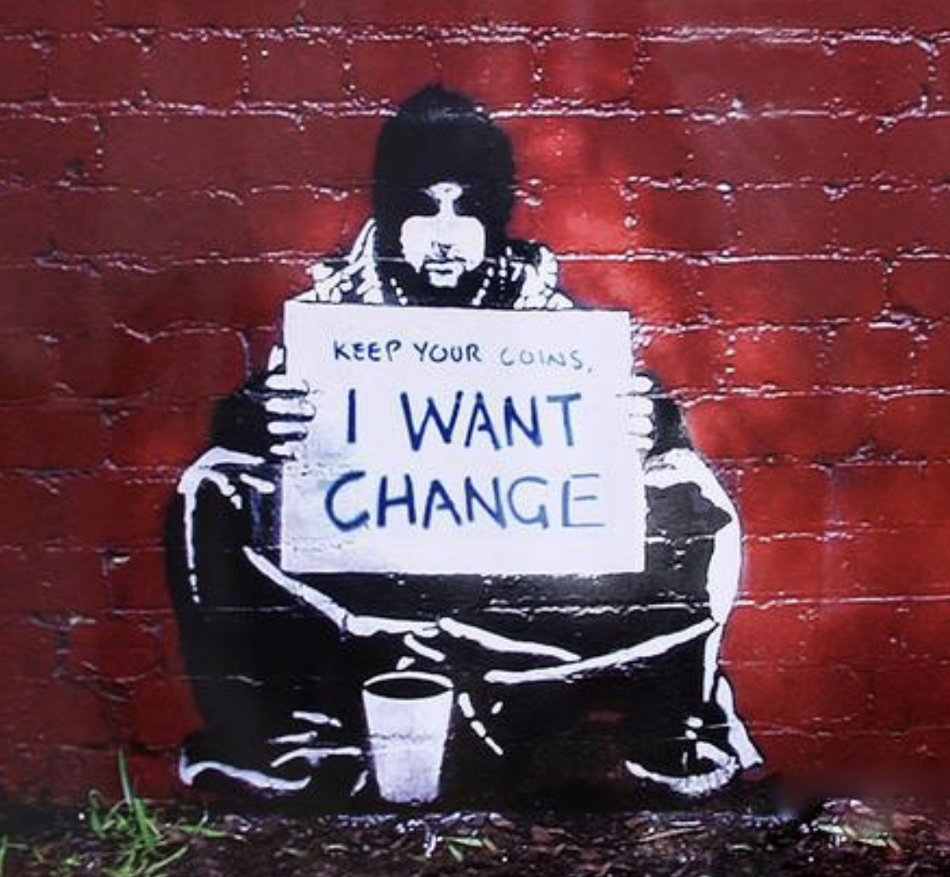
Which of these works is political art? Why? What properties define a political work of art?
Mondrian - 1944
Banksy - 2004

Slide 4
Both are political!
Victory Boogie Woogie, Mondrian - 1944
Keep your coins, I want change, Banksy - 2004
Notes:
Answer: Trick question! They’re both political art.
Right: “Keep your coins, I want change” by Banksy
What: an apparent homeless person who does not want coins, but would prefer seeing change in the world.
Left: “Victory Boogie Woogie” by Mondriaan
Context: 1941, War US-Japan, Mondriaan believes in a good ending
What: A painting that attempts to capture the rhythm of America and illustrate the contradictions contained within NYC:
Light/dark
Chaos/disorder
Static/dynamic.

Slide 5

Defining Political Art
Expresses political opinions
Addresses social issues
Purpose: convince others of your standpoint and/or create awareness
Notes:
Political art is created to express opinions on societal or political issues.
Its goals are often to raise awareness or persuade audiences about a certain viewpoint.
Political art appears in many forms, including posters, theatre, comedy, music, and poetry.
This module focuses on visual art influenced by or targeting governments and multinational corporations.
Propaganda and protest art are key examples, showing how art interacts with powerful actors.
Image source: <a href="https://www.vecteezy.com/vector-art/3337485-political-leader-with-his-supporter-illustration-concept-vector">Political leader with his supporter illustration concept vector Vectors by Vecteezy</a>

Slide 6
Can you think of other examples of political art?
Notes:
Political art does not have to be visual. Artists can express their political opinions in different ways. One example of another art form is music. Let’s watch an example.

Slide 7
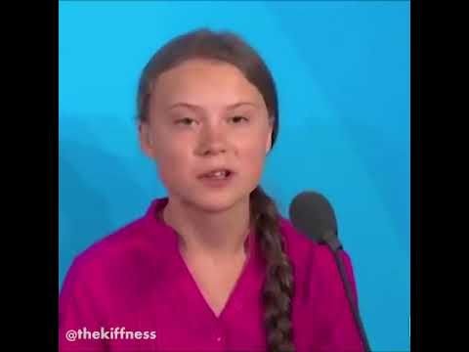
Right Here,
Right Now
Greta Thunberg X Fatboy Slim

Slide 8
What does this video show?
Is this an example of political art? Why/why not?
If yes, is it effective?

Slide 9
Possible answers:
Effective: The song reaches a different type of audience than Greta’s speech at the UN potentially would.
→ After Fat Boy Slim played the track at his concert, it went viral on the Internet, reaching an even wider audience.
Not effective: Not everyone will relate to the hype around the track, which means that the message may be lost.

Slide 10
What is power?

Slide 11
What is power?
Power refers to the ability of an actor (an individual, a group of people, an institution) to either act or to produce an effect by being in possession of control, authority and influence over others.
This can be achieved through hard and/or soft power.

Slide 12
Hard power
Soft power
Holly-wood
political values
Culture
Military
Economic power
History
Foreign policy
Notes:
In politics, power can be separated into soft and hard power.
Hard power: a coercive approach, where military and economic power are used to influence another party
Soft power: less visible, refers to the use of more abstract/subtle measures to ‘co-opt’ the other party to act in the way that you want.
e.g. culture, political values, foreign policy
Power refers to the ability of an actor (an individual, a group of people, an institution) to either act or to produce an effect by being in possession of control, authority and influence over others. This can be achieved through hard and/or soft power.

Slide 13
Introduction
Propaganda
Protest art
Conclusion

Slide 14
What is propaganda?

Slide 15
Propaganda =
“The spreading of ideas, information, or rumor for the purpose of helping or injuring an institution, a cause, or a person. Ideas, facts, or allegations spread deliberately to further one's cause or to damage an opposing cause.”

Slide 16
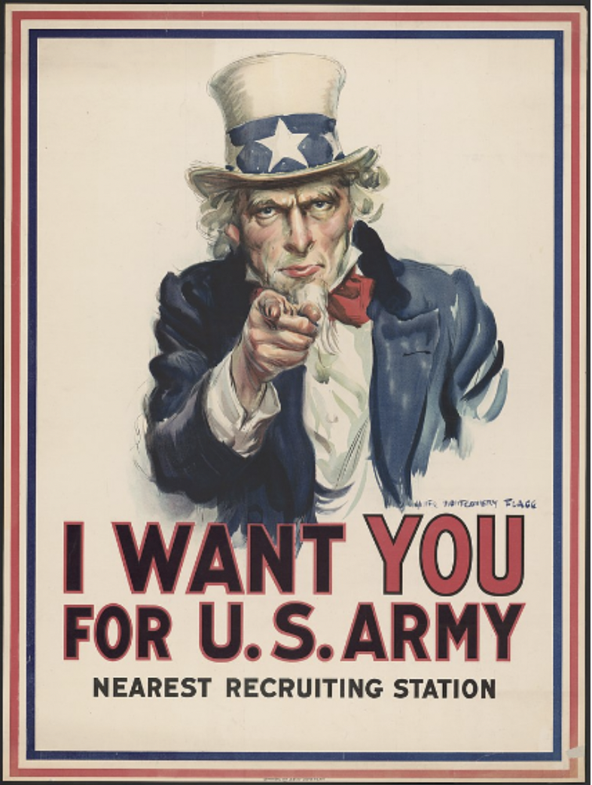
WWII Propaganda Posters - USA
CASE STUDY
Questions:
Can you describe what you see?
Why is this propaganda?
Does anyone know who uncle Sam portrays?
Notes:
Answer:
Uncle Sam poster:
Calls out US citizens to enlist for the US army
Used during WWII
Speaks to the person looking at the poster; he looks at you, points at you, and states that he wants you for the US army, not just any person.
Uncle Sam:
Personification of the US government
Has been used for over 200 years
Often used to invoke patriotism
Purpose: getting US citizens to enlist into the army

Slide 17
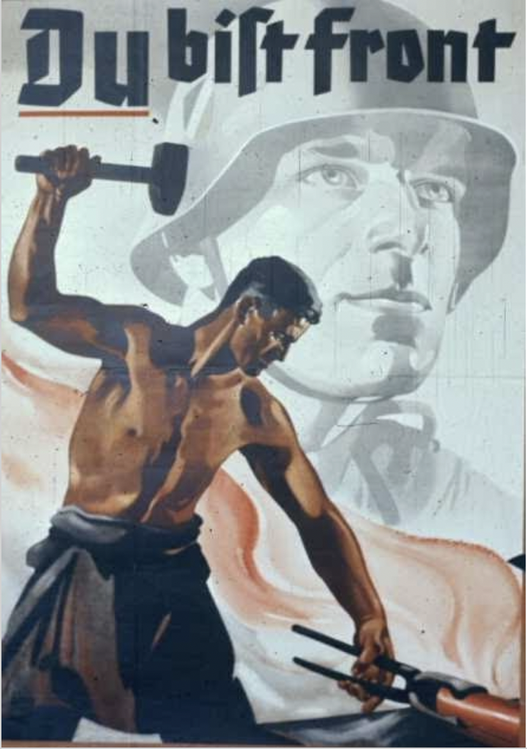
WWII Propaganda Posters - Germany
CASE STUDY
“You are the front!”
Notes:
Most of this message is conveyed by the text, which makes clear that German citizens should see themselves as part of the war and get involved. The use of art provides a powerful image to sway German citizens, as the man in the poster is strong and powerful, creating an impactful image of the front and the men involved. The soldier we can see in the background creates a sense that joining the front is an honorable action and respected.
Propaganda posters were a widespread phenomenon during WWII. The two earlier posters have the aim of enlisting men to join the front and war effort. However, propaganda posters also have the pow

Slide 18
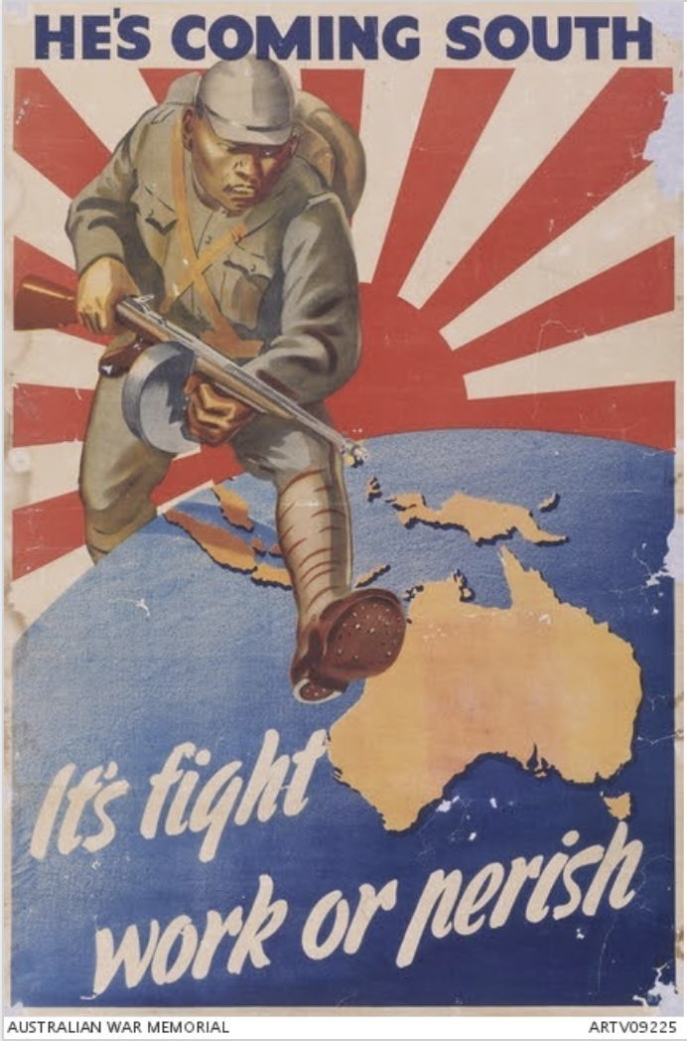
WWII Propaganda Posters - Australia
CASE STUDY
Questions:
What did all these propaganda posters have in common?
Notes:
Message: Japan is a threat
Portrayed: Japanese soldier advancing on Australia, and a strong image combined with the text “It’s fight work or perish.”
The Australian government wants to warn its citizens of the potential threat that Japan poses, and that the way forward is to prepare for any attack by fighting for the military or working in another way for the war front.
This poster, however, differs from the previous two examples in the sense that the nation is to unite against an external enemy, whereas the two earlier posters want their citizens to act, enlist, and contribute in war times.

Slide 19
Do you think propaganda is still used today?
If yes, how? Where?

Slide 20
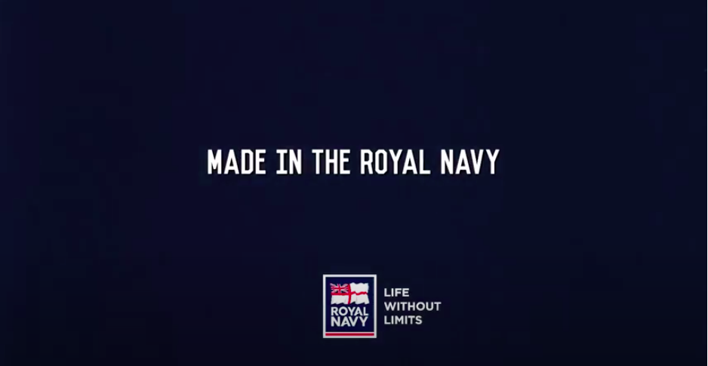
Royal Navy recruitment
Example:
Notes:
This is a modern day example of propaganda, as the Royal Navy uses these short videos to recruit young people in the UK. It shares similarities with some of the war propaganda posters that urge people to enlist in the war effort. However, the format is different.
It could be argued that advertising is a form of propaganda, as adverts have an aim of getting their audience to do something (buy the product). However, the political motivation may be lacking.

Slide 21
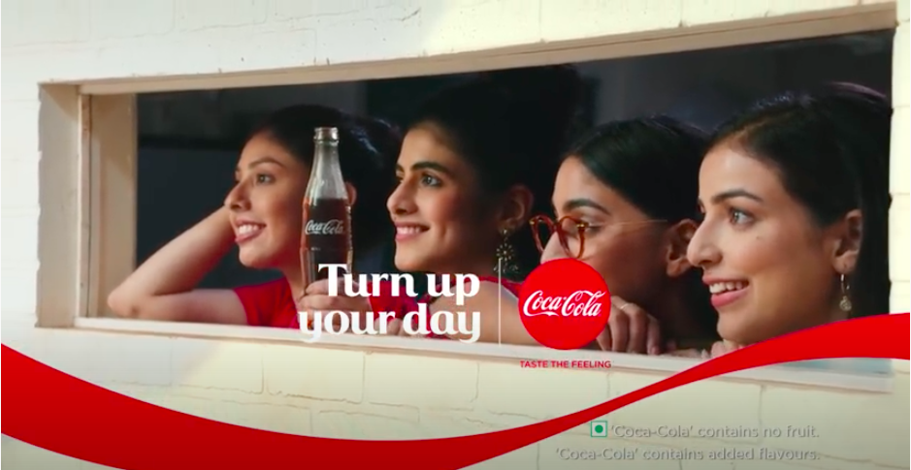
Coca-Cola
Example:
Notes:
This advert could be seen as propaganda. This advert is making Coca-Cola desirable and enticing for consumers to buy. Therefore, the advert is trying to convince their audience of something. However, it does not have an explicit political angle, and thus it could also be argued that the advert is not propaganda.

Slide 22
Who or what has power in expressing through this medium?
Notes:
These examples of propaganda show that within the expression of political ideas through propaganda, power lies in the hands of the government or political party.

Slide 23
Introduction
Propaganda
Protest art
Conclusion

Slide 24
Protest art:
Citizens criticize government
Symbols
Gives citizens agency and power
Notes:
Art is not only used by the government to sway its citizens, but is also used by citizens to criticize the government. For example, protest movements often use symbols in order to stick to people’s memory. Power can yet again be seen, as protest art gives citizens agency and power to express their opinion in the hope of actually changing government action.

Slide 25

Peace Symbol
Questions:
What does this symbol mean?
Does anyone know anything about the origins of this symbol?

Slide 26
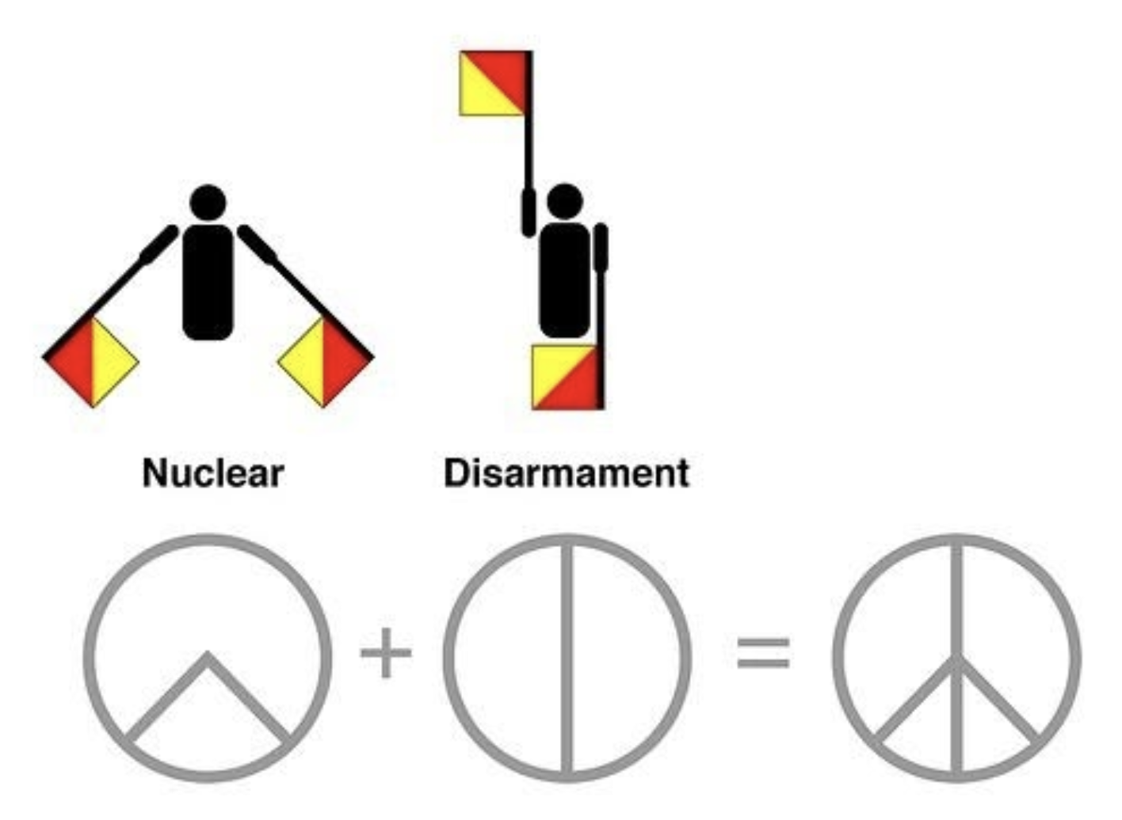
Peace Symbol
Semaphore alphabet
Despair
Notes:
Answer:
This is the peace symbol. It has been around since 1958. You may not think of it as art, but this symbol is designed with much purpose, for the British campaign promoting nuclear disarmament.
The sign was created using the letters “N” and “D” of the semaphore alphabet, referring to Nuclear Disarmament. Gerald Holtom, the designer of the symbol, not only meant to portray letters with this symbol; he also wanted to show an individual – himself – in despair with hands palm outstretched outwards and downwards.

Slide 27
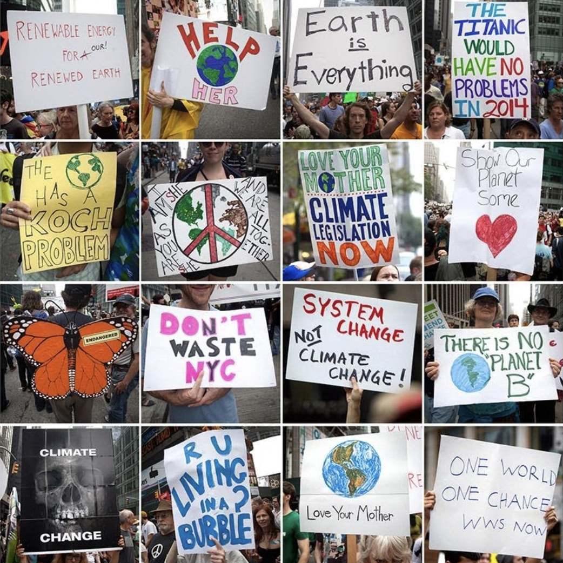
Climate Change March Protest Art
Overlap propaganda:
Powerful imagery
Convince powerful party
Clear message
Text accompanying imagery
Notes:
These examples of protest art have many of the same elements as propaganda have:
Powerful imagery
Issued by the people in order to convince a powerful party to do something
Clear message: unlike some other types of art you do not have to think deeply in order to understand the message
Combination of imagery and text: imagery is used to support a written message
Impact of climate marches:
Research shows that protest has the ability to sway the public and policy makers and that these effects are critical for movements to achieve their goals
Can shift public opinion, alienate bystanders (to encourage action) and motivate policy makers

Slide 28
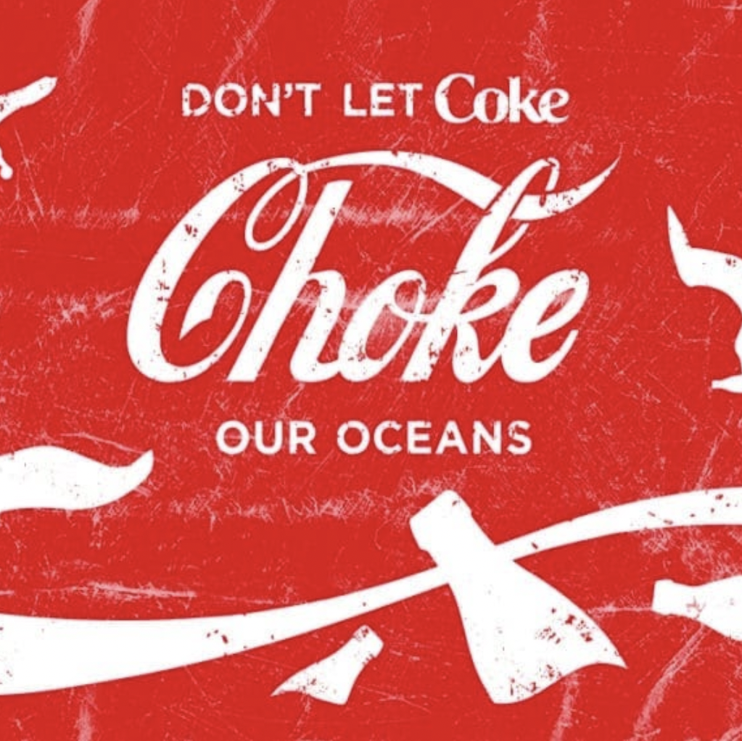
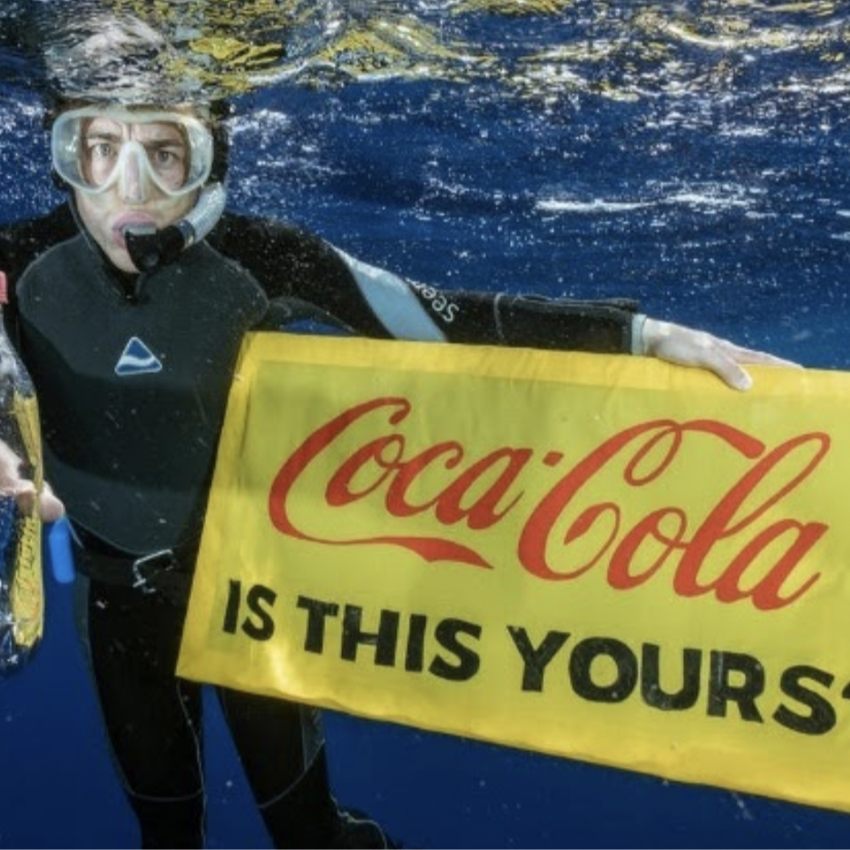
Case Study:
Coca Cola
Notes:
In what way is plastic pollution reflected in political art nowadays? Plastic pollution can mainly be found in protest art.
Coca Cola is a large multinational which sells most products in single-use plastic bottles. They therefore massively contribute to plastic pollution, being the largest polluter on British beaches. Such a visible polluter calls for protest art.
Picture left:
This is a poster by Greenpeace, which illustrates a parody of Coca Cola’s logo. Hereby it calls out against the plastic pollution caused by single use coke bottles.
Imagery:
plastic bottles floating around in the ocean
seagulls picking up the plastic
Messages:
calls out both the company coca cola as consumers
buy less single-use plastics
specifically calls out Coca Cola (directs blame)
Picture right:
This protest art pictures an angry looking man in snorkeling gear, holding up a coke bottle and a sign with the question “Coca Cola, is this yours?” referring to the plastic pollution of the ocean caused by single use plastics. → very straightforward message
Even though these images are examples of protest art, they have many of the same characteristics we saw in propaganda:
Powerful imagery
Issued by the people in order to convince a powerful party to do something
Clear message: unlike some other types of art you do not have to think deeply in order to understand the message
Combination of imagery and text: imagery is used to support a written message
Impact of protest art on Coca Cola:
Increased societal attention on recycling. Coca Cola is playing into this public movement:
Claim that all their packaging is 100% recyclable and are researching more sustainable resources to develop their packaging.
On their American website, a large section is devoted to sustainability, among which recycling and plastic pollution are key themes. https://www.coca-colacompany.com/learn-more-about-sustainable-packaging

Slide 29
With reference to the protest art at climate churches and the protest art against Coca Cola, who is expressing power?

Slide 30
What are the advantages and disadvantages of this medium?
Notes:
Answer:
These examples of protest art show that within the expression of political ideas through protest art, power lies in the hands of citizens, both individuals and groups of people.
Advantages:
Highly accessible
Citizens can get their voices heard
Allows for expression of individual or group politics
Can have an effect on governments or multinationals
Disadvantages:
Can be dismissed
May not be responded to appropriately

Slide 31
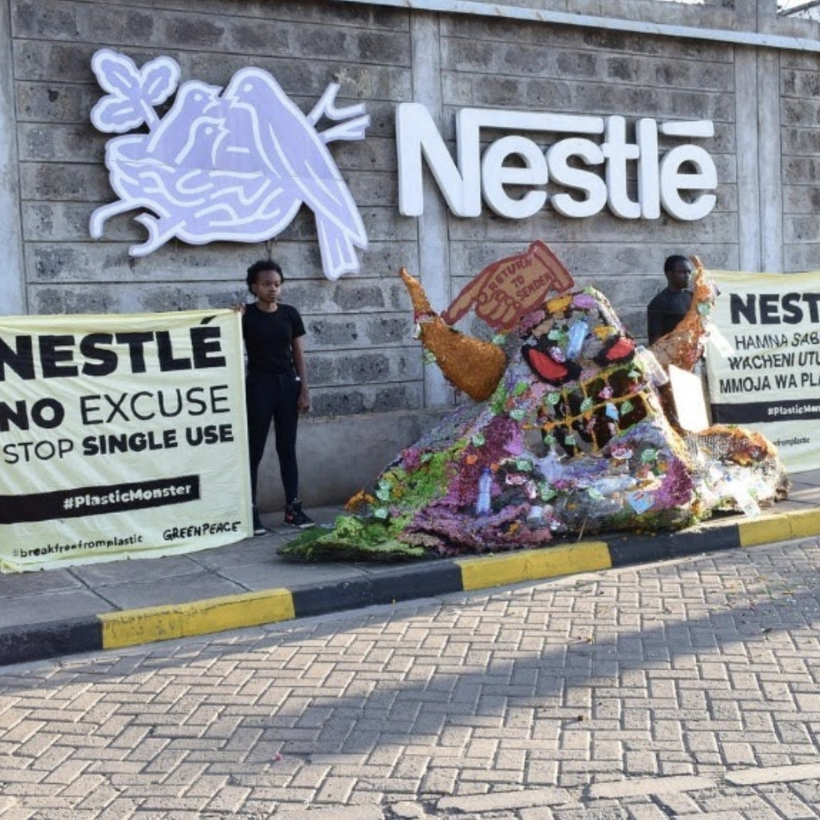
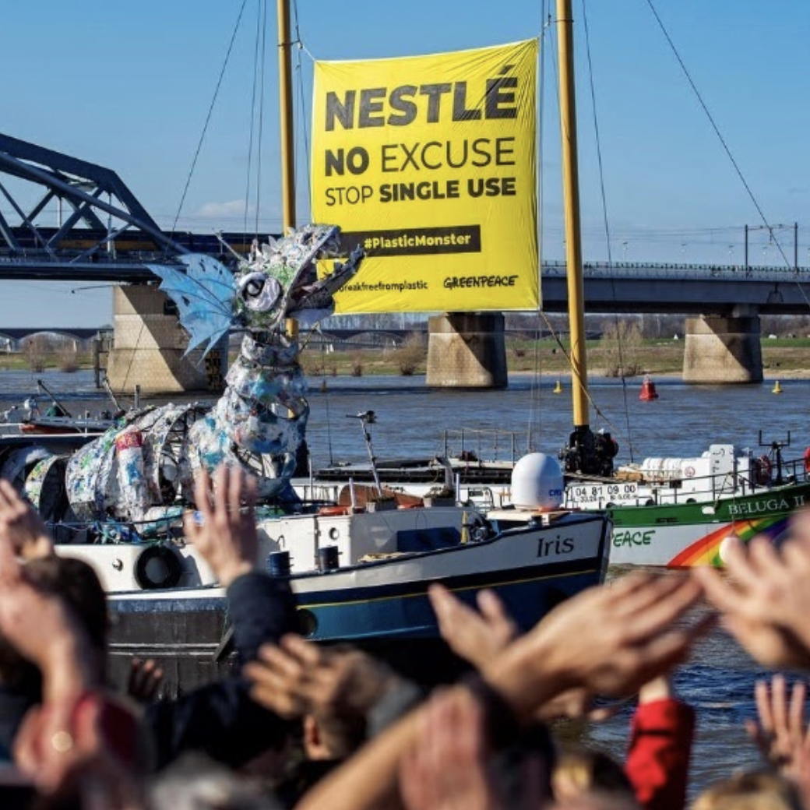
Plastic Monsters
Headquarters
Travelling on boat
Notes:
These are “Plastic Monsters” about Nestlé. They are made by greenpeace protestors with the aim for Nestlé to stop using single use plastics. This is because Nestlé is one of the largest polluters and is still increasing its use of single-use plastics (according to Greenpeace). A powerful, visible polluter seems like the right target for protest art. Over the entire world, Greenpeace members created these plastic monsters, who “woke up and decided to return home to Nestlé”.
Left: activists in front of Nestlé’s headquarter in Nairobi, Kenya.
Right: plastic monster on a boat which was traveling all throughout Europe, its final destination being Nestlé’s global headquarters in Switzerland.
Nestlé’s response: “We are determined to reduce our use of single-use plastics. We are introducing reusable packaging, new delivery systems and innovative business models.”
Impact on nestle:
Demands Nestlé to show true leadership and confront the throwaway culture that underpins its current business model
Nestlé has vowed to make 100 percent of its packaging recyclable or reusable by 2025 and push the use of compostable and biodegradable materials polymers.

Slide 32
Propaganda or protest art: Is what Greenpeace is doing propaganda? Why/why not?
Notes:
Answer:
Recall propaganda:
The spreading of ideas, information, or rumor for the purpose of helping or injuring an institution, a cause, or a person.
Ideas, facts, or allegations spread deliberately to further one's cause or to damage an opposing cause.
Thus, this could be interpreted as propaganda. On the other hand, it could be argued that this is NOT propaganda because Greenpeace is protesting against a powerful multinational, Nestle.

Slide 33
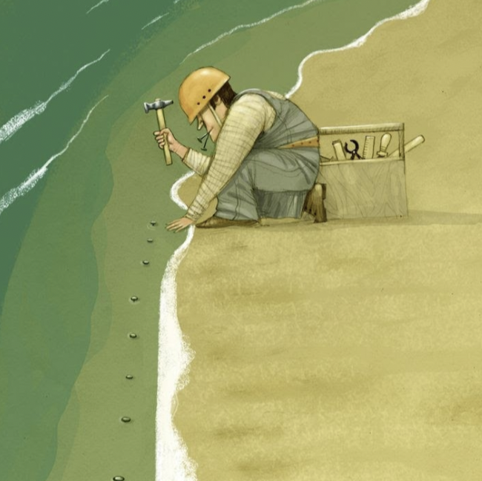
Cartoons and Satire
Andrei Popow
Questions:
What is meant by this image?
Notes:
Protest art often requires active participation by those involved. Furthermore, protests are confined to space in which they happen. and is confined to a space. In however, in order to reach a wider audience, other mediums are adopted. Another way of addressing climate change through art is through cartoon illustrations. These illustrations are often published in both digital and analogue media, meaning that they have the ability to reach a larger number of people. These are often stand alone illustrations that do not include text, or are drawn like cartoon strips with text and speech. We will go through a couple of different cartoons, through which the cartoonist exerts power by expressing their opinion. First, let’s look at an example relating to climate change, and then hone in on plastic pollution.
This is a cartoon about climate change, with which Andrei Popow won the 2014 Niels Brugge Cartoon Award. It had a theme of the climate, and a focus on oceans was encouraged, with the idea “we need to save oceans in order to save ourselves.”
Cartoon: light, humorous, visual manner of addressing serious issues
Interpretation: mankind trying to fix sea level rising
Man nailing nails in the ocean as if that were to be helpful
Mankind thinking they can quick-fix everything

Slide 34
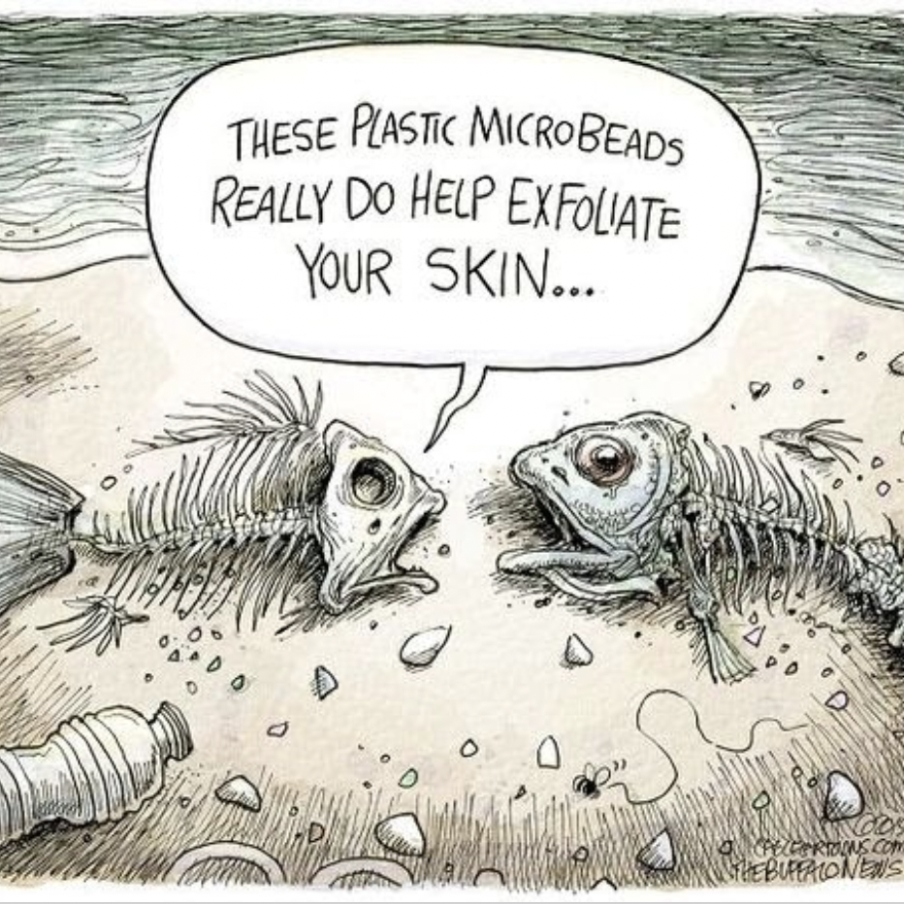
Cartoons and Satire
Adam Syglis
Questions:
What is meant by this image?
Notes:
This is a cartoon about plastic pollution:
Theme: the impact of plastic pollution, specifically plastic micro-beads, which are present in many cosmetic products, on marine life.
Focus: plastic micro-beads in products used to exfoliate skin are deadly to marine life
The use of satire in the text makes reference to how plastic micro-beads are so efficient; they exfoliate (kill) marine life.
Interpretation: The products that humans use pollute the earth. Specifically, plastic debris and plastic micro-beads are deadly to fish and other marine organisms.
Cartoon: Visual representation on the impact of plastic pollution on fish.

Slide 35
Introduction
Propaganda
Protest art
Conclusion

Slide 36
Propaganda
The government aiming to influence their citizens to take certain actions.
Here the government and/or political party exerts power through art.

Slide 37
Protest Art
Citizens express their dissatisfaction and with the government exert their power via art
This can also be done in a light, humorous manner via cartoons, in which power is exerted by citizens

Slide 38
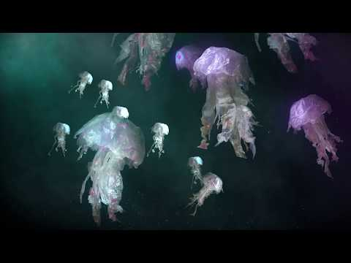
Political Art for Plastic Pollution

