Slide 1
Activity
Physical Geography
Geography - Module UnPlastic Geography Package
Geography - Module 1

Slide 2
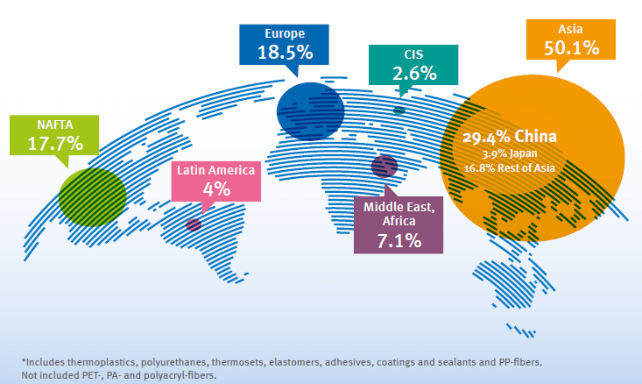
Recap
Global distribution of plastic pollution
Notes:
Image source: https://www.researchgate.net/publication/338150269_PLASTIC_FLOW_IN_WORLDWIDE_CONTEXT_MHSE11_-CIRCULAR_ECONOMY

Slide 3
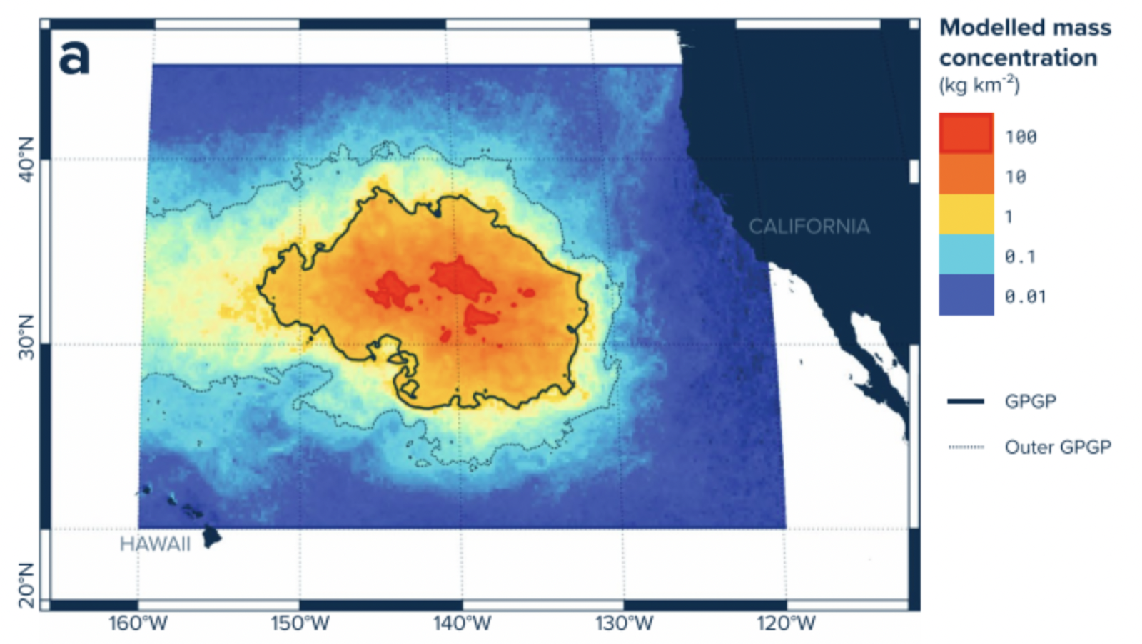
Great Pacific Garbage Patch
Recap
A massive cluster of floating debris, mostly plastic, accumulated and stirred by gyres
Most of it consists of tiny plastic fragments and chemical sludge

Slide 4
It is clear that the garbage patches are a problem. So why isn’t more being done to clean it up?

Slide 5
It is clear that the garbage patches are a problem. So why isn’t more being done to clean it up?
Too far away
Too expensive
Too complicated

Slide 6
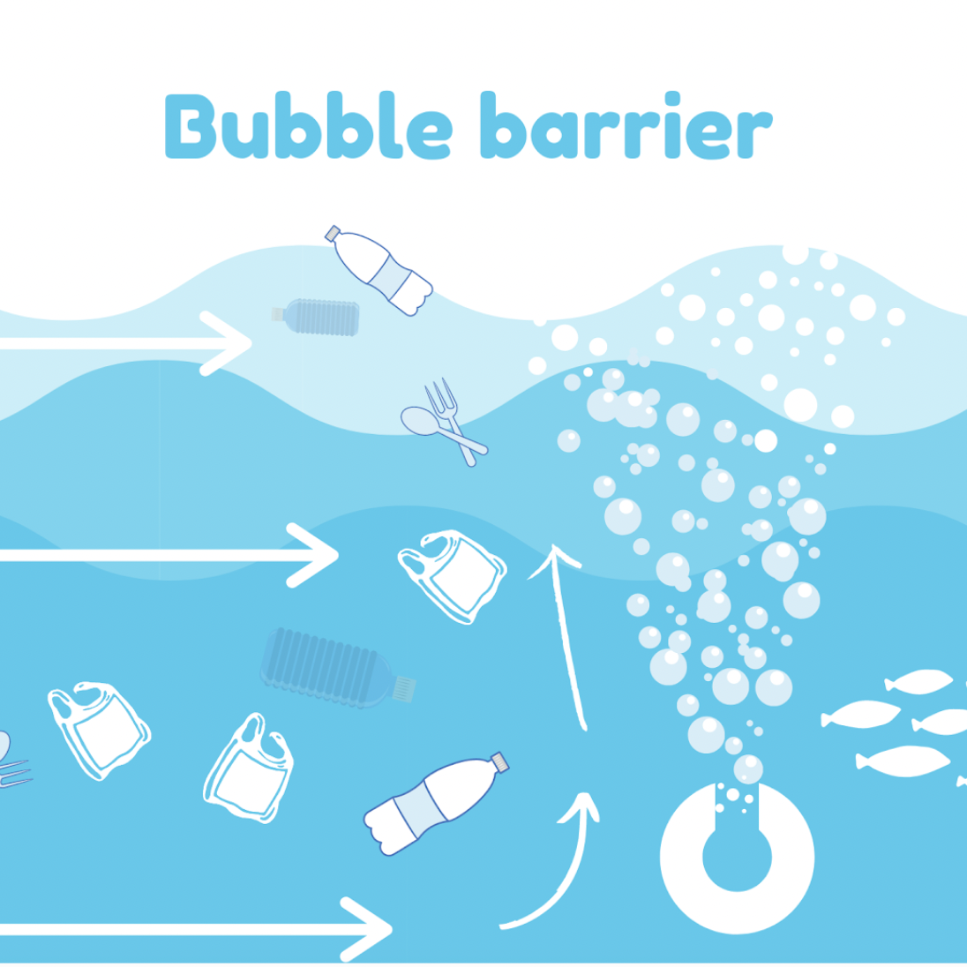
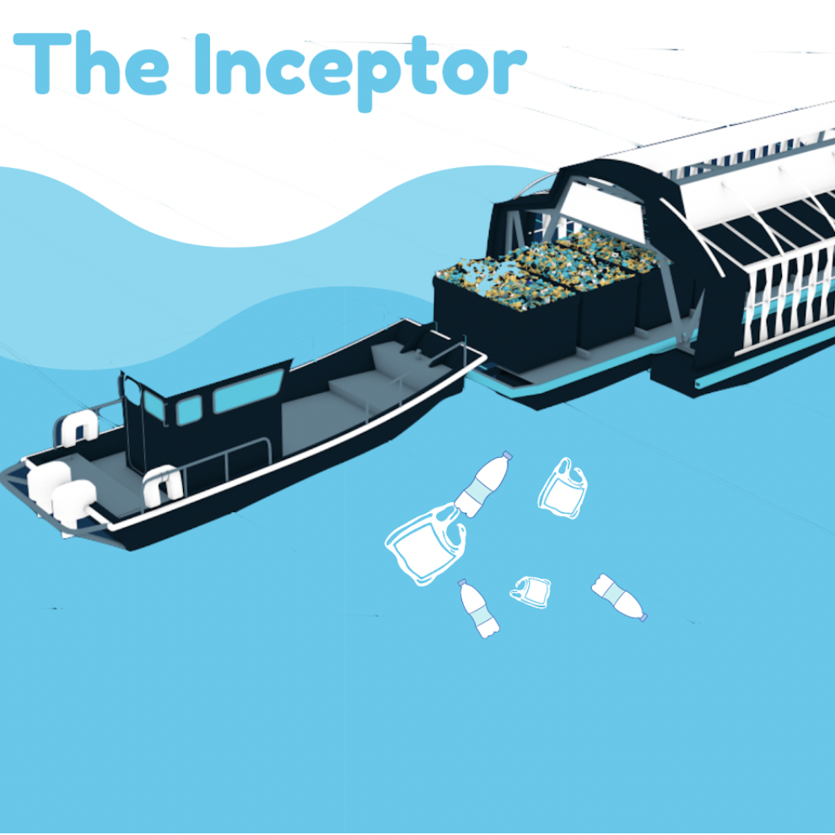
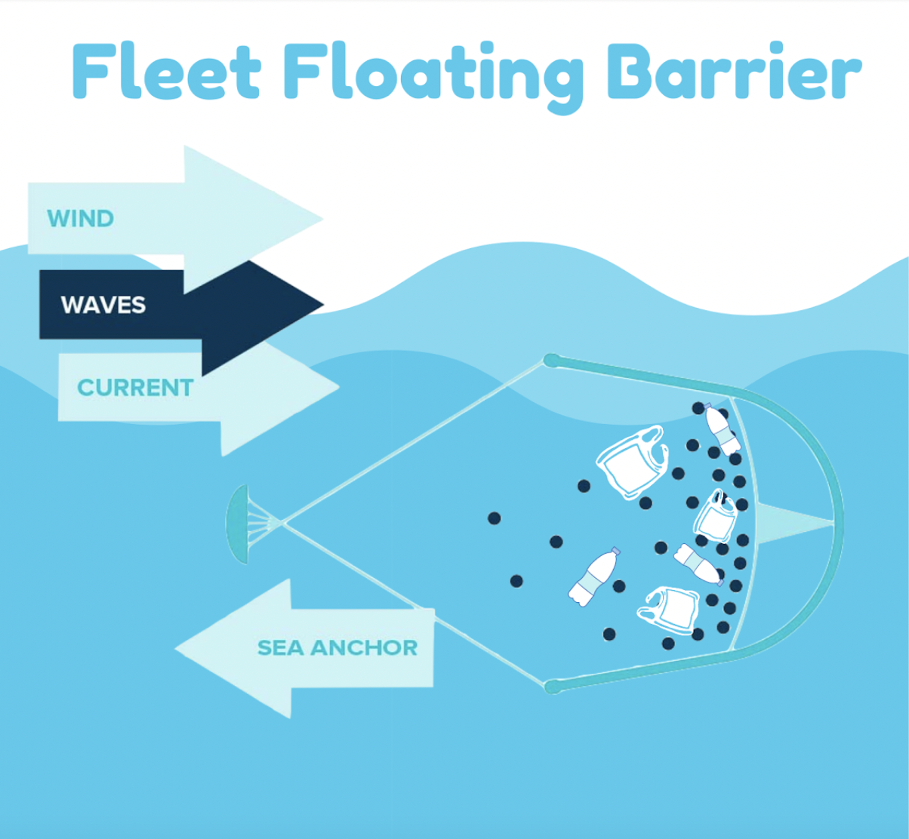

Slide 7

Judges Panel
Will vote for a solution to give a grant to
Image 9

Slide 9
Stance
Creative introduction
How does it work with water dynamics (wind, waves, currents)
What are positive and negative aspects about your solution?

Slide 10
Concluding the activity
What do YOU as a class feel was the best solution?
What were some negative impacts you noticed of your own solution?

Slide 11
What do you think that you can personally do to address the issue of plastic pollution in the ocean?

Slide 12
Plastic pollution is a worldwide problem, and oceanic geospatial processes aggravate the problem.
However, there are solutions! And these are currently being innovated and implemented.

