Slide 1
Activity
Power of political art
UnPlastic Art Package
Art - Module 2

Slide 2
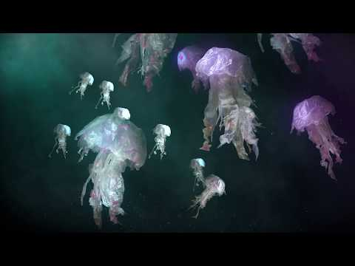
Political Art for Plastic Pollution

