Slide 1
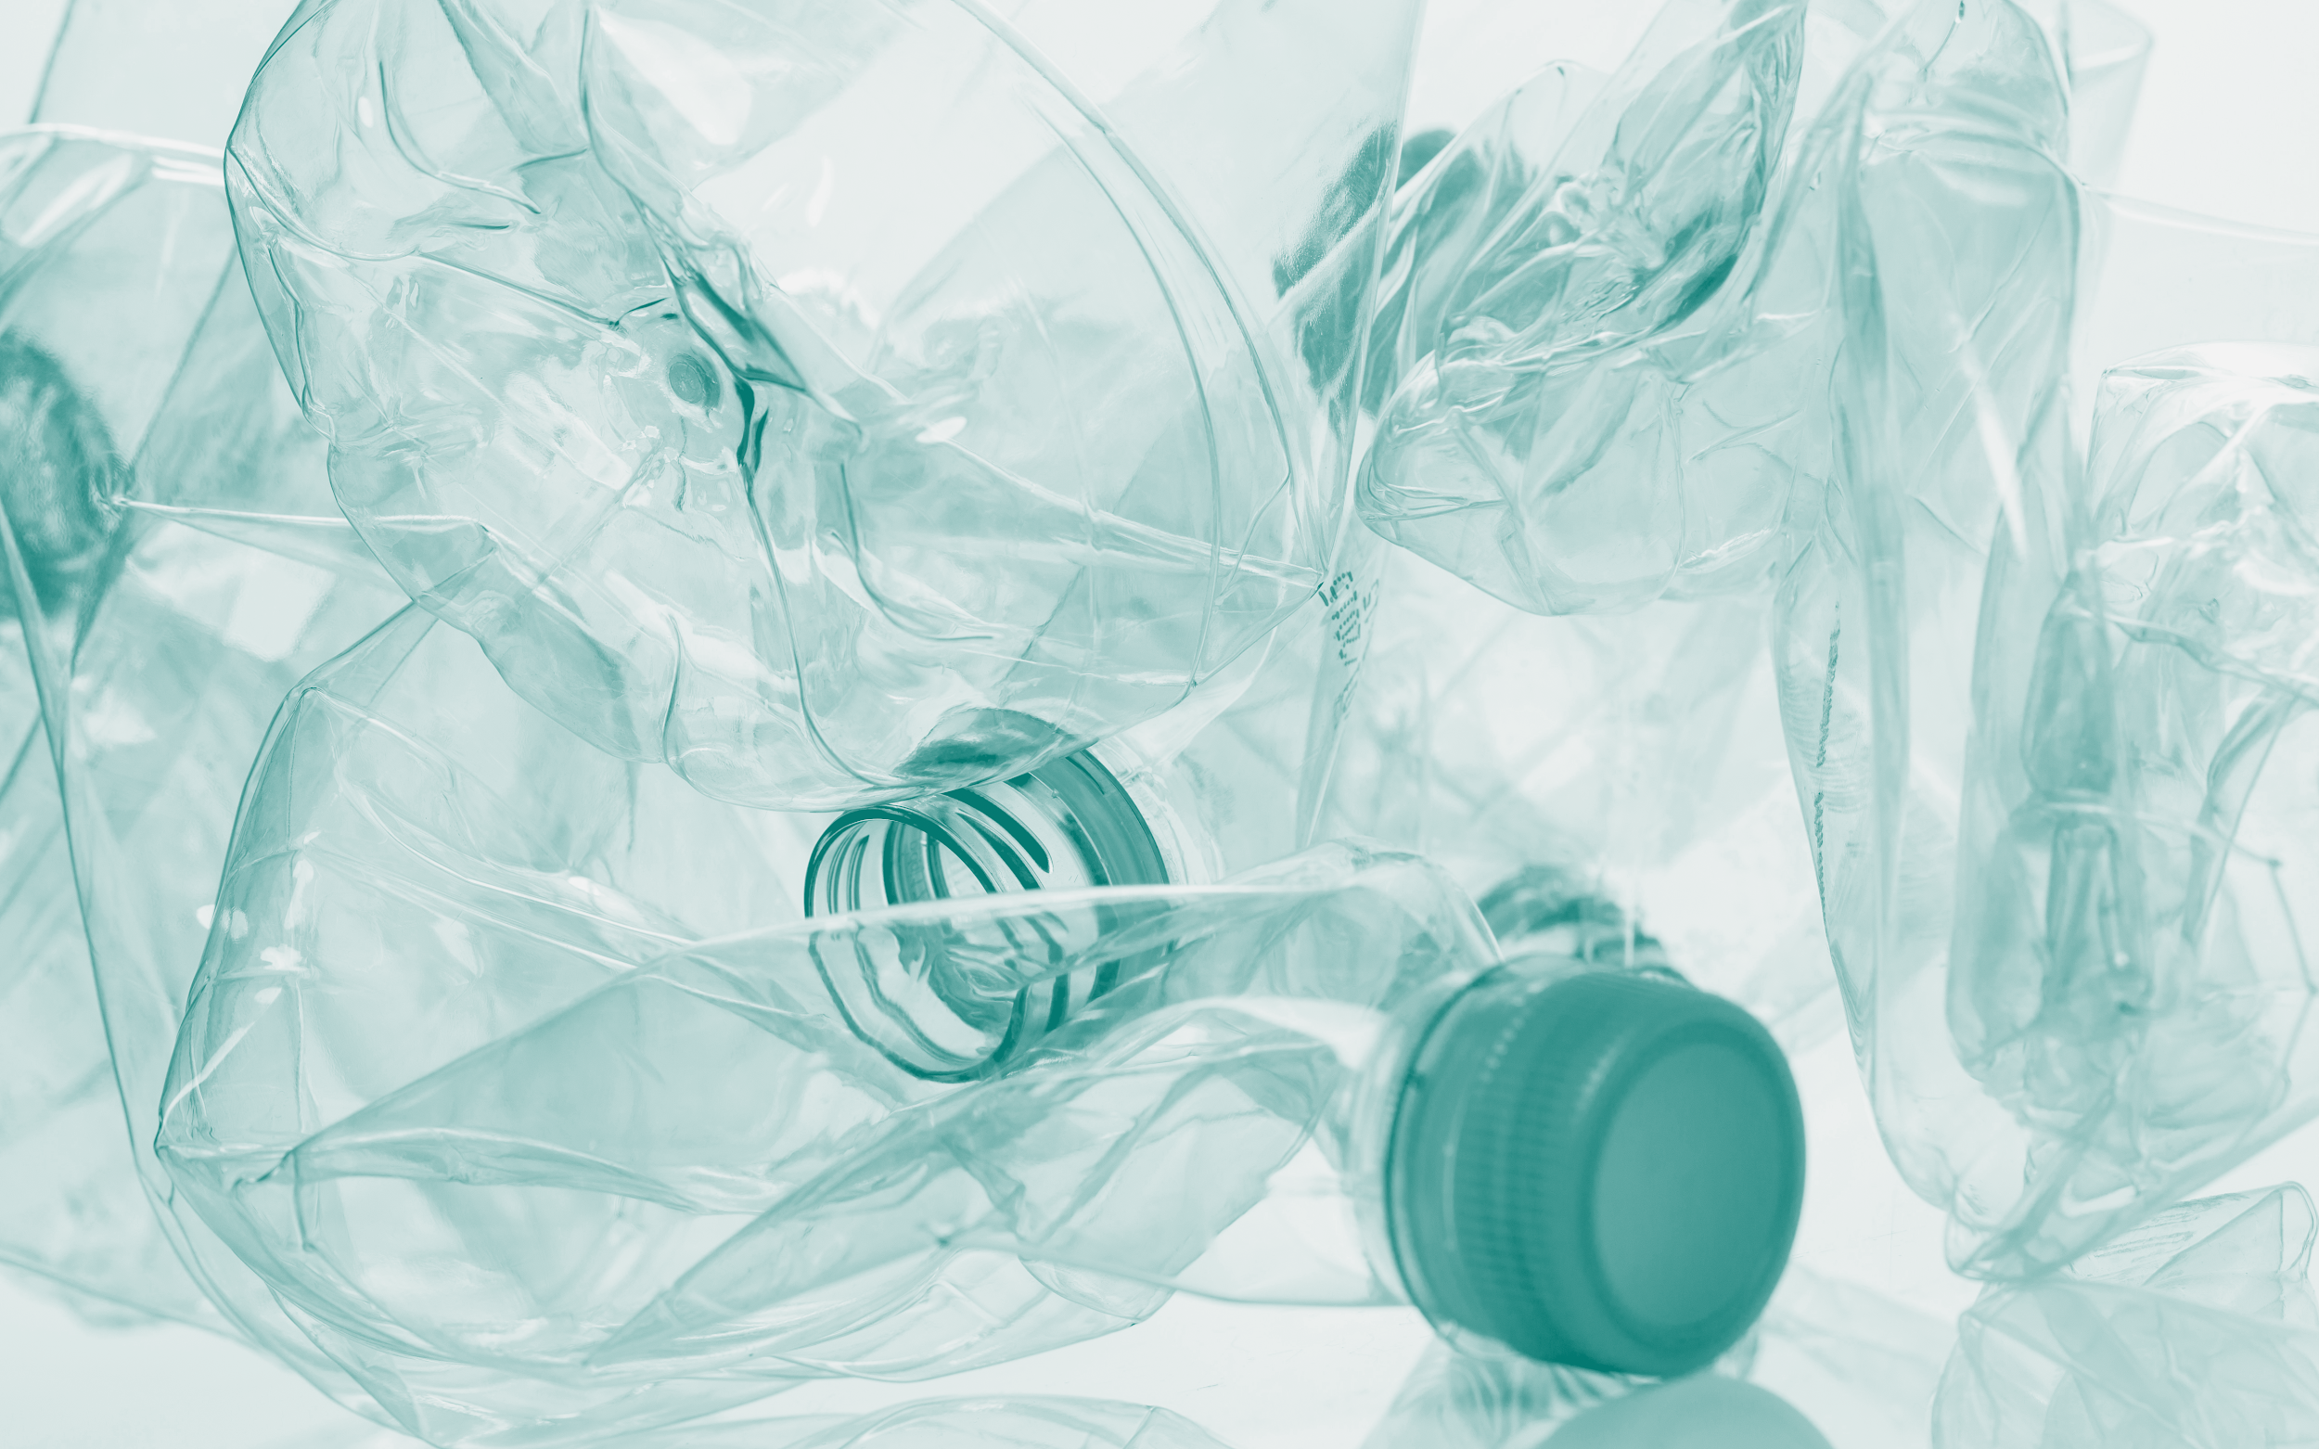

Microplastics
UnPlastic Biology Module 2
Biology - Module 2

Slide 2
What are microplastics?
Microplastic ingestion
Conclusion

Slide 3
1
How big are microplastics?
Above 25mm
Less than 5mm
1 μm to 1 mm
Above 50mm

Slide 4
1
How big are microplastics?
Above 25mm
Less than 5mm
1 μm to 1 mm
Above 50mm

Slide 5
2
Where are microplastics found?
Honey
The Arctic
Salt
All of the above

Slide 6
2
Where are microplastics found?
Honey
The Arctic
Salt
All of the above

Slide 7
What are microplastics?
Topic 2
Topic 3

Slide 8
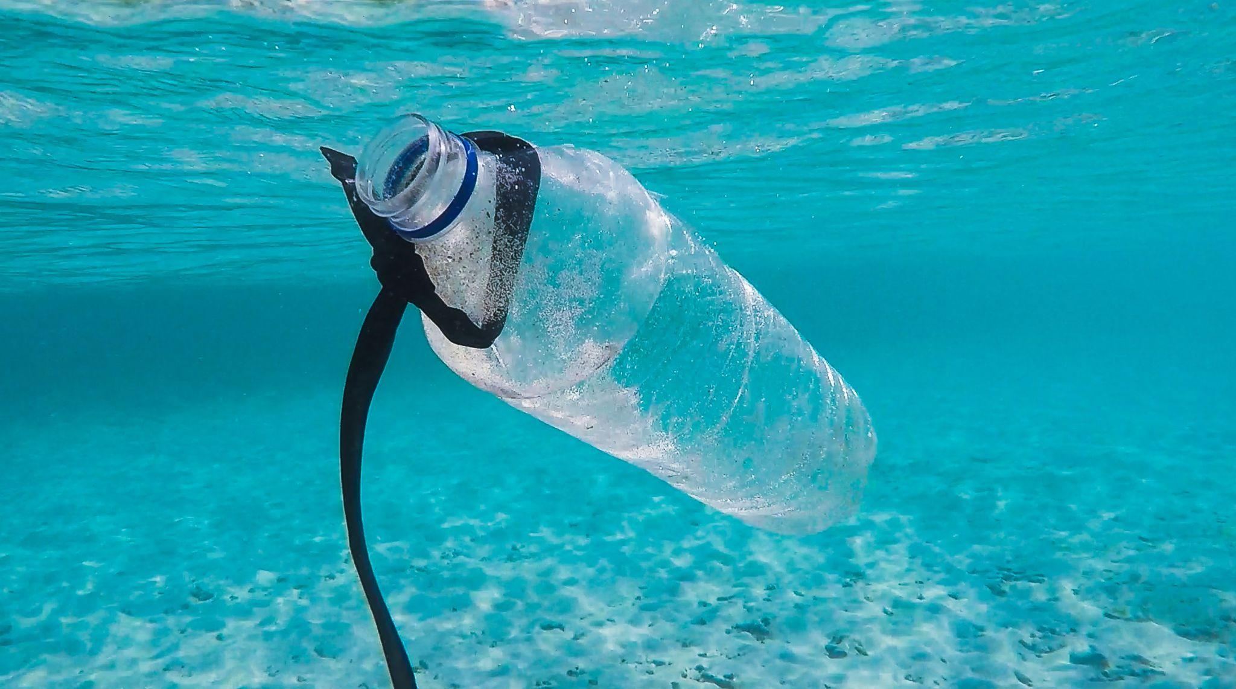
Plastic
Decomposes very slowly
Remains in the environment for centuries
→ decomposes into smaller pieces, which become microplastics.
Notes:
Plastic does not decompose quickly and can persist in the environment for centuries.
Larger plastic items can break down into smaller particles called microplastics.
Microplastics are defined as plastic pieces less than 5 mm in length.
This is a current topic of interest in scientific research.
The module will explore what microplastics are, their impacts, and the state of research.

Slide 9
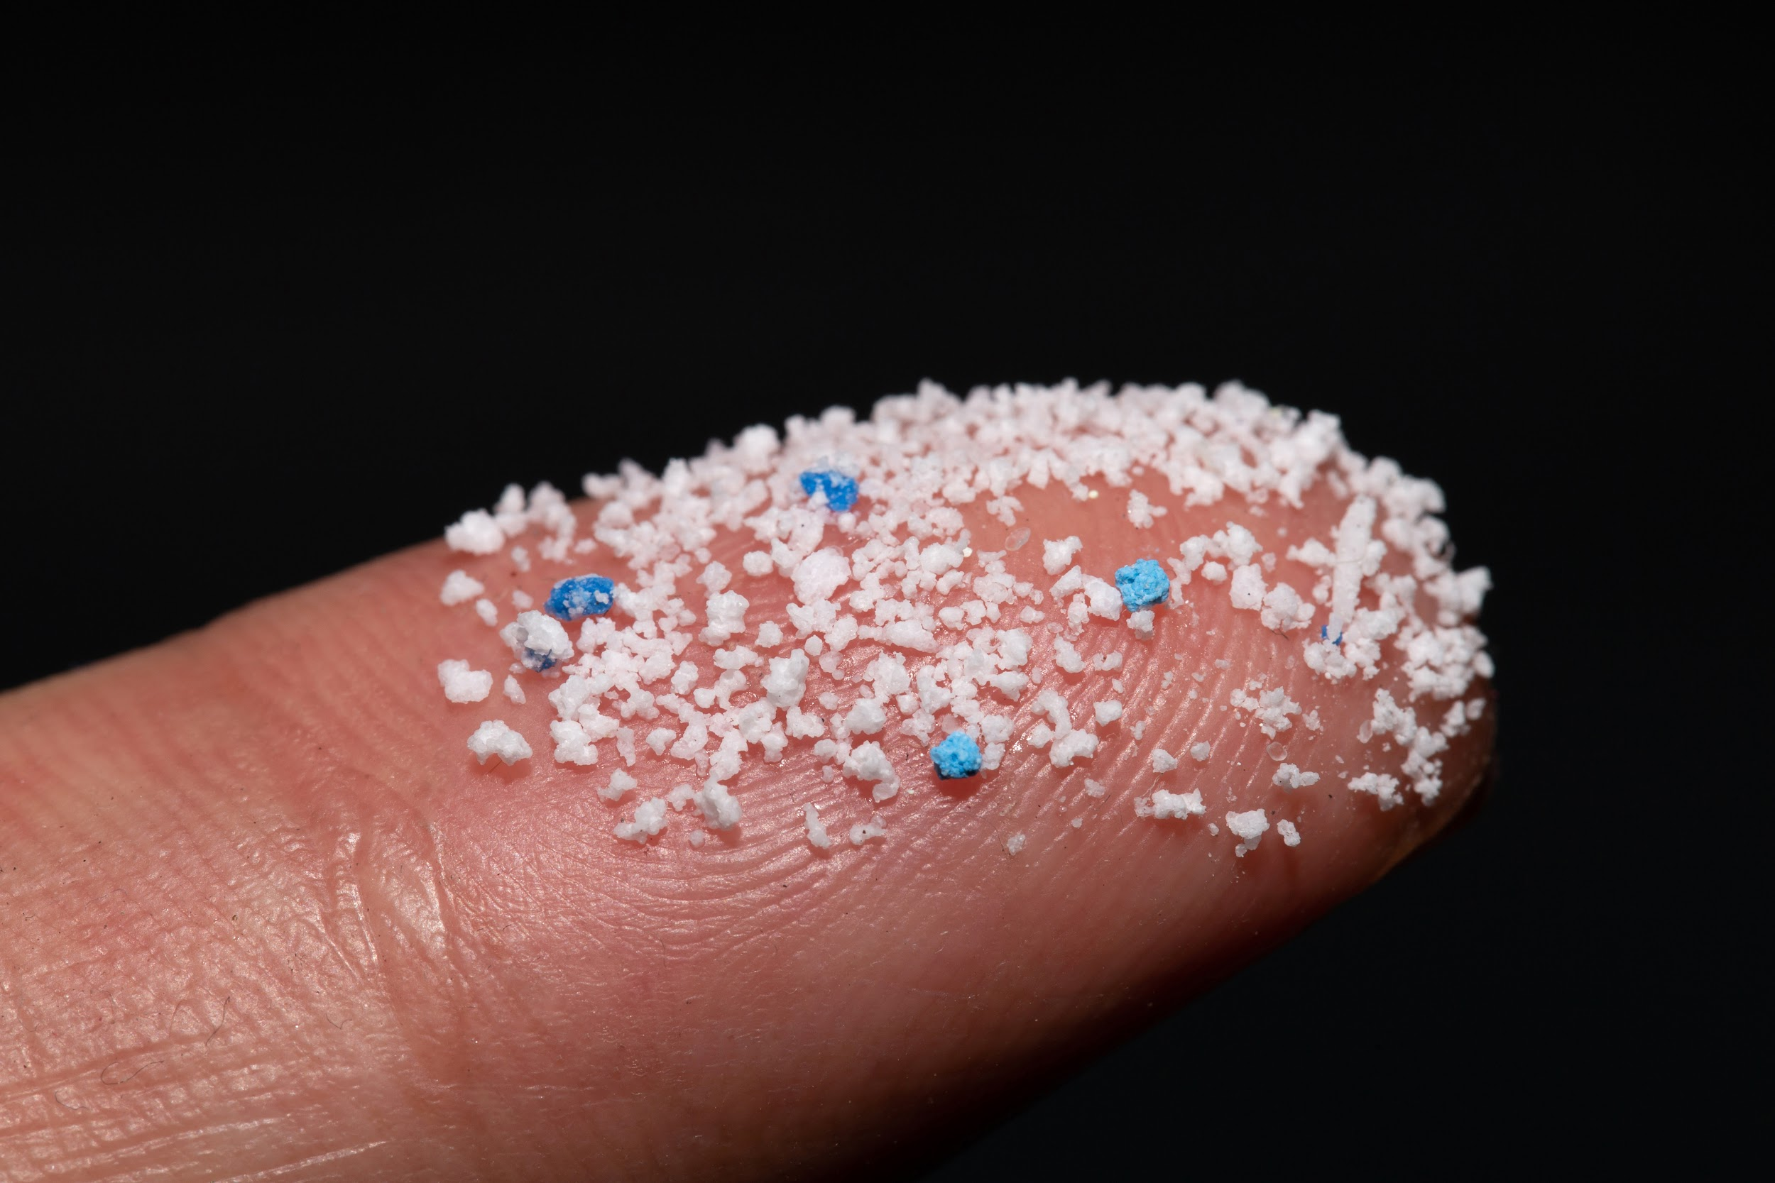
Microplastics
Microplastics are pieces of plastic smaller than 5mm.
Because of their small size:
We are often unaware of their presence
They have different impacts than larger plastics (macroplastics)
Notes:
Microplastics are plastic particles smaller than 5 mm.
The distinction is important because size affects visibility and environmental impact.
Microplastics are harder to detect and behave differently than larger plastics.

Slide 10
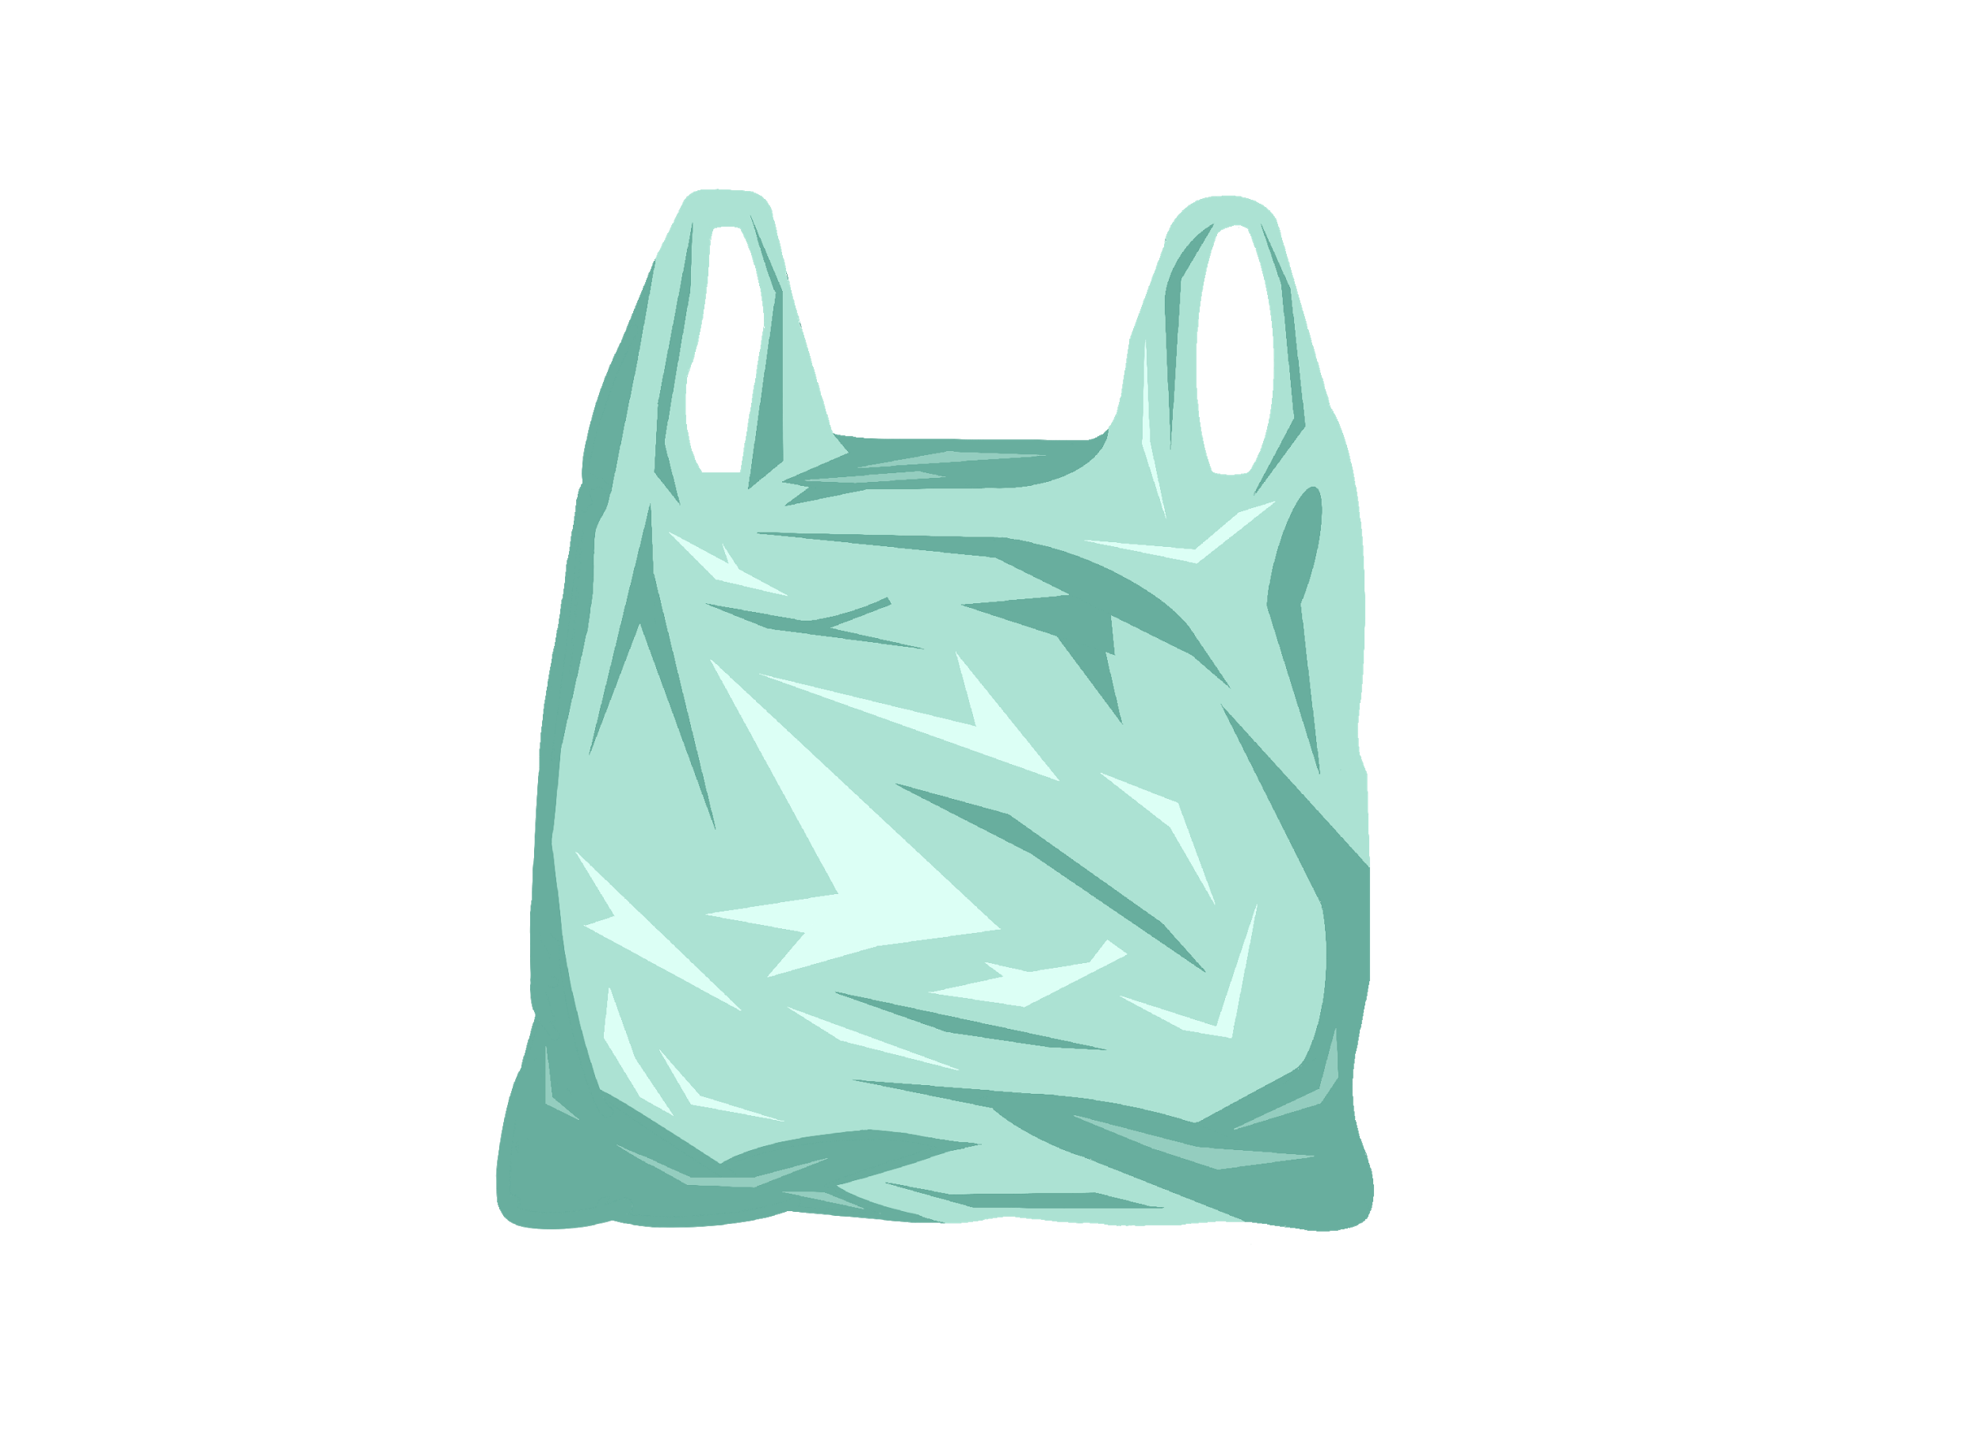
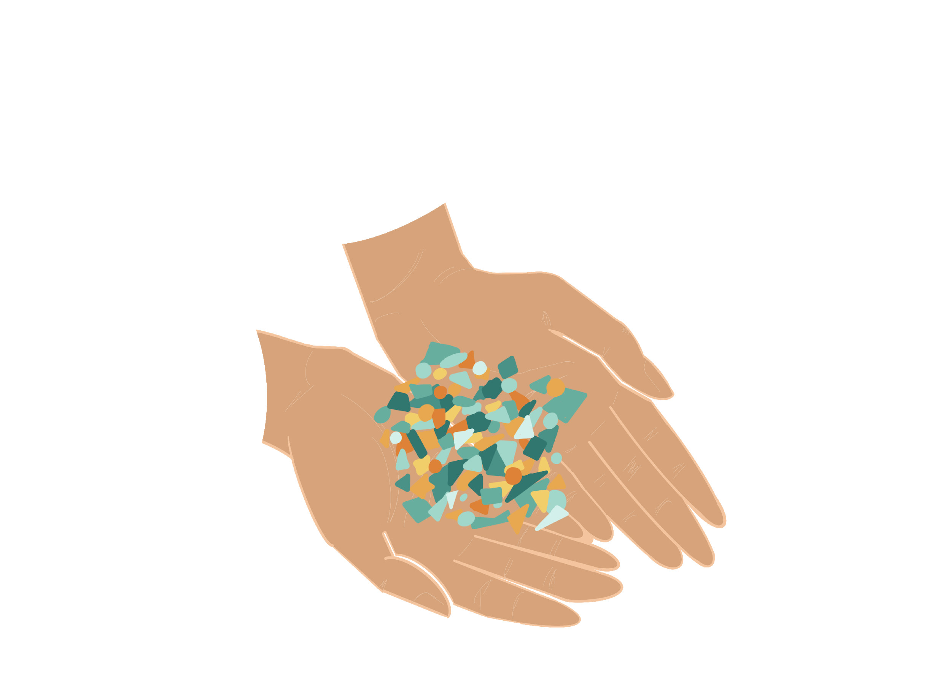
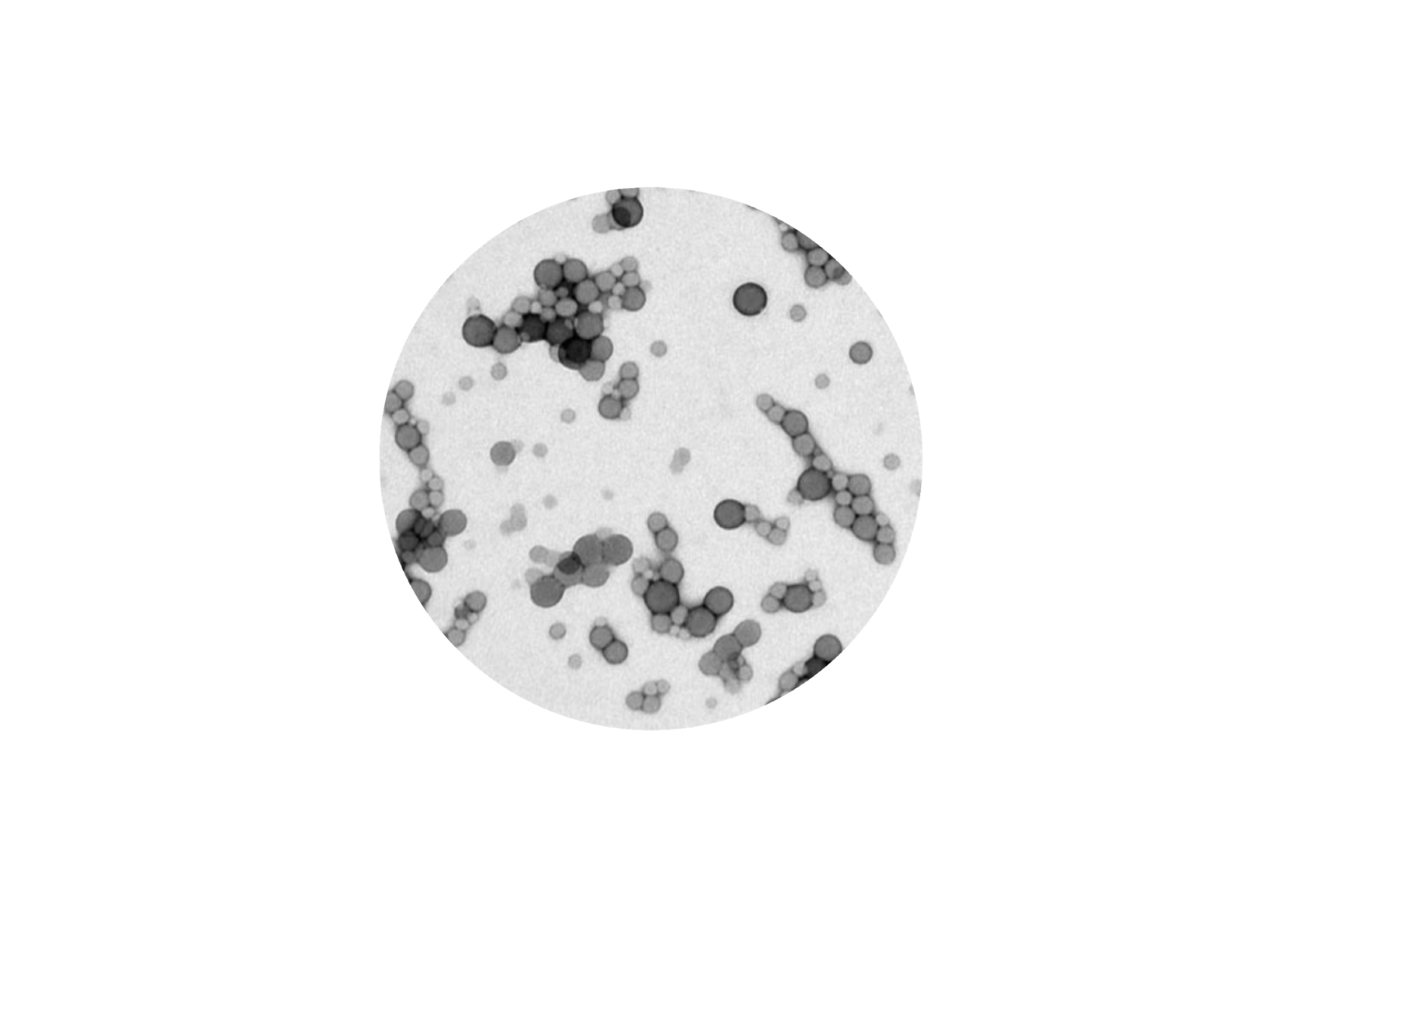
Nanoplastic:
smaller than 1000nm
Macroplastic:
bigger than 5mm
Microplastic:
smaller than 5mm
Notes:
Nanoplastics are even smaller, measuring less than 1 micrometer (μm).
These categories help researchers understand how plastics interact with organisms and ecosystems.
The difference between a 5.5 mm macroplastic and a 4.4 mm microplastic is minimal.
In contrast, the difference between a 1 mm microplastic and a 50 nm nanoplastic is significant due to their interactions and behaviors.

Slide 11
Why do you think we have microplastics?
Notes:
Answer
Because they were created this way, or because larger plastics broke down into smaller pieces. Primary microplastics are pieces of plastic that were purposefully created in that size (smaller than 5 mm in diameter) and added to a product. Once the product is used the microplastic particles can end up in the environment. Secondary microplastics are different, as they were not initially created as microplastics, but instead were created at a larger size. This larger piece of plastic, a macroplastic, can degrade in the environment and result in microplastic.

Slide 12

Primary and secondary microplastics
Primary microplastics
Intentionally created
Secondary microplastics
Created from breakdown of larger plastics
Notes:
Andere nodig

Slide 13
Do you think we should be worried about microplastics? Why?
Notes:
The answer is in 3 parts. Check presenter notes on each of the following slides.

Slide 14
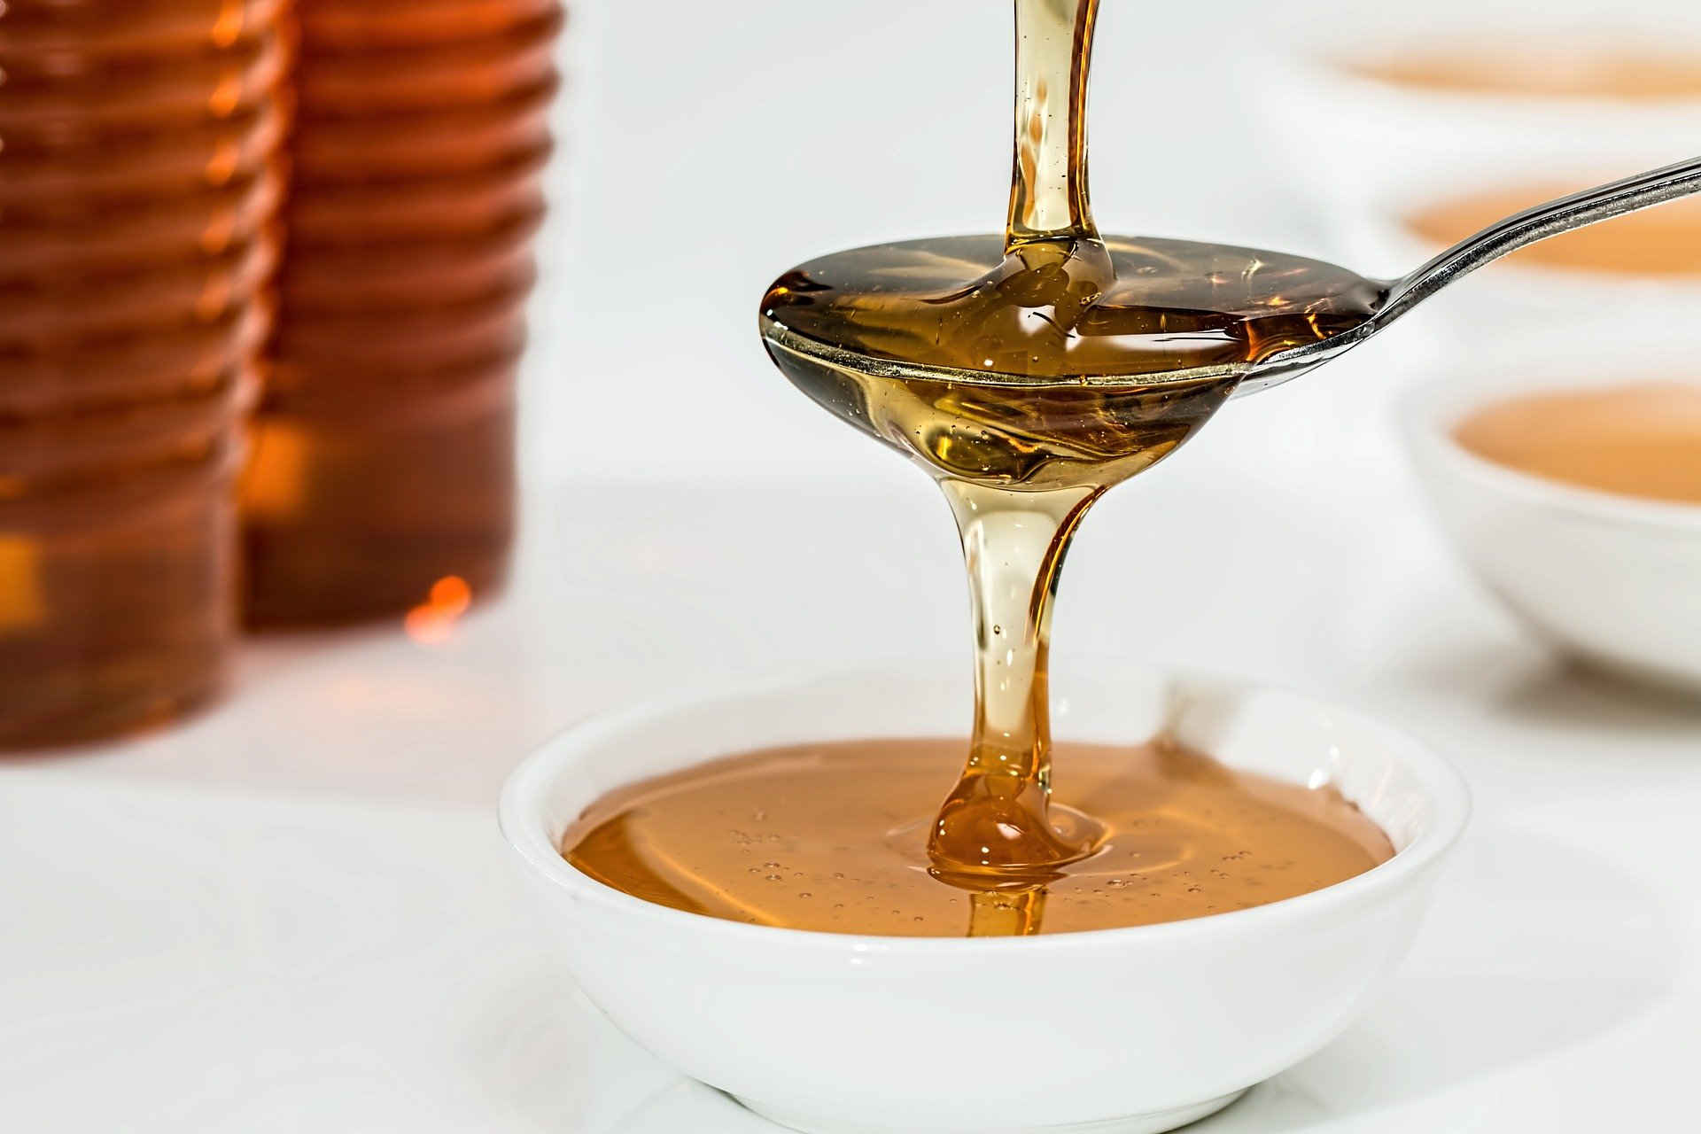

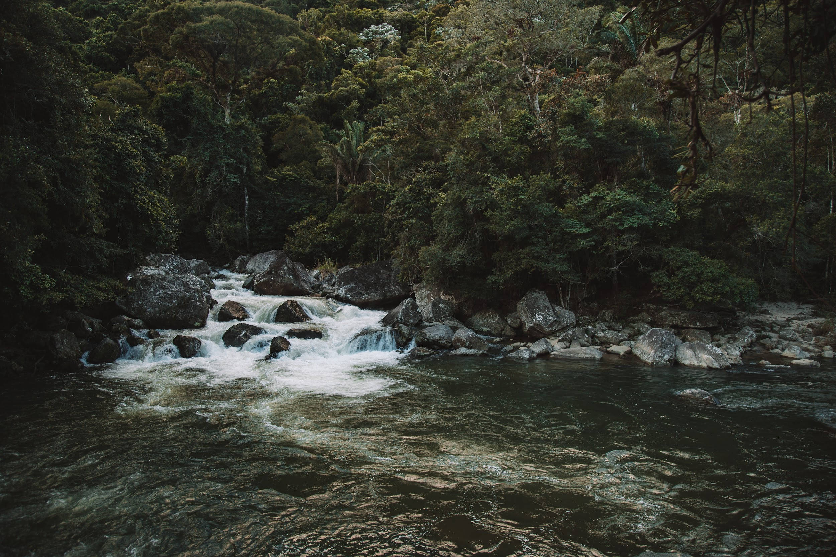
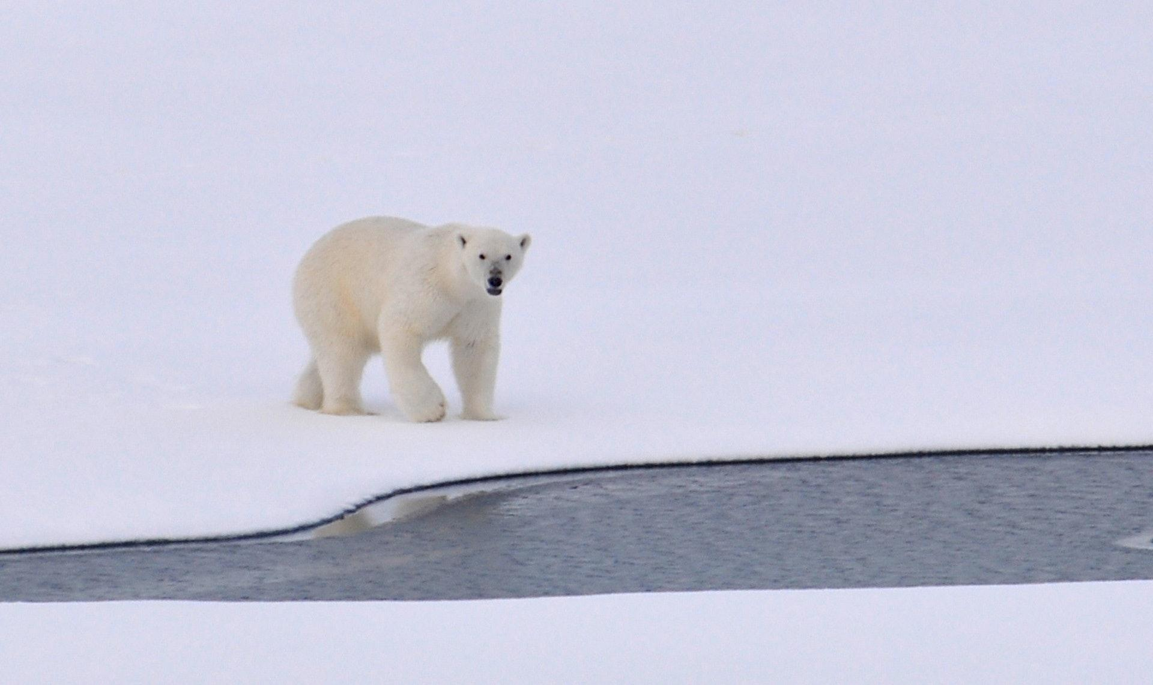
Abundantly present around us
In the rain, the arctic ice, in snow, in our water, and in our food
Notes:
1 - Abundant everywhere
Microplastics are a concern due to their small size and widespread presence.
They are found globally—even in remote regions like the polar areas—transported by wind and ocean currents.
Microplastics are present in the air, drinking water, beer, salt, honey, soil, rivers, and oceans.
Wind can carry microplastics into the air due to their light weight and small size.
They enter drinking water through runoff, wastewater, and degraded plastics; they also come from manufacturing processes and household activities like washing clothes.

Slide 15
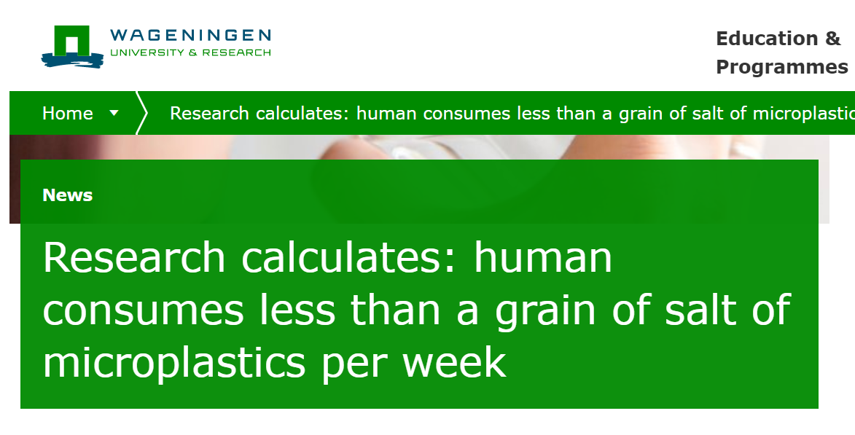
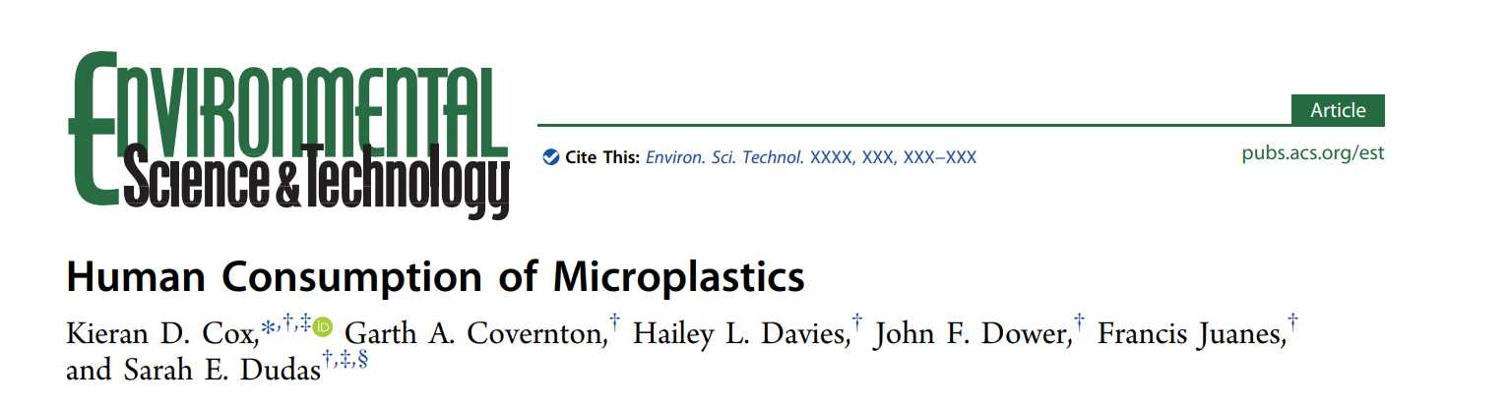
Abundantly present around us
We consume microplastics
We drink, eat and breathe microplastics
Notes:
2 - Because of their size, we do not always see them but they are present in our food and water. We, therefore ingest them, just like other animals in the environment do.

Slide 16
Abundantly present around us
We consume microplastics
Health hazard?
We are exposed to microplastics, but what are the consequences?
Notes:
3- Health Hazards
The health effects of ingesting microplastics are still largely unknown.
Some studies link microplastics in animals to increased rates of infectious diseases, but causation is unclear.
If microplastics do cause harm, the impact on human and animal health could be significant.
The concern lies in the certainty of exposure and the possibility of harmful effects.

Slide 17
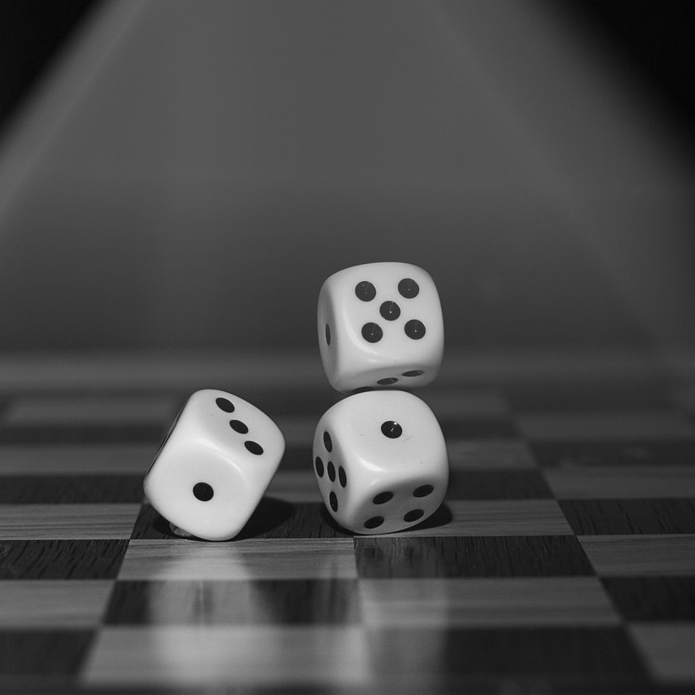
Hazards & Risks
Effects
Hazard: things that could cause harm → example: a ladder
Risk: The probability of a hazard actually causing harm → example: the probability of you falling of the ladder, the ladder falling on you, etc.
Notes:
We know microplastics are abundantly present around us and that we consume them. We know this ingestion is likely to have some negative consequences on our health. But we don’t know:
What the consequences are;
How large these consequences are;
How large the amount of microplastics needs to be before we suffer these consequences.

Slide 18
Hazards & Risks
Effects
Microplastics: hazard
Risk: ?
Notes:
Microplastics are a Hazard, but we still dont know the risk.

Slide 19

Global distribution
How do microplastics move?
Microplastics are everywhere, but not always as much
Microplastics move due to natural and human factors
Notes:
Even though microplastics can be found everywhere, they are not uniformly distributed throughout the world. Microplastics are moved by natural factors and by human factors.

Slide 20
What factors (natural and human) do you think impact the amount of microplastics in our oceans?

Slide 21

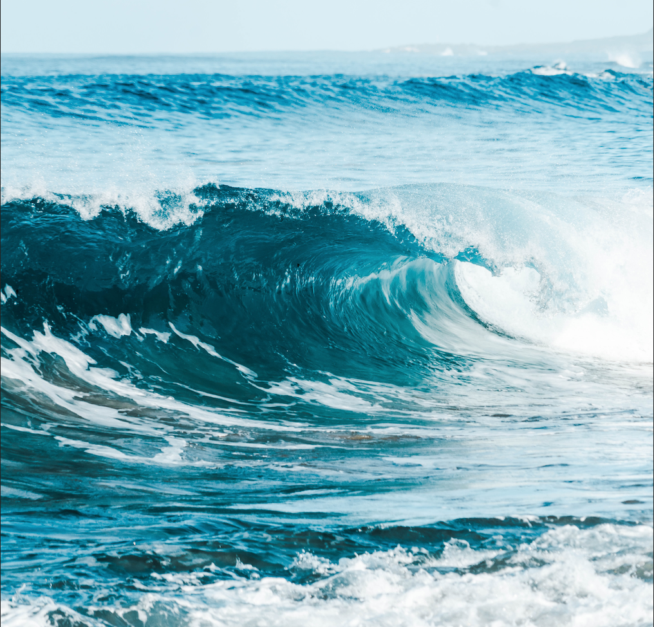
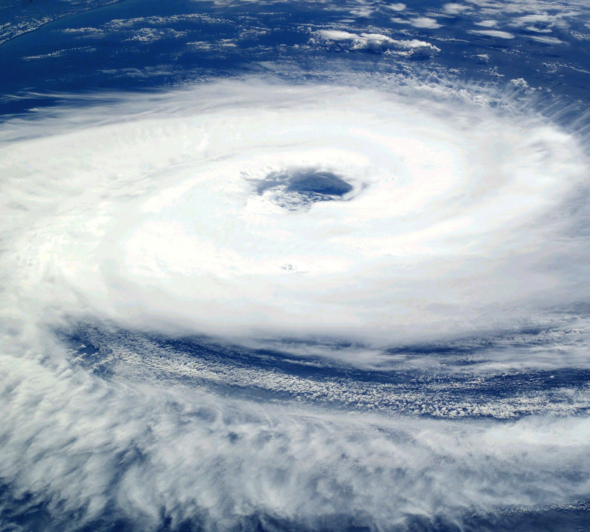
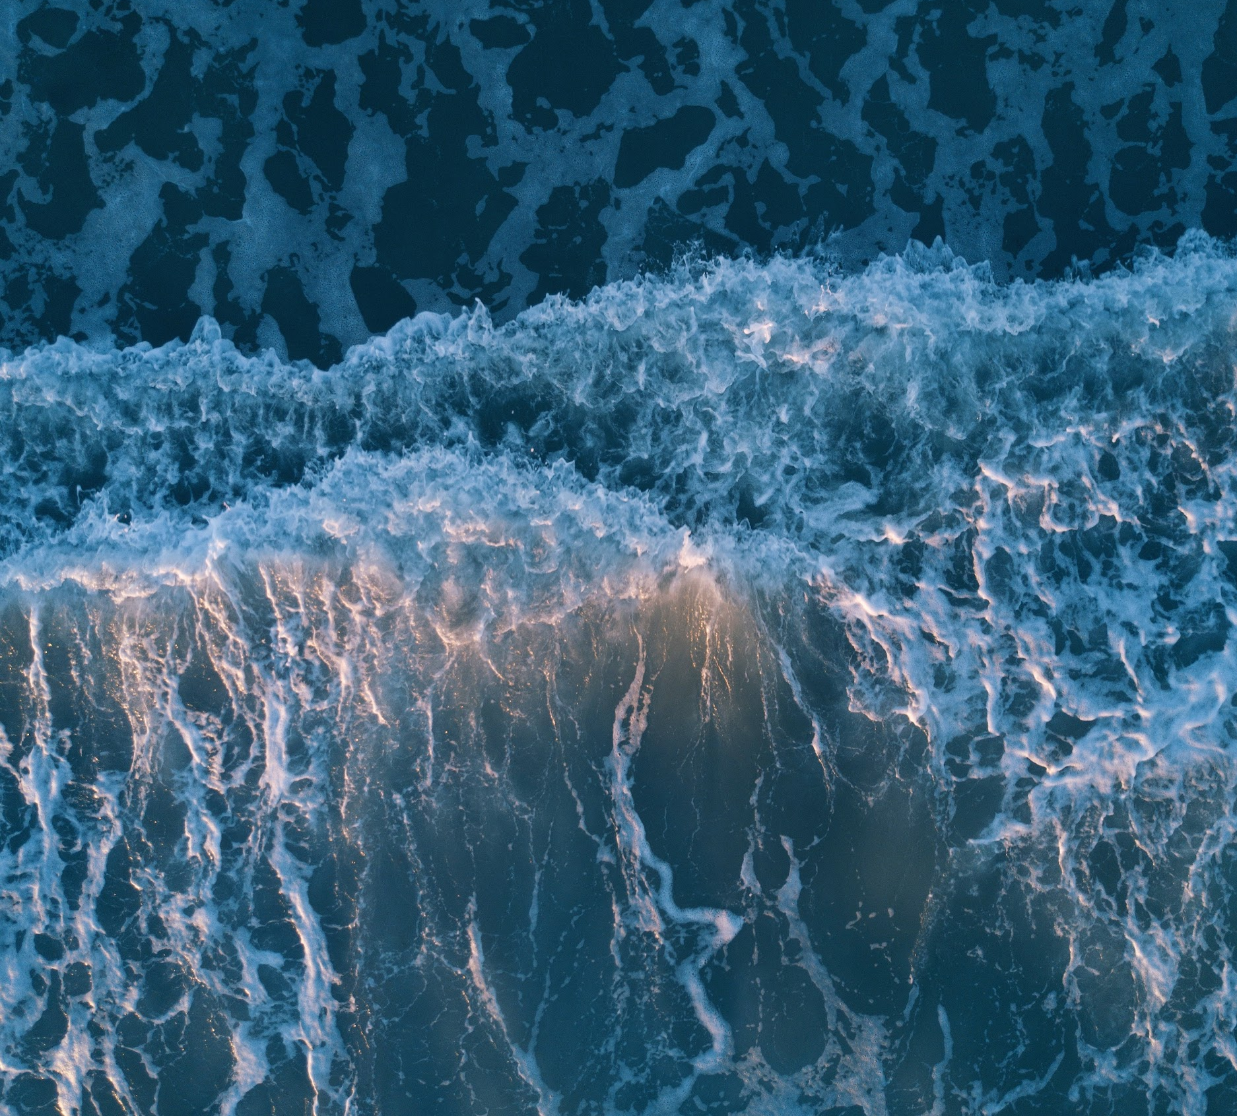
Natural factors that affect global distribution
Wave currents
Wind direction
Cyclones
Tides
Notes:
Many acceptable answers. Examples can be put into two groups:
Natural factors that influence microplastic distribution are:
Wave currents
Cyclones
Wind direction
Tides
River dynamics
Anthropogenic factors that influence microplastic distribution are:
Presence of particular industries
Tourism
Regulating laws and policies

Slide 22
Topic 1
Microplastic ingestion
Topic 3

Slide 23
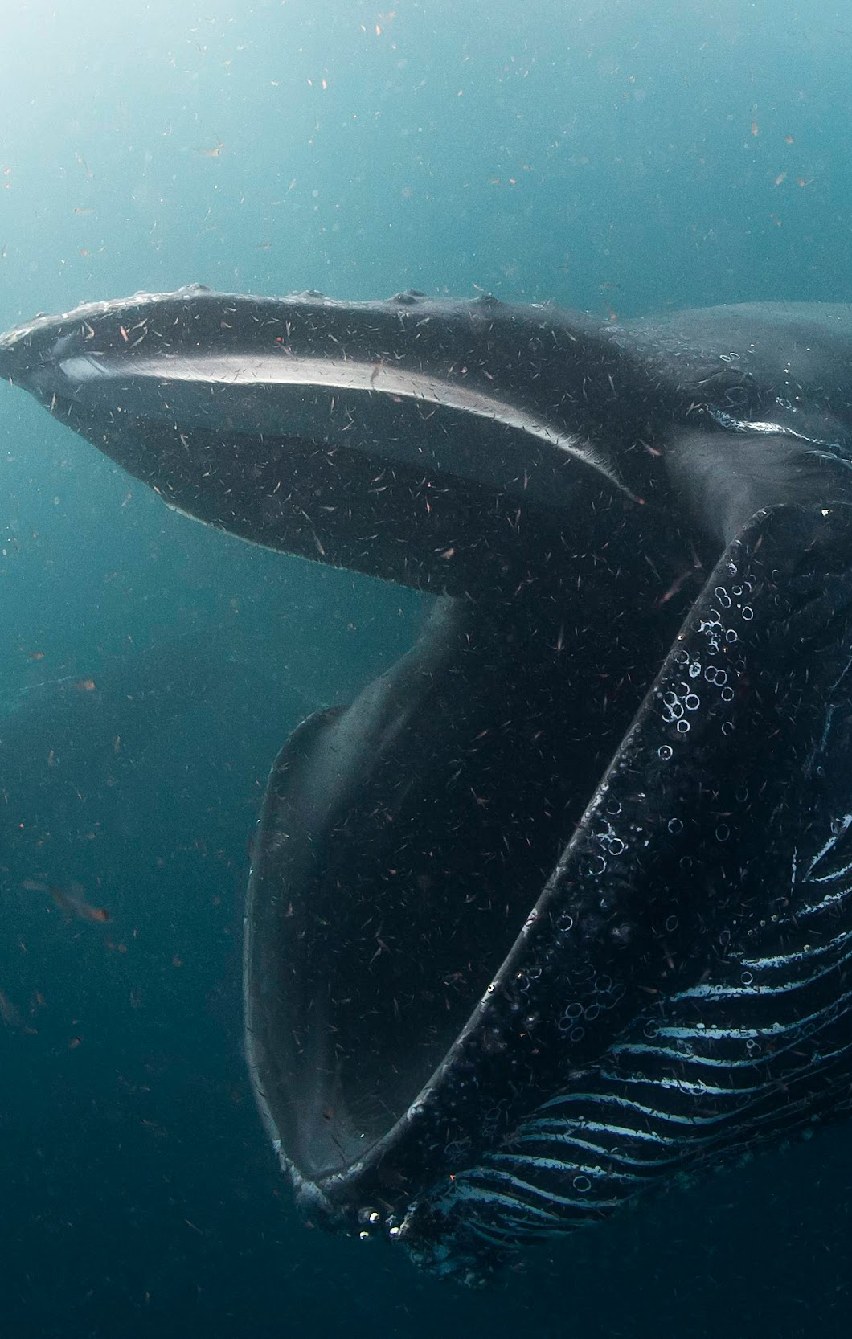
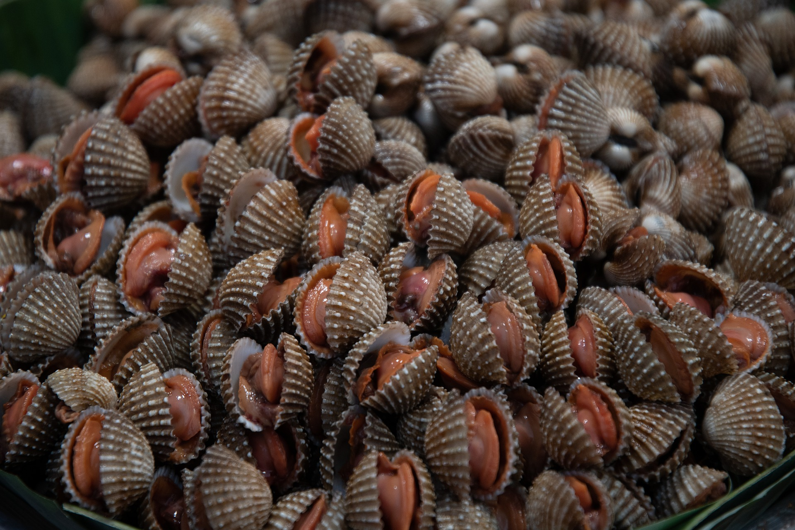
Microplastic Ingestion
Ingestion =
the process of taking food, drink, or another substance into the body by swallowing or absorbing it
Photo by Jean Tresfon

Slide 24
Microplastic Ingestion
Specific vs. Non-Specific Feeding
Filter feeding
Specific feeding: confusing microplastics with prey
Photo by Jean Tresfon
Notes:
Organisms can ingest microplastics through a variety of feeding behaviors.
Non-specific feeding occurs when animals cannot control exactly what they ingest.
Passive feeders like whale sharks open their mouths while swimming, unintentionally consuming everything in their path—including microplastics.
Whale sharks and manta rays in places like Indonesia have been heavily impacted by this kind of ingestion (Germanov et al., 2019).
Filter feeders (e.g., whales, clams, some fish) extract small food particles by filtering large volumes of water.
While filtering for plankton or small organisms, these species can accidentally consume microplastics suspended in the water.
Filter feeders are particularly vulnerable to microplastic ingestion due to this feeding method.
Microplastics vary in size and color, making them visually similar to prey for some species.
Specific or active feeders may mistake microplastics for food due to their appearance and consume them intentionally.
Animals using both passive and active feeding methods can suffer from the ingestion of microplastics, often leading to similar health risks.

Slide 25
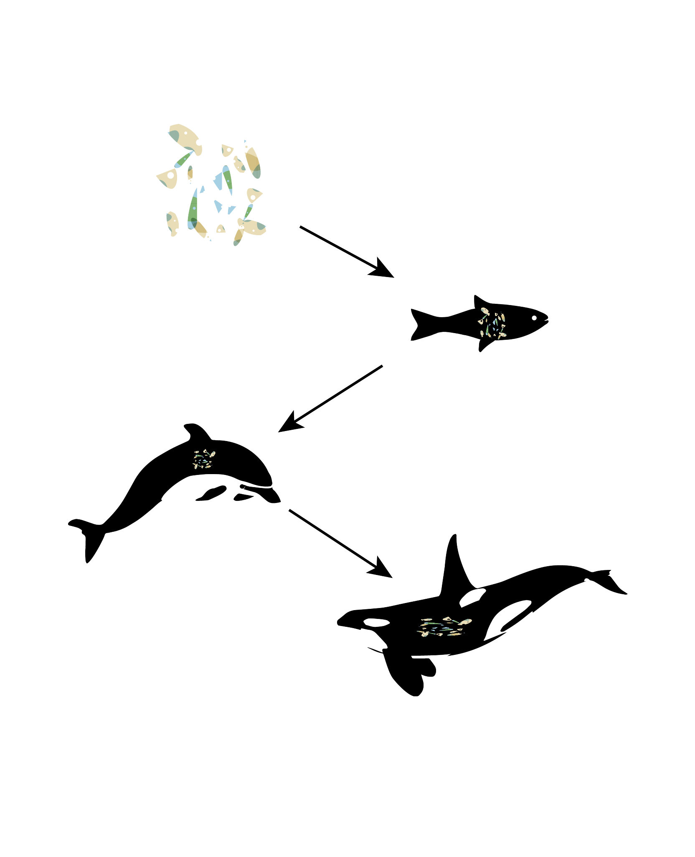
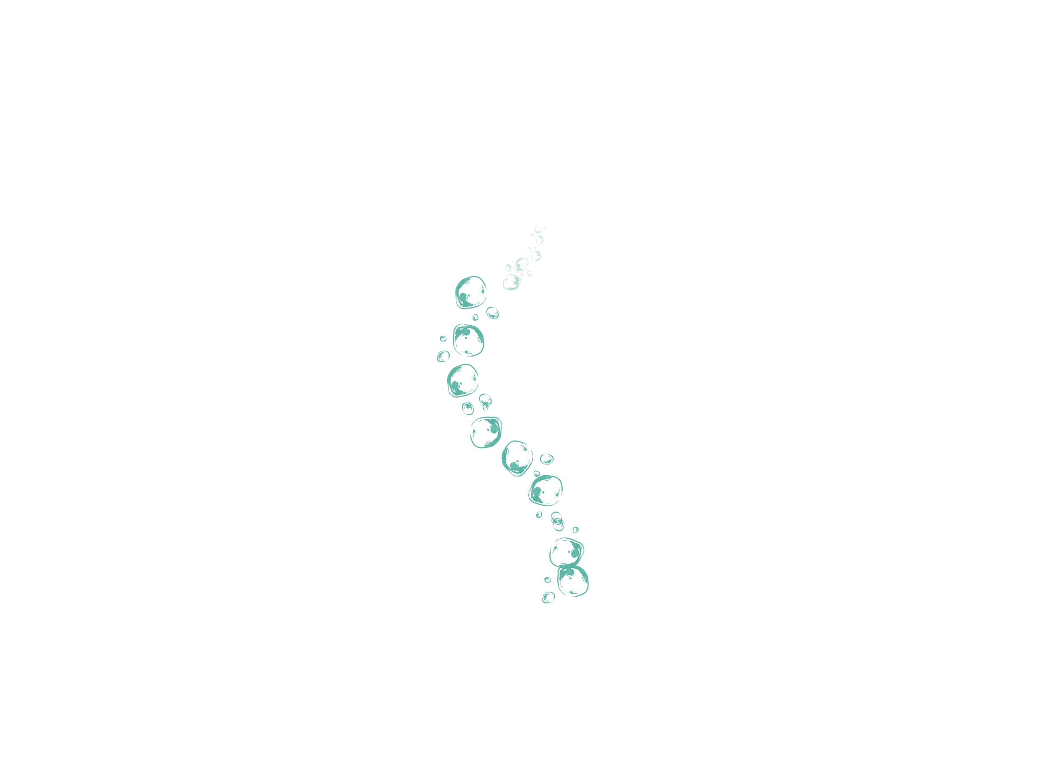
Trophic Transfer
Animals can eat other animals that have consumed microplastics
→ microplastics move through the food web
→ animals ingest them indirectly
Notes:
Once an organism ingests an amount of microplastics, these microplastics are now in the food chain. Microplastics can now move through the food web, meaning animals who didn't directly eat them can still ingest them by eating animals that contain microplastics. Of course, animals can also excrete microplastics via their poop.

Slide 26
Trophic Transfer
→ organisms have a trophic level
→ microplastics moving from one trophic level to another (by ingestion) is called trophic transfer
Microplastic can move through the food web through:
Ingestion (trophic transfer)
Excretion (leaving the food web)
Notes:
When one animal eats another animal that contains microplastics, these microplastics can move up from one trophic level to the next. A trophic level is “each of several hierarchical levels in an ecosystem, consisting of organisms sharing the same function in the food chain and the same nutritional relationship to the primary sources of energy.” In the picture on the slide, the grasshopper and the squirrel both eat plants, so are both at the same trophic level. The next trophic level is the scorpion and the golden eagle.
Through ingestion of organisms, microplastics can move from one trophic level to another. This is called trophic transfer.
Microplastics can move around levels through ingestion of the host or excretion (the process of eliminating or expelling waste matter). While some may also leave the food chain through excretion, a part remains within the food chain.

Slide 27
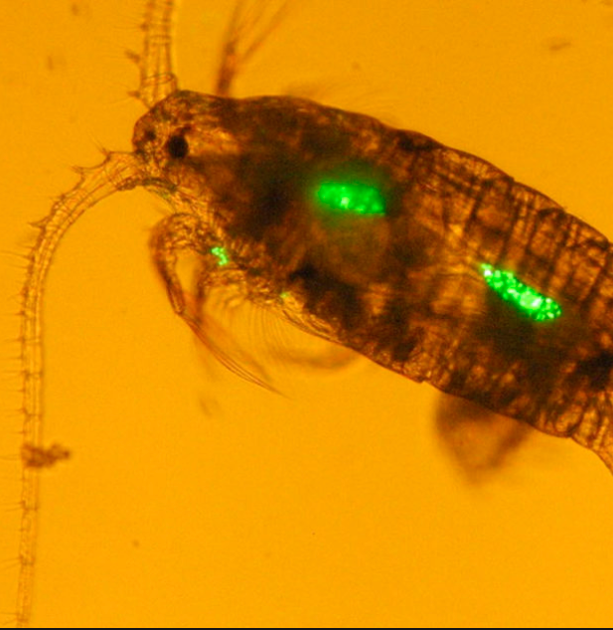
Bioaccumulation
Microplastics can accumulate within an organism, potentially causing harm.
Microplastics
Photo courtesy of New Scientist
Notes:
Microplastics can accumulate inside organisms after ingestion, sometimes embedding in tissues or organs.
While most microplastics are excreted, some particles remain in the body.
Repeated ingestion can lead to a buildup of microplastics over time.
The health effects of this bioaccumulation are not fully understood.
Research suggests potential risks, but the field is still in early stages and more study is needed.

Slide 28
What does this mean for the amount of microplastics consumed by the predator?
Notes:
Multiple answers possible, but let students reflect on what they learned.

Slide 29
Effect on humans?
Microplastic ingestion
We breathe, drink and eat microplastics.
If we consume organisms, are we ingesting larger amounts of microplastics?
What would be the consequences?

Slide 30
Topic 1
Topic 2
Conclusion

Slide 31
What would you like to see done about microplastics? Do you see any possible solutions?
Notes:
Multiple answers possible, but let students reflect on what they learned. Good moment to refresh the inclass activity from Macroplastics.

Slide 32
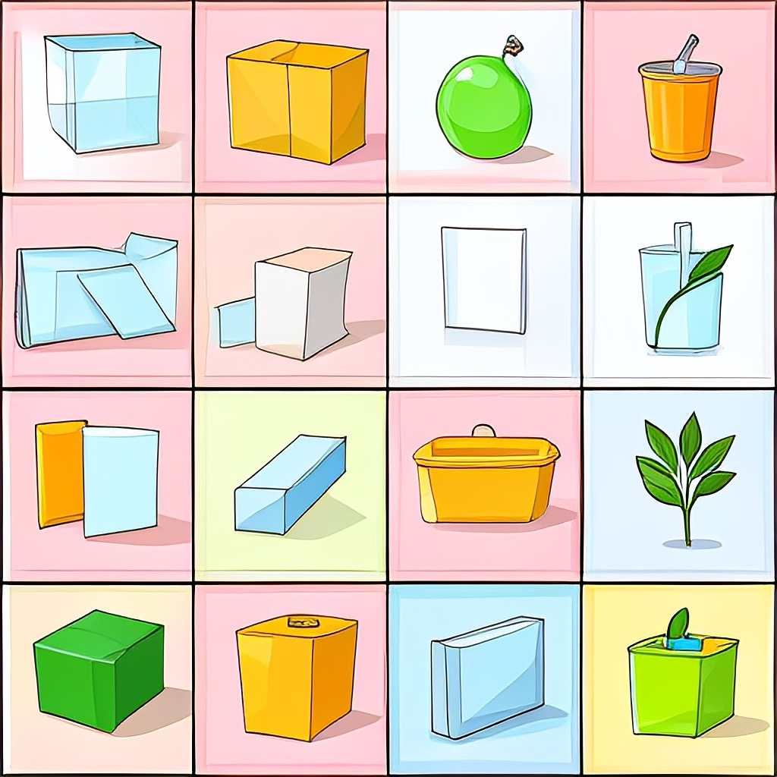
Microplastics: What next?
Microplastics:
Abundant
Don’t know the risks
For now:
Research
Limit plastics
Waste management
Notes:
We are starting to realize that we cannot escape them, and therefore we need to understand them. We have learned a lot about microplastics, however we are just scratching the tip of the iceberg.
The more we know, the more we can do, the better we can tackle this problem. Thus, we need more research.
In the meantime, we know it’s best to limit our plastic use as much as possible and properly manage our waste.

Slide 34
Citations: Graphics
Nurdle Picture: Photo by Paul Nettles, 2008. Licensed under the Creative Commons Attribution 2.0 Generic license. https://www.flickr.com/photos/28451803@N00/2414135327
Whale Photo: Photo by Jean Tresfon, 2020.
https://www.facebook.com/JeanTresfonPhotography
Food Web Graphic: Cain, Michael L., William D. Bowman, and Sally D. Hacker. n.d. Ecology. Sunderland, Massachusetts (Sinauer Associates, Inc.): 2014.
Sand Flea Microplastics: New Scientist, “Plankton eating plastic caught on camera for the first time”
https://www.youtube.com/watch?v=mGzIz9Ld-sE
Activity Trophic Chain: icons: Flaticon.com'. This cover has been designed using resources from Flaticon.com
All graphics, unless otherwise stated, have been sourced with permission from Shutterstock, Pexels or Pixabay

