Slide 1
Macroplastics
UNPLASTIC BIOLOGY MODULE 1
Biology - Module 1

Slide 2
Macroplastics & Wildlife
Exposure and effects
Conclusion

Slide 3
1
What is the most prevalent source of plastic pollution in the oceans?
Food packaging
Fishing gear
Straws
Electronics

Slide 4
1
What is the most prevalent source of plastic pollution in the oceans?
Food packaging
Fishing gear
Straws
Electronics

Slide 5
4
How many seabirds are killed each year due to plastic debris in the oceans?
Over 500,000
Over 3 million
Over 1 million
Over 5 million

Slide 6
4
How many seabirds are killed each year due to plastic debris in the oceans?
Over 500,000
Over 3 million
Over 1 million
Over 5 million

Slide 7
5
By what year will there be more plastic than fish in the world’s oceans?
2025
2050
2075
2100

Slide 8
5
By what year will there be more plastic than fish in the world’s oceans?
2025
2050
2075
2100

Slide 9
7
How much plastic do Laysan Albatrosses feed their chicks each year?
5 milligrams
5 grams
5 kilograms
5 tons

Slide 10
7
How much plastic do Laysan Albatrosses feed their chicks each year?
5 milligrams
5 grams
5 kilograms
5 tons

Slide 11
What are microplastics?
Topic 2
Topic 3

Slide 12
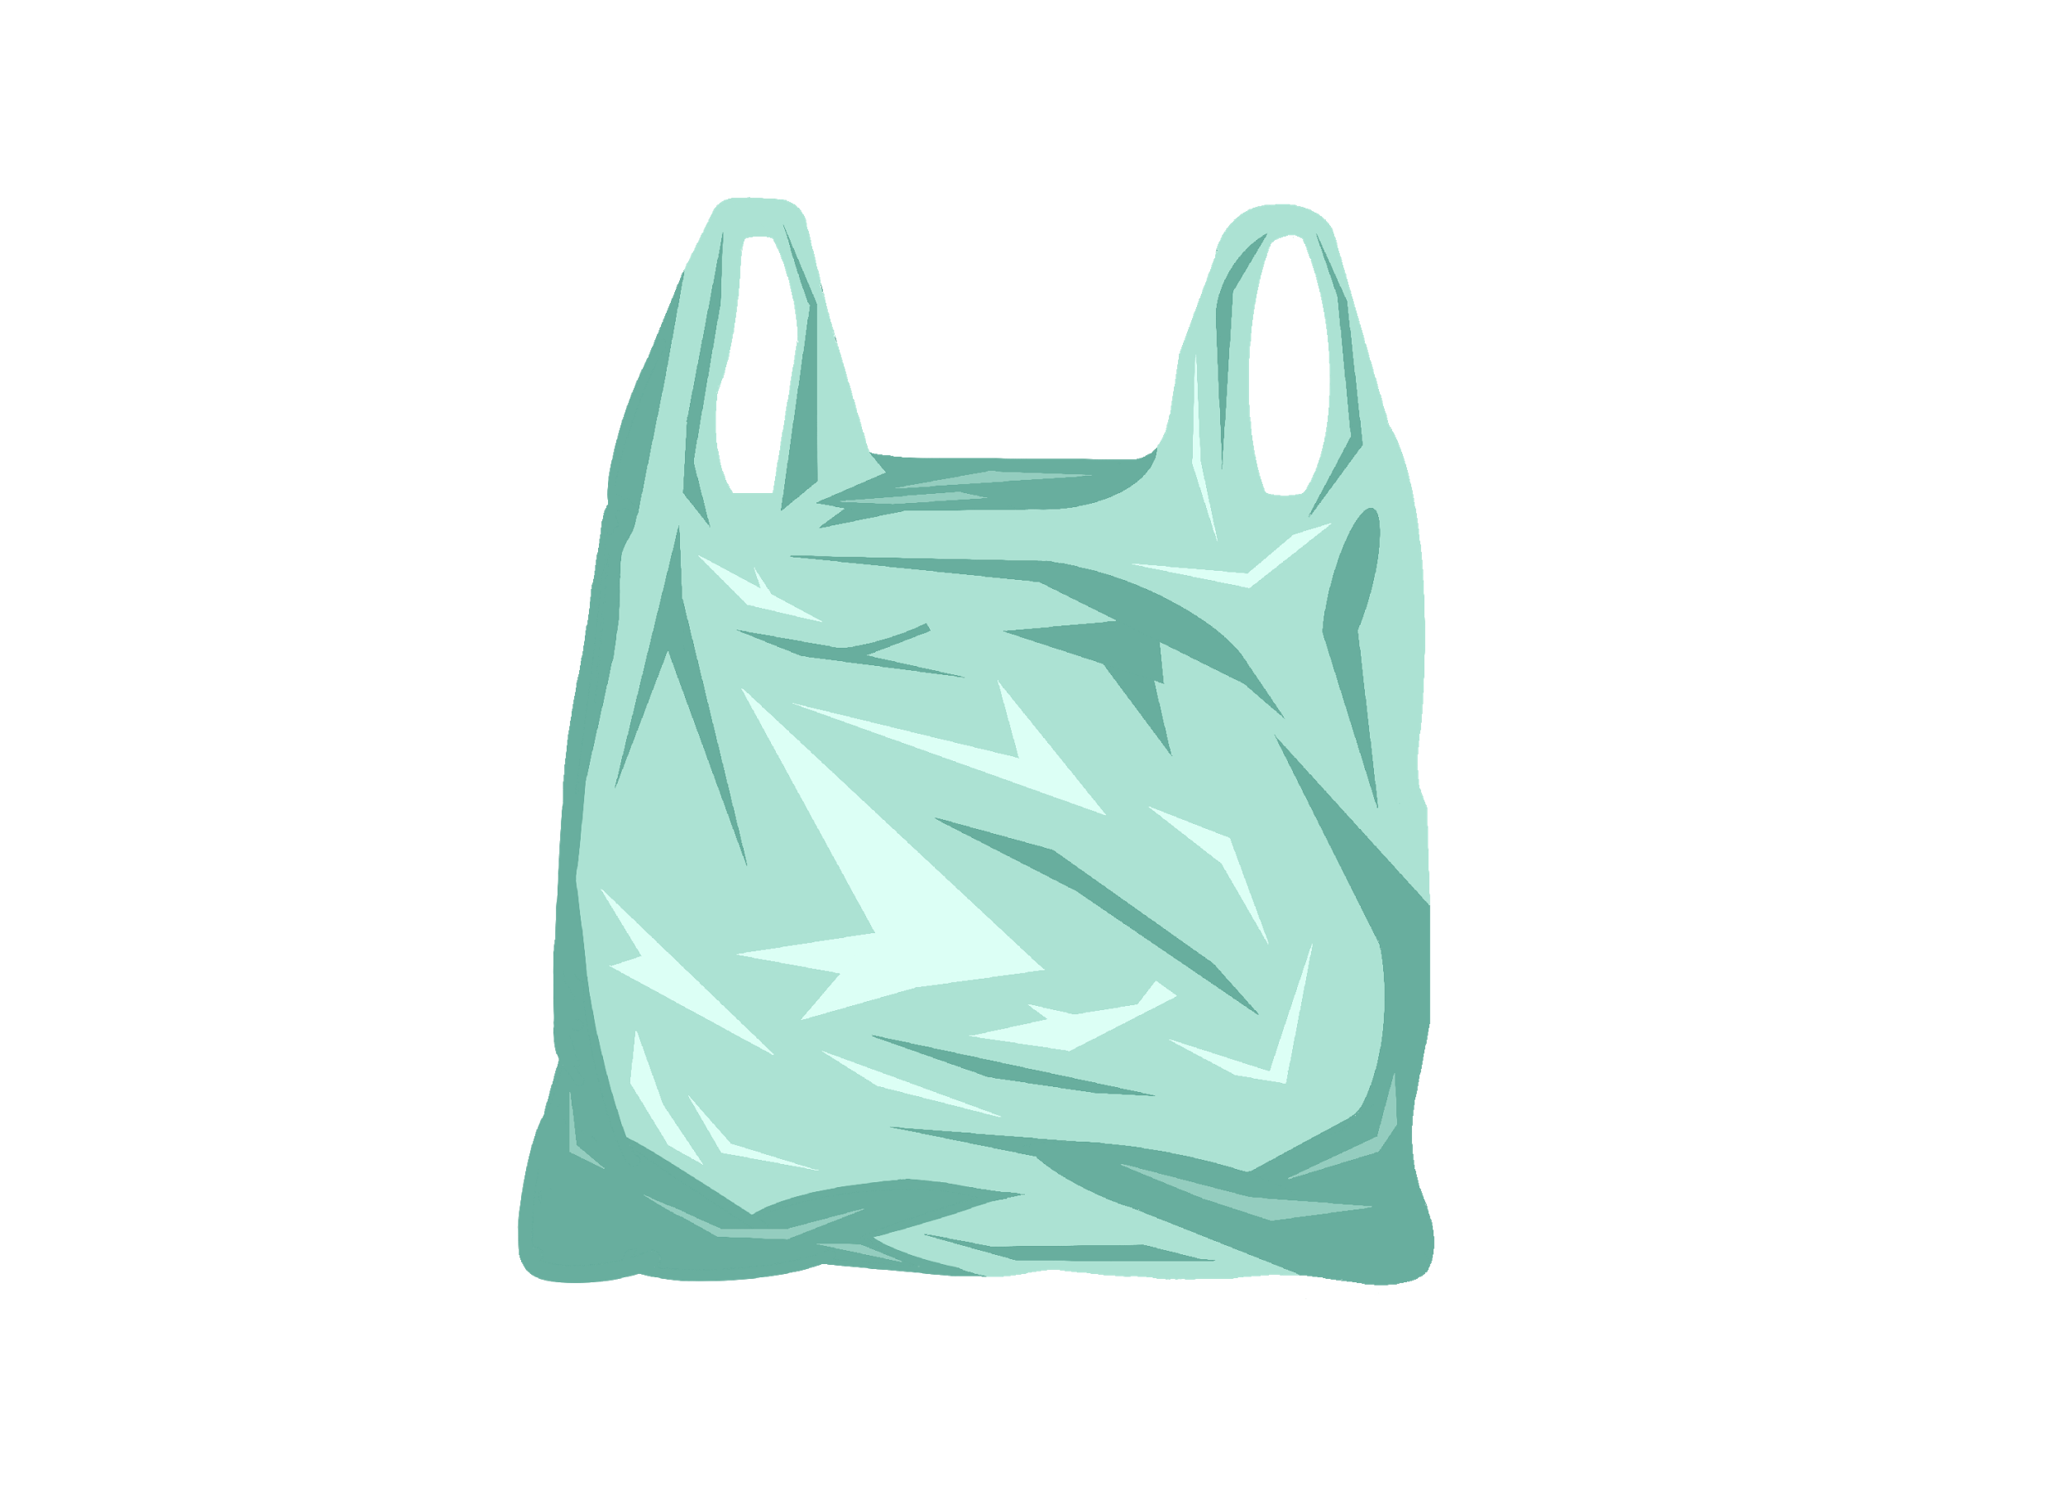
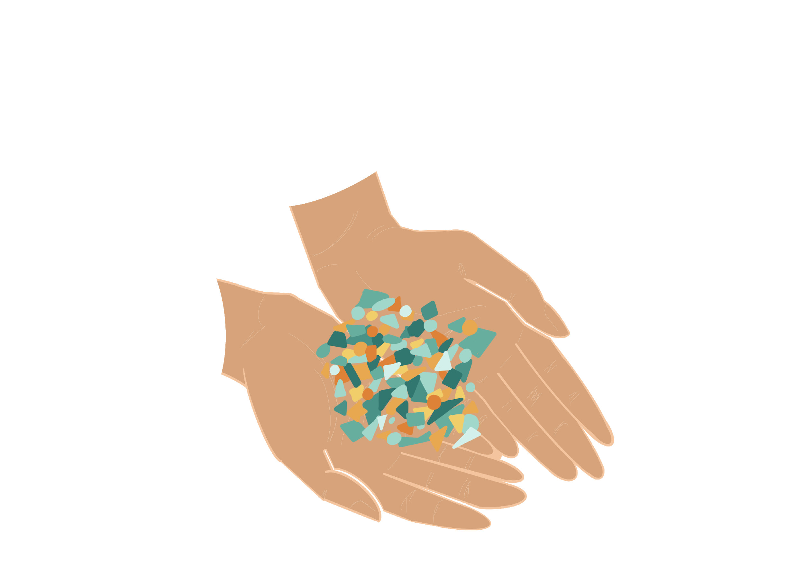
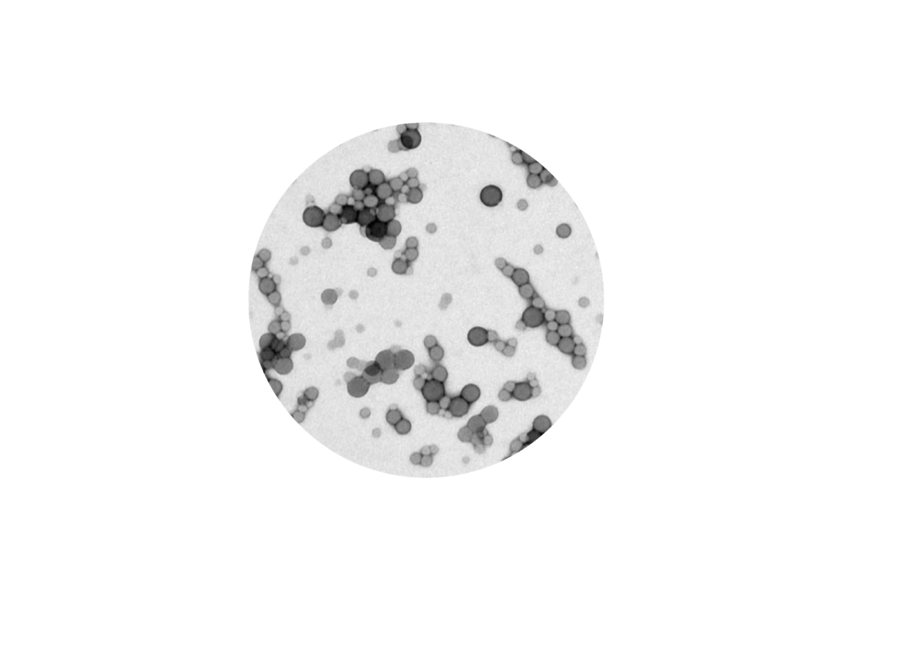
Macroplastics
Nanoplastic:
smaller than 100nm
Macroplastic:
bigger than 5mm
Microplastic:
smaller than 5mm
Notes:
What are macroplastics? Larger-sized plastic items that can be seen and identified with the naked eye (usually defined as >5 mm).

Slide 13
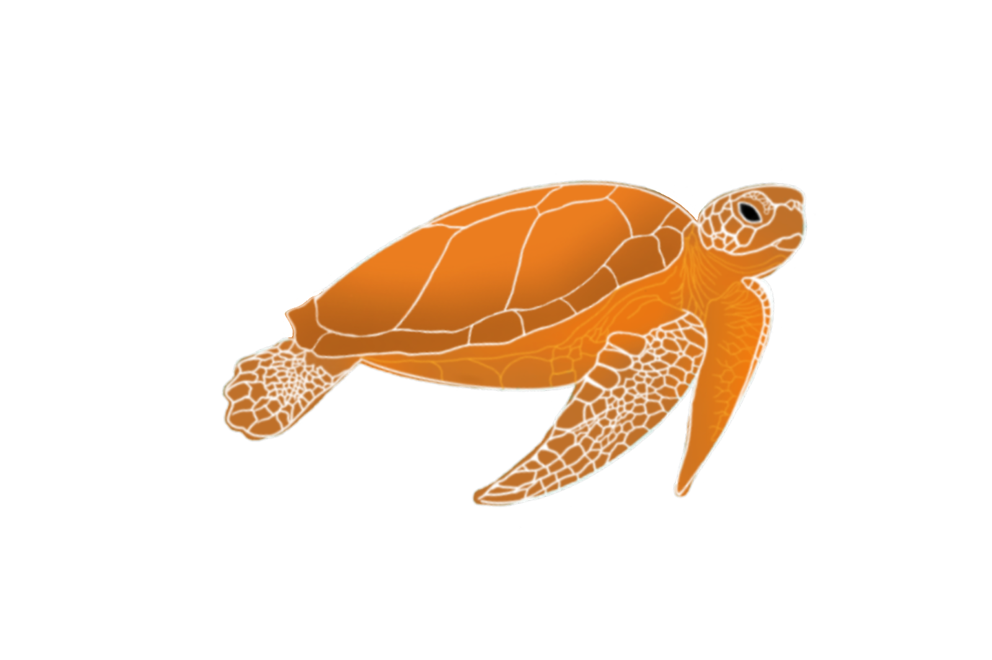
Macroplastics & Wildlife: example of the sea turtle
Notes:
The example of the sea turtle will be used as a running example throughout the module. Macroplastics affect wildlife in all environments (e.g., terrestrial, freshwater, soil, domesticated, and marine systems).

Slide 14
Sea turtles have become a symbol of the impacts of plastic pollution on wildlife, but do you think this is the only challenge for the turtle?
Notes:
Answer: No, sea turtles are in danger because of many other threats as well. For example:
1. Climate change is endangering their nesting habitats, which decreases nesting success rates.
2. Bycatch in nets of fishing often includes sea turtles, killing them in the process; coastal development is a threat to their habitat.
3. Other types of pollution such as chemicals and other solid waste is also causing illnesses, injuries, and even death. For example, smaller eggs and compromised immune systems in loggerhead turtles have been linked to chemical pollution.
Plastic pollution is just one of the dangers to sea turtles. Furthermore, turtles face the challenge of cumulative effects, as the combination of separate effects cause even bigger challenges for organisms.

Slide 15
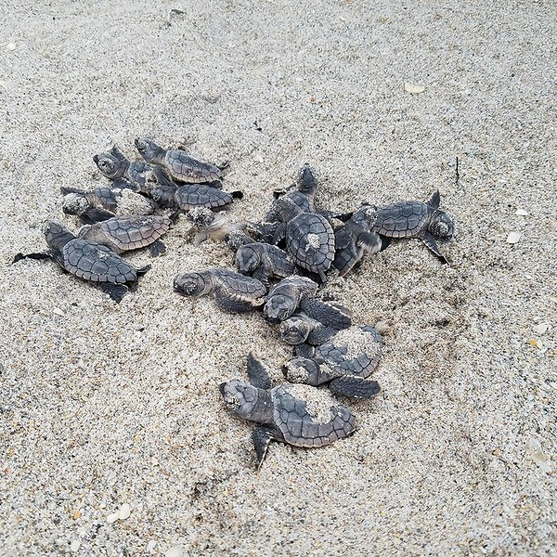
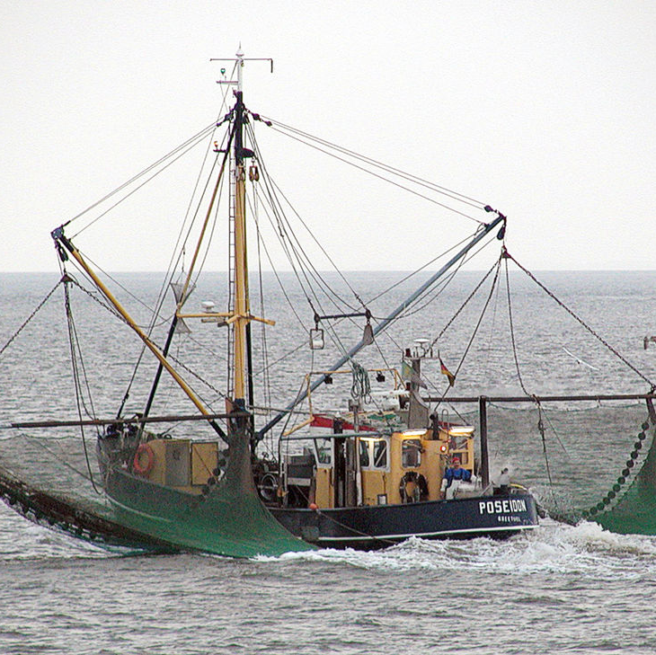
Notes:
Nieuwe plaatjes nodig

Slide 16
Can you come up with possible ways in which an animal may come into contact with macroplastics?
Notes:
Possible answers:
Getting tangled in plastic,
eating/ingesting plastic (and having their stomach or digestive system obstructed as a consequence),
abrasion (getting physically hurt by plastic),
taking up space/obstructing light flow.

Slide 17
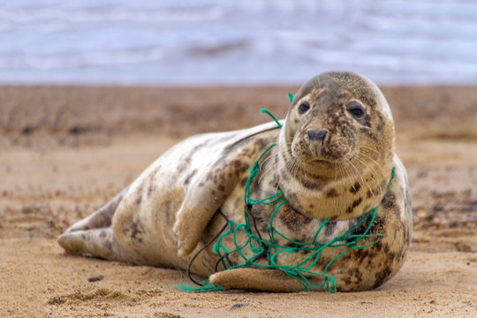
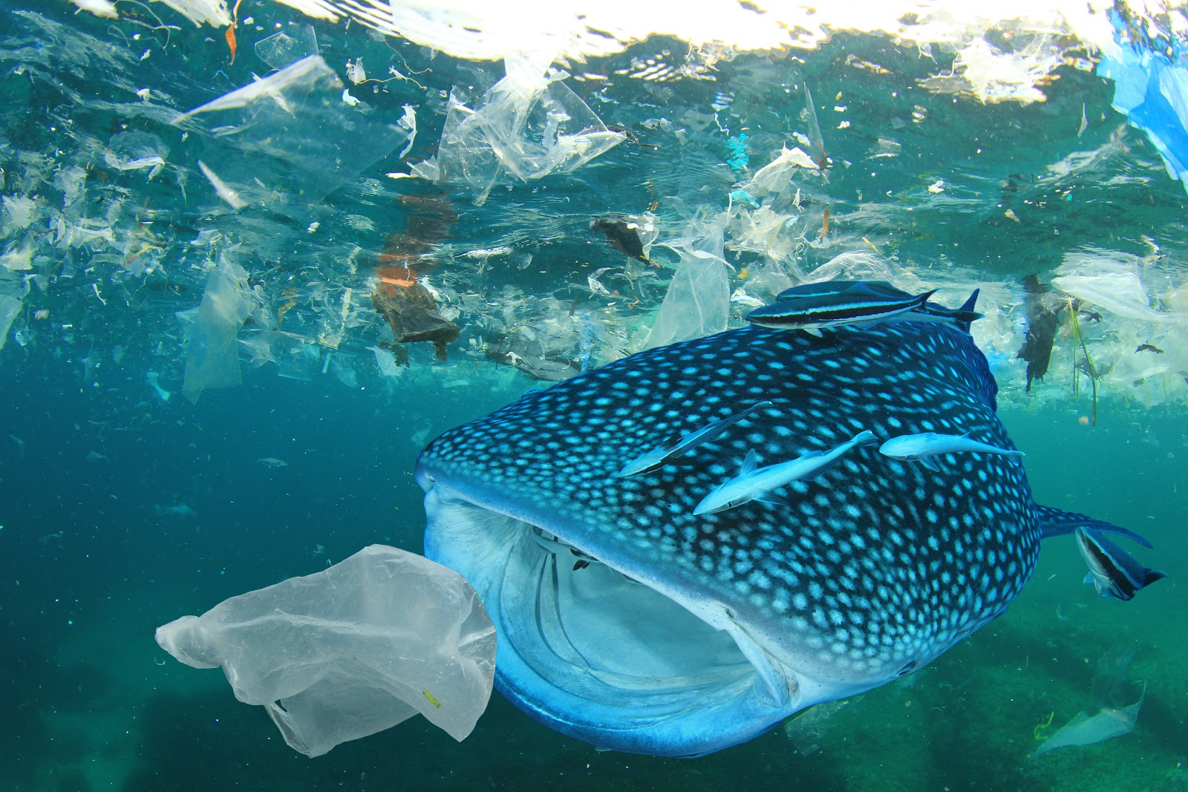
Two Most Common Interactions
Entanglement
Ingestion

Slide 18
Entanglement
INTERACTIONS- MACROPLASTICS AND WILDLIFE
Pieces of plastic entrap or constrict animals
Impact on individuals:
Drowning
Starving
Unable to avoid predators
Injury
Death
Notes:
The most common plastic objects animals get entangled in are plastic ropes, netting, and abandoned fishing gear, but other types of plastic like packaging are not excluded.
Entanglement, especially in fishing gear, can cause injuries and death to wildlife, both in marine and terrestrial areas. If animals are entangled and aren’t able to free themselves, they have a very poor chance of surviving. For example:
They drown.
They starve due to their inability to forage.
They have a harder time moving and avoiding predators.
If they are injured by the litter during their struggle to free themselves, the wounds can get infected, which may cause:
Poor health (and survival skills)
Death

Slide 19
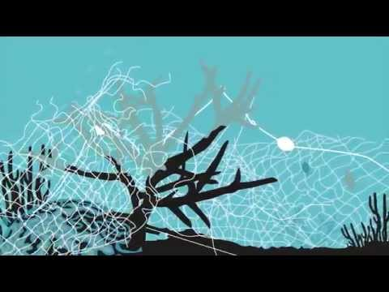
Case Study: Ghost Fishing
INTERACTIONS- MACROPLASTICS AND WILDLIFE
Lost and uncontrolled fishing gear continues to catch animals
Not only target species
Also happens with new nets
Causes drowning
Video: Olive Ridley Project “Threats of Ghost Fishing” (00:00-01:02)
Notes:
Ghost fishing is when lost and uncontrolled fishing gear such as nets (ghost nets) continues catching animals.
According to the Blastic EU project, for example, Swedish fishermen lose up to 165 km of fishing nets per year - this is equal to circa 0.1% of all nets used in the country.
Even if old nets deteriorate and lose catching efficiency, new nets are continuously being lost, adding to the problem.
The nets don’t only trap original target species, but a variety of species that it comes into contact with. This includes marine species, as well as birds.
Entanglement in fishing gear can cause drowning.
Additionally, there seems to be a chain effect where bait species attract other species that get tangled themselves.
Possible to show the class the following video on ghost fishing: Olive Ridley Project “Threats of Ghost Fishing” (00:00-01:02 min)

Slide 20
What is the chain reaction explained in the video? Draw this on a piece of paper
Notes:
Answer: Prey fish entangled in the net attract predators which also get entangled in the net, causing more and more organisms to become entangled.

Slide 21
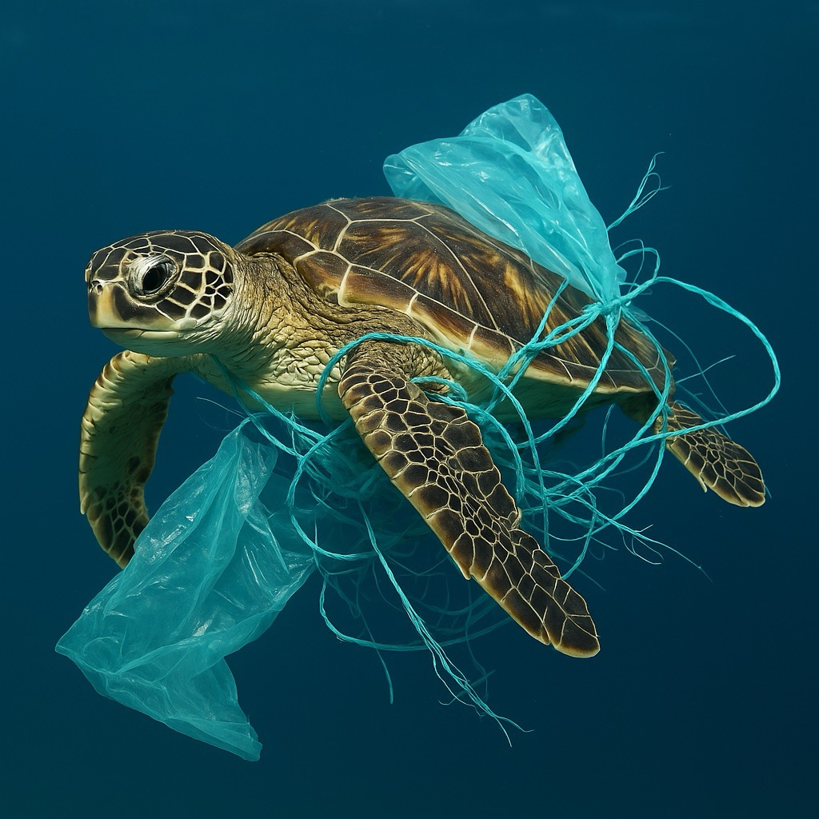
Entangled prey attract predators

Slide 22
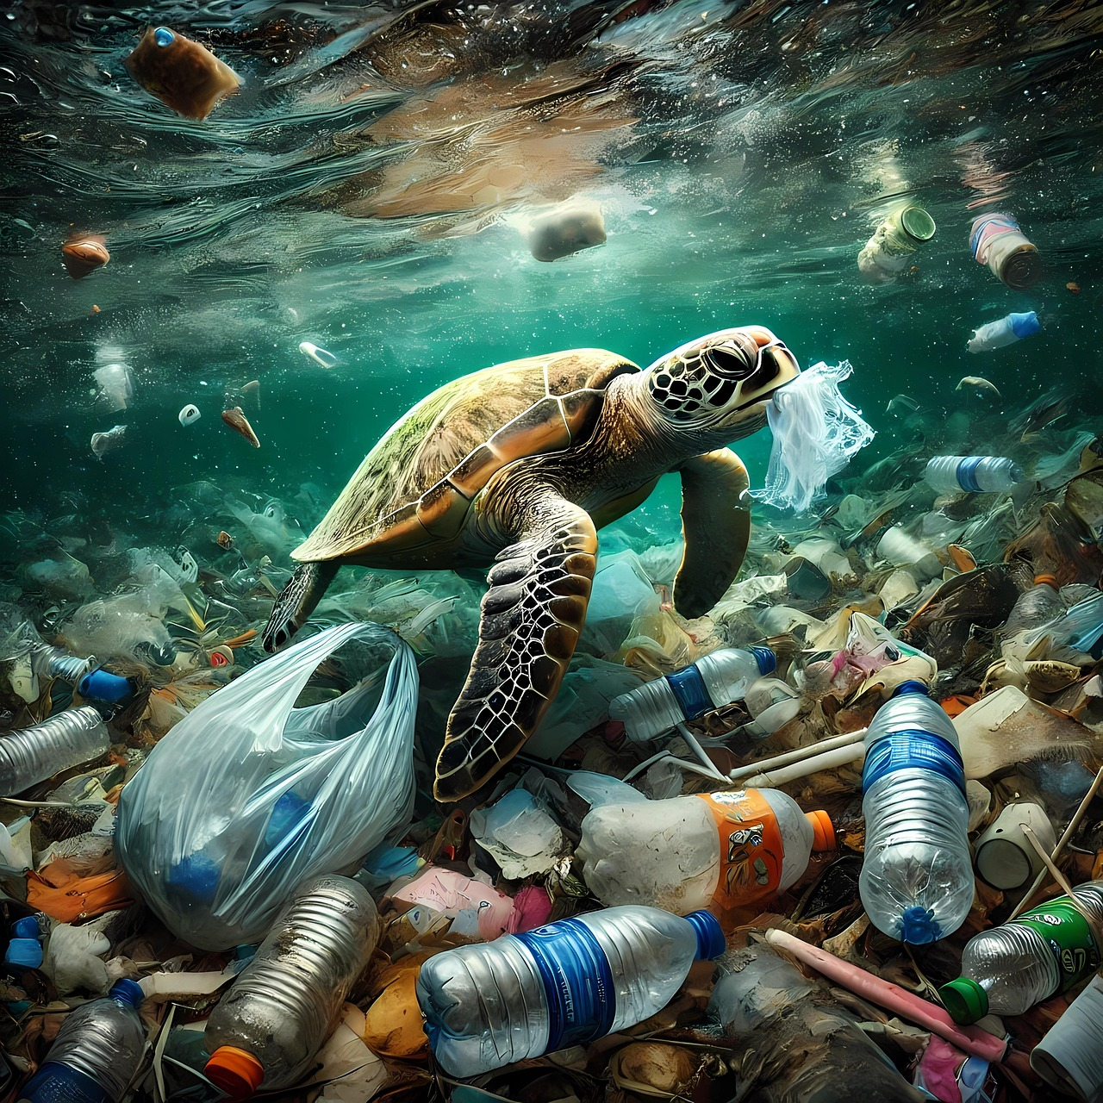
Ingestion
INTERACTIONS- MACROPLASTICS AND WILDLIFE
An animal consumes pieces of plastic as if it is a food source
Examples:
Sea turtle confusing a piece of plastic for a jellyfish
Notes:
Ingestion is when an animal consumes plastic pieces as if it is a food source. Examples:
Sea turtles confuse plastic bags for jellyfish. This is probably a well-known example, since it has been used for campaigns.
Marine birds, such as the Laysan Albatross, whose carcasses have been photographed full of plastic.

Slide 23
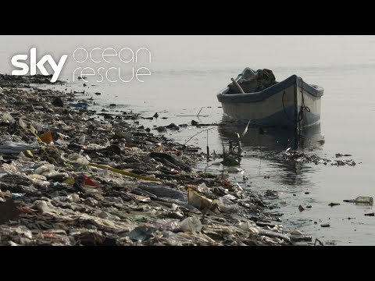
Video: Albatross carcasses full of plastic
Special report: A Plastic Tide | #OceanRescue (19:41-21:25)
Notes:
Video: Special report: A Plastic Tide | #OceanRescue minutes 19.41-21.25 to highlight the interaction between plastic pollution and birds.
In Biology Module 2, on microplastics, you can go into further depth on how plastics are transferred along trophic levels.

Slide 24
What is it exactly that causes animals to die after they have ingested plastic? Think about what you’ve seen in the video!
Notes:
Answer This is already briefly explained in the video so the students should be able to recap this to some extent.
Macroplastics end up in the animal’s stomach, but cannot be digested. Due to this, the animal thinks it is full and does not feel the impulse to eat, which causes it to starve.

Slide 25
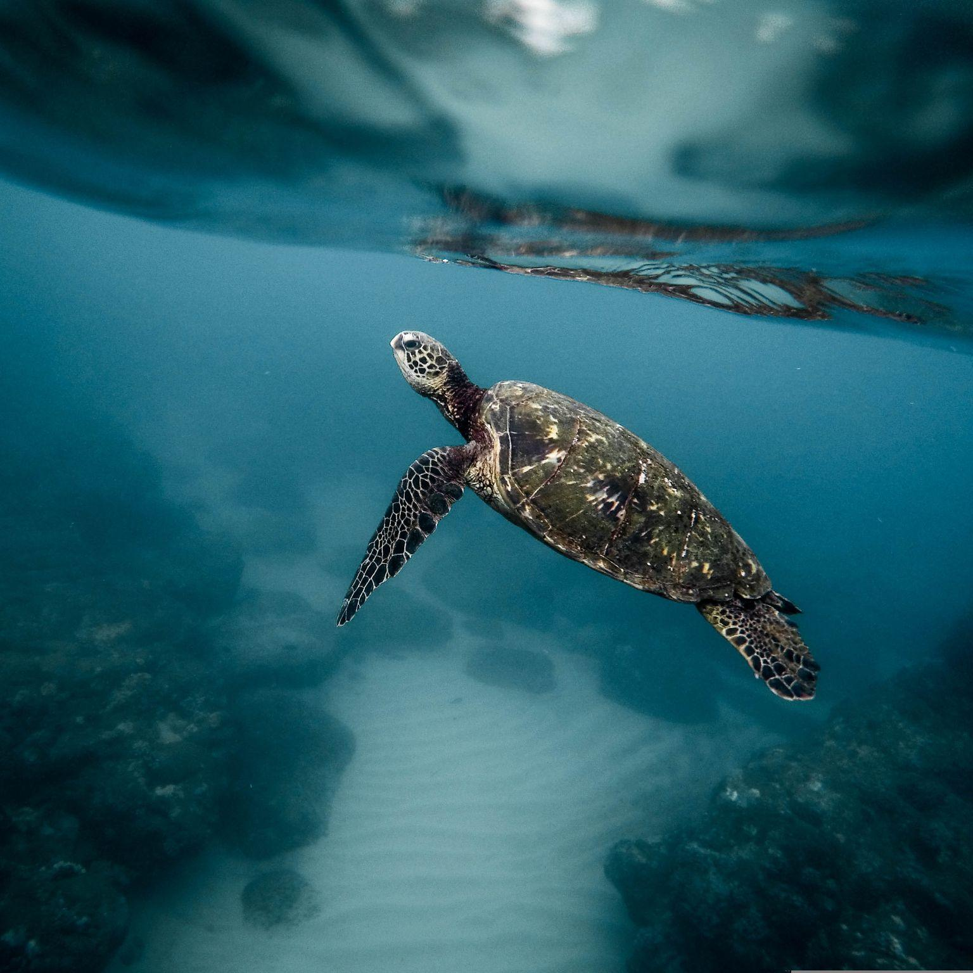
The animal thinks it’s full, so doesn’t eat
Notes:
Nieuwe plaatjes nodig

Slide 26
Impacts of Ingestion on Individuals
INTERACTIONS- MACROPLASTICS AND WILDLIFE
Reduction of stomach capacity
False sense of satiation
Suppurating skin lesions and ulcerating sores
Death
Notes:
General impacts of swallowing plastic pieces on an organism’s health can include:
Reduction of stomach capacity
Loss of appetite/false sense of satiation
Suppurating skin lesions and ulcerating sores
Death
It is important to remember that the impact of ingesting plastic is not the result of a one-time instance; rather, plastic accumulates in the organism’s stomach over its lifetime.
The interactions between macroplastics and wildlife are not limited to entanglement and ingestion. For example, they may cause physical harm such as cuts or they may occupy space in the environment. However, this module focuses on the two most prevalent types.

Slide 27
Topic 1
Exposure and effects
Topic 3

Slide 28
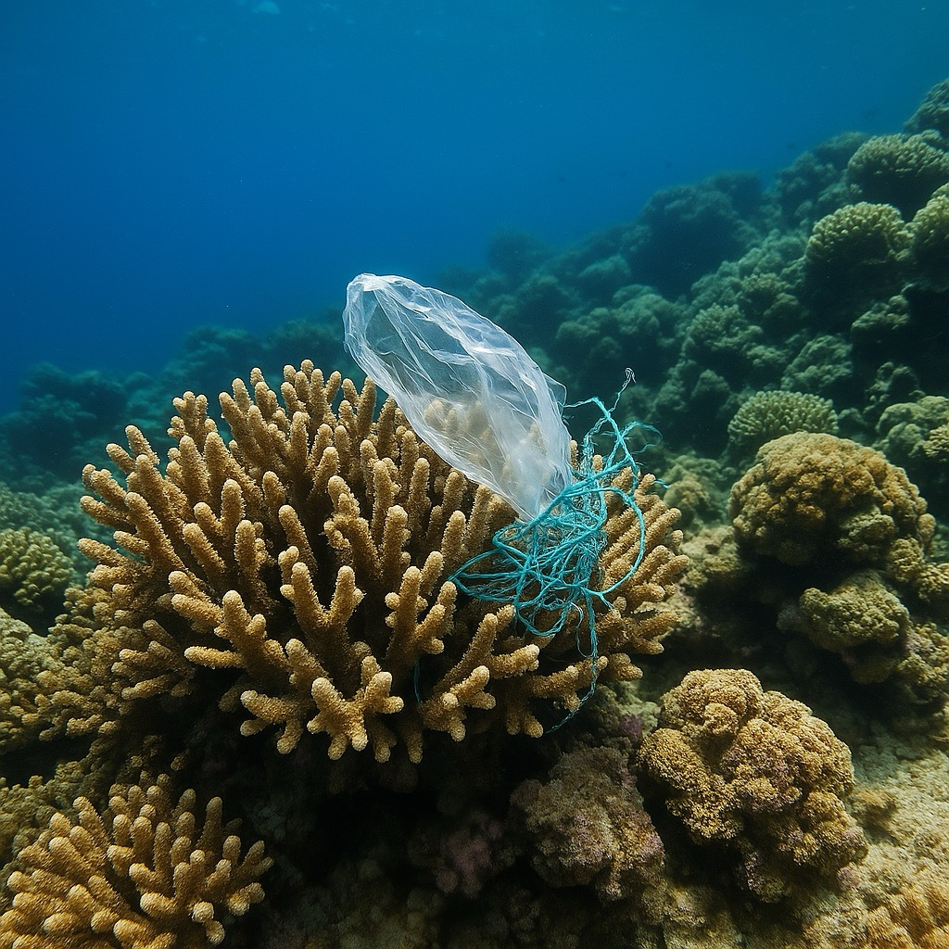
Chronic vs. Acute Exposure and Effects
CHRONIC AND ACUTE EXPOSURE AND EFFECTS
Chronic: constant, long-term
Acute: instant, short-term
→ from exposure to an effect

Slide 29
Earlier, you watched a video on the ingestion of plastic by the albatross. Would you consider this exposure to be chronic or acute?
Notes:
Answer: Chronic exposure is the most plausible answer, since these birds and turtles have plastic in their stomachs for a longer period of time. It only becomes fatal at the point where they are completely starved.
Similar to acute and chronic exposure, there are acute and chronic effects of plastics to wildlife. Acute exposure also causes an acute effect.

Slide 30
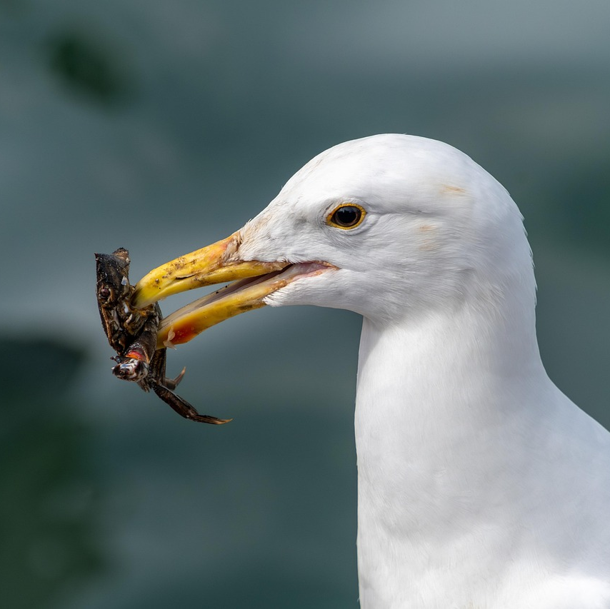
Stomach full of plastic:
probably starved over time, so chronic
Notes:
Nieuwe plaatjes nodig

Slide 31
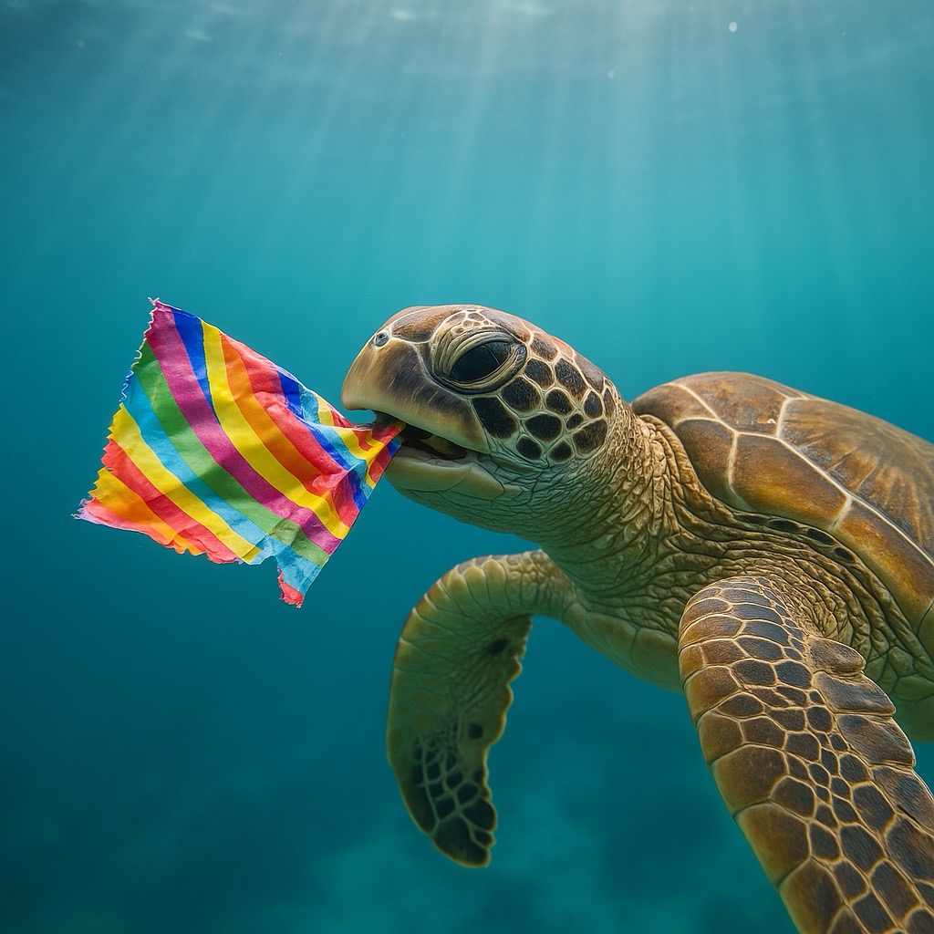
Acute Exposure and Effect
CHRONIC AND ACUTE EXPOSURE AND EFFECTS
If a sea turtle chokes on a plastic bag:
Short-term exposure
Short-term effect: choking
Acute exposure is followed up by an acute effect

Slide 32
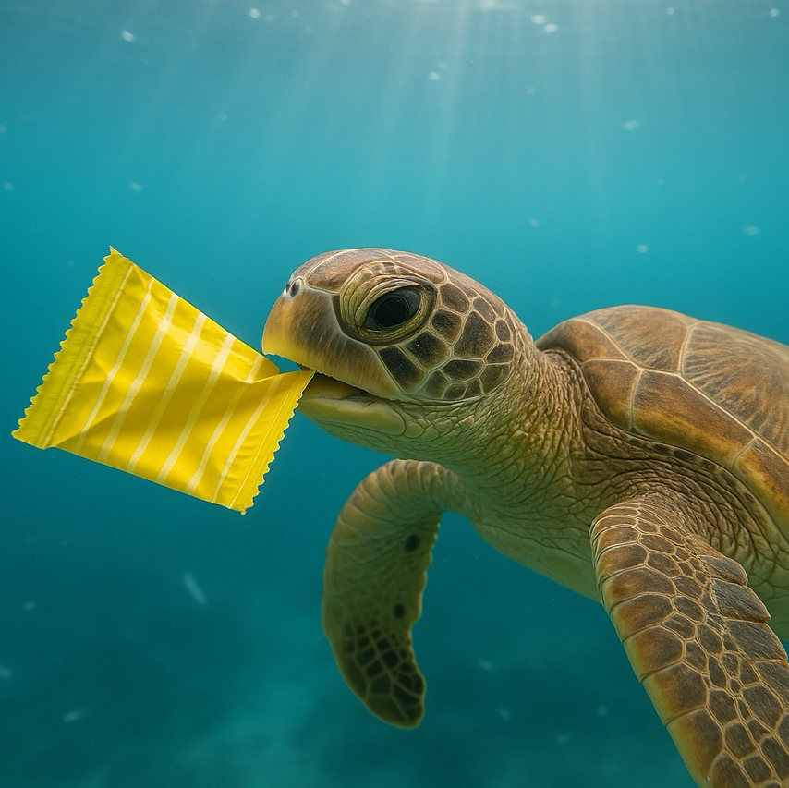
Chronic Exposure and Effect
CHRONIC AND ACUTE EXPOSURE AND EFFECTS
If the plastic bag ends up in the sea turtle’s digestive system:
Long-term exposure
Long-term effect: sense of satiation causing starvation
Chronic exposure is followed up by a chronic effect.

Slide 33
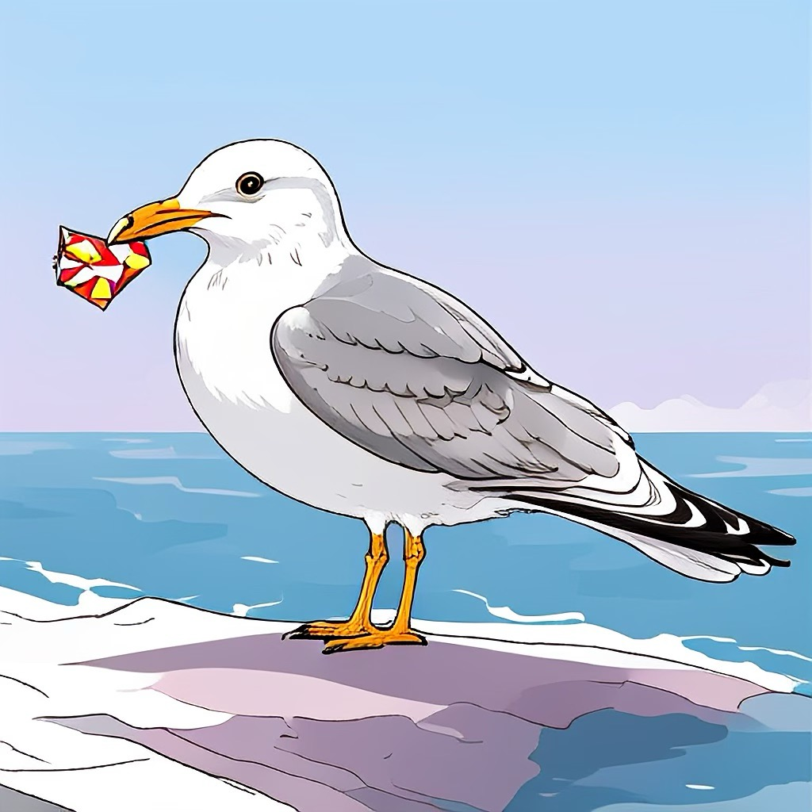
Acute & chronic exposure and effects
→
Lethal and sublethal effects

Slide 34
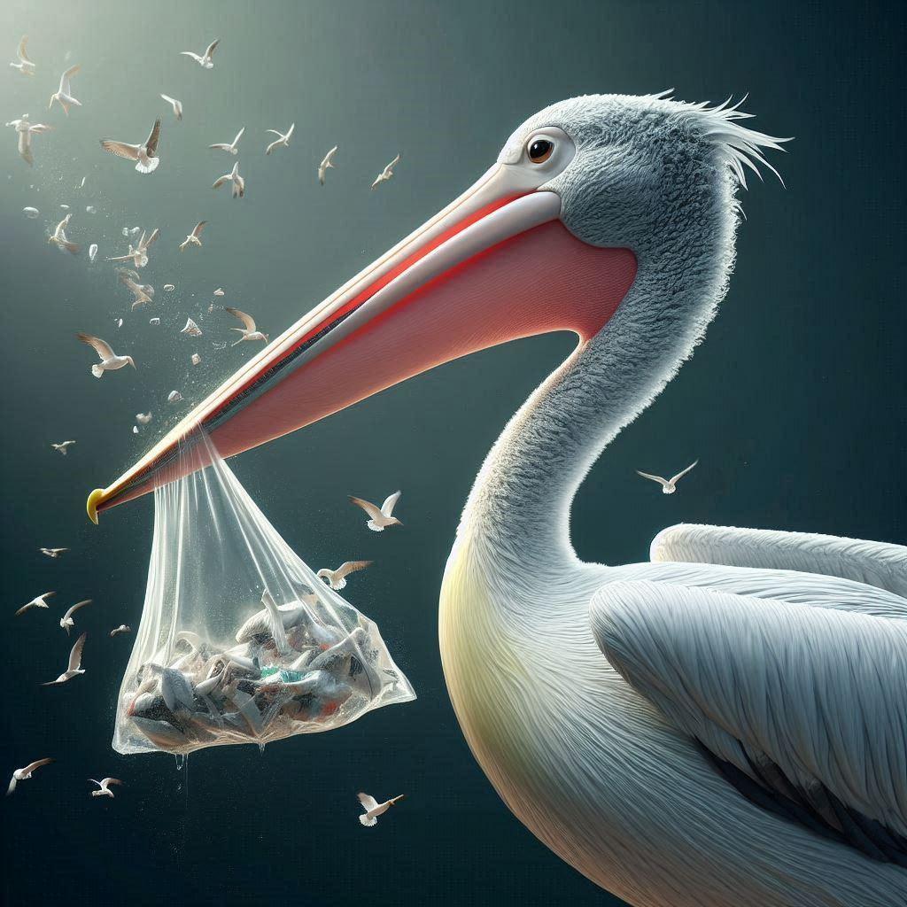
Lethal Effects
LETHAL AND SUBLETHAL EFFECTS
Most severe effects
that can be observed in animals
Directly cause death

Slide 35
For sea turtles, what is an example of acute exposure to macroplastics that leads to a lethal effect?
How about chronic exposure?
Notes:
Several possible correct answers. Examples:
Acute: sea turtle chokes on a piece of plastic
Chronic: macroplastics accumulate in a sea turtle’s stomach over time, leading to death from starvation

Slide 36
Acute: choking
Chronic: plastic accumulation in stomach leading to starvation

Slide 37
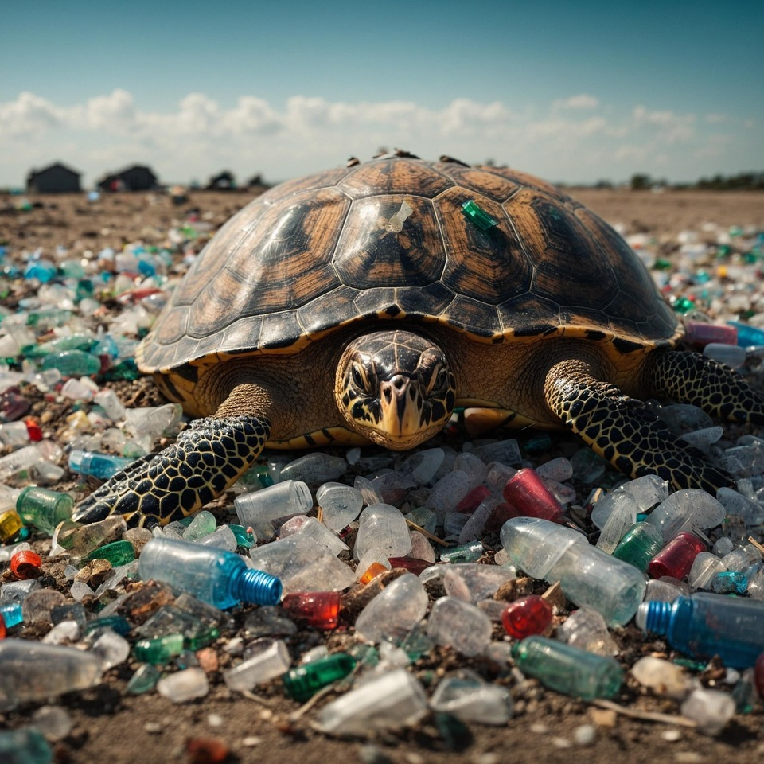
Sublethal Effects
LETHAL AND SUBLETHAL EFFECTS
Reduce an animal’s fitness (ability to survive, grow, and reproduce)
Changes in:
Growth
Reproduction
Behavior
Physiology (immune, endocrine, nervous systems)
Notes:
Sublethal effects are those which do not cause mortality, but reduce an animal’s fitness. In biology, fitness refers to an animal’s ability to survive, grow, and reproduce. Sublethal effects include changes (usually reductions) in:
Growth of organisms
Reproductive output
Behavior (for example the ability to feed effectively, or capture prey)
Additionally, there are many impacts that might change the physiological processes in organisms.
Their immune system might be compromised
Their endocrine (hormone) system can be disrupted
Their nervous system might not function optimally

Slide 38
Case Study: Turtles Eat Plastic Because It Smells Like Food!
LETHAL AND SUBLETHAL EFFECTS
Turtles ignored smell of clean plastic
Responded to smell of food and ocean-soaked plastic
Notes:
Case Study: Sea Turtles Eat Plastic Because It Smells Like Food:
For a long time, scientists speculated that turtles were attracted to plastic due to its appearance. In the study, the turtles ignored the smell of clean plastic and water but responded to the smell of food and ocean-soaked plastics by sticking their noses out of the water to smell. This is an example of how plastic has sublethal effects on turtle behavior.
Newburger, Emma. “Sea Turtles Are Eating Ocean Plastic Because It Smells like Food, Study Finds.” CNBC, March 9, 2020.

Slide 39
Can you think of any examples of sublethal effects of consuming macroplastics for sea turtles?
Notes:
Several possible correct answers. Examples:
The accumulation of large amounts of buoyant materials in the intestines can affect swimming behavior and buoyancy control, causing behavioral (e.g., feeding) changes. Buoyancy control is particularly important for deep diving species, such as leatherbacks and small benthic foragers (i.e., organisms living at the bottom of a body of water), for example flatbacks.
Plastic ingestion can compromise reproduction by, for instance, blocking the passage of a female’s eggs.
Macroplastics can accumulate in the gut of a sea turtle, leading to malnutrition in the long term. A large amount of plastic can accumulate in a sea turtle’s gut before causing lethal damage.

Slide 40
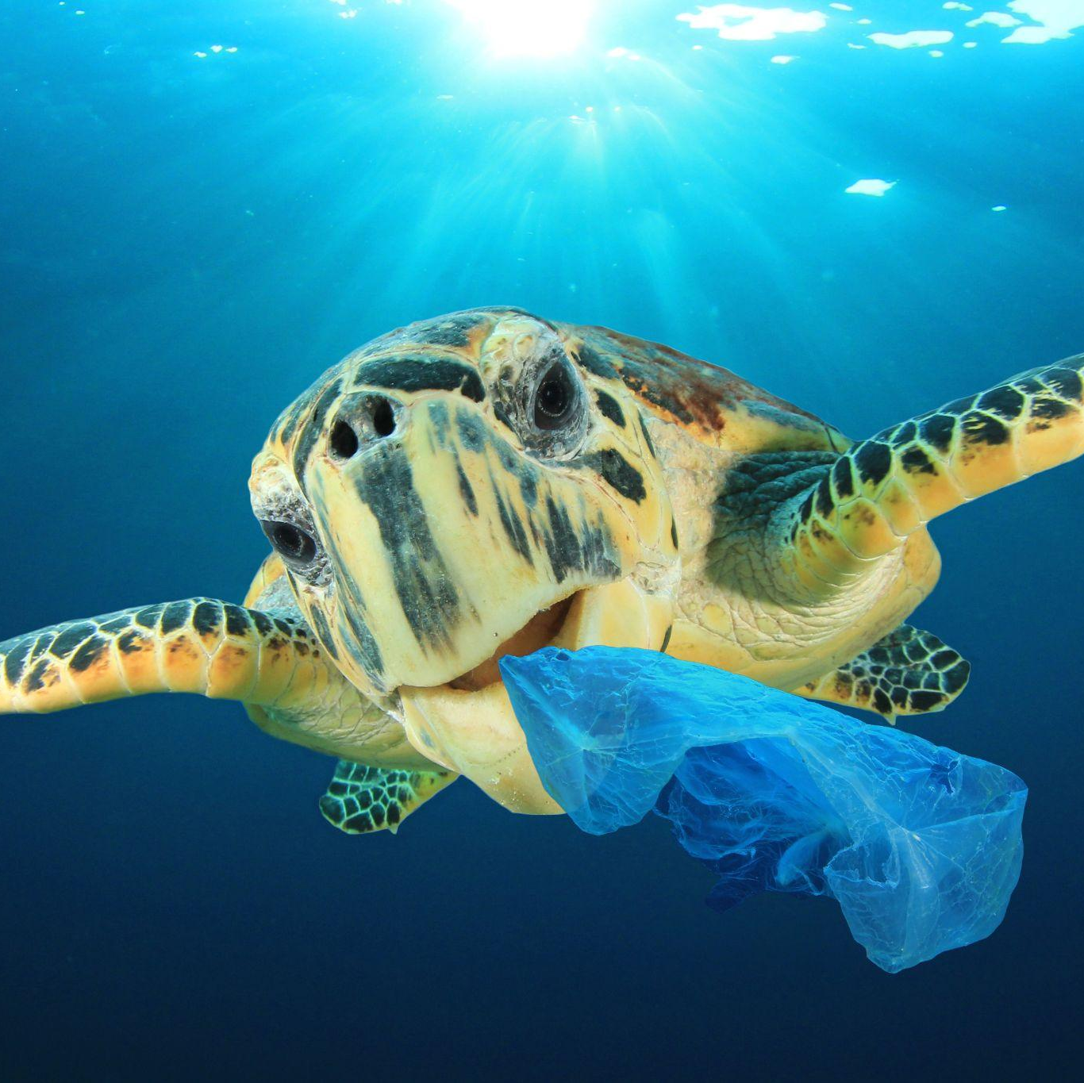
Swimming behaviour affected
Reproduction compromised
Malnutrition

Slide 41
Do you think lethal or sublethal effects of macroplastics receive more attention from the media? Why?
Do you think this is problematic?
Notes:
Answer: Lethal effects receive more attention from the media because they are more impactful and easier to understand. Not giving enough attention to sublethal effects can be problematic because these effects also have significant impacts on wildlife and thus should be recognized.

Slide 42
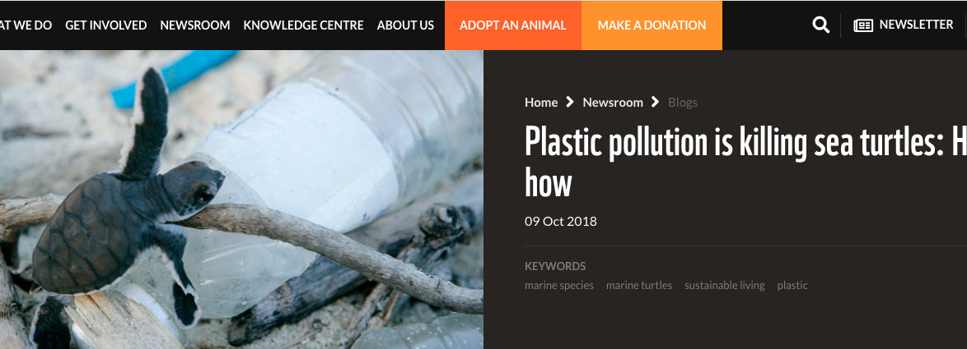
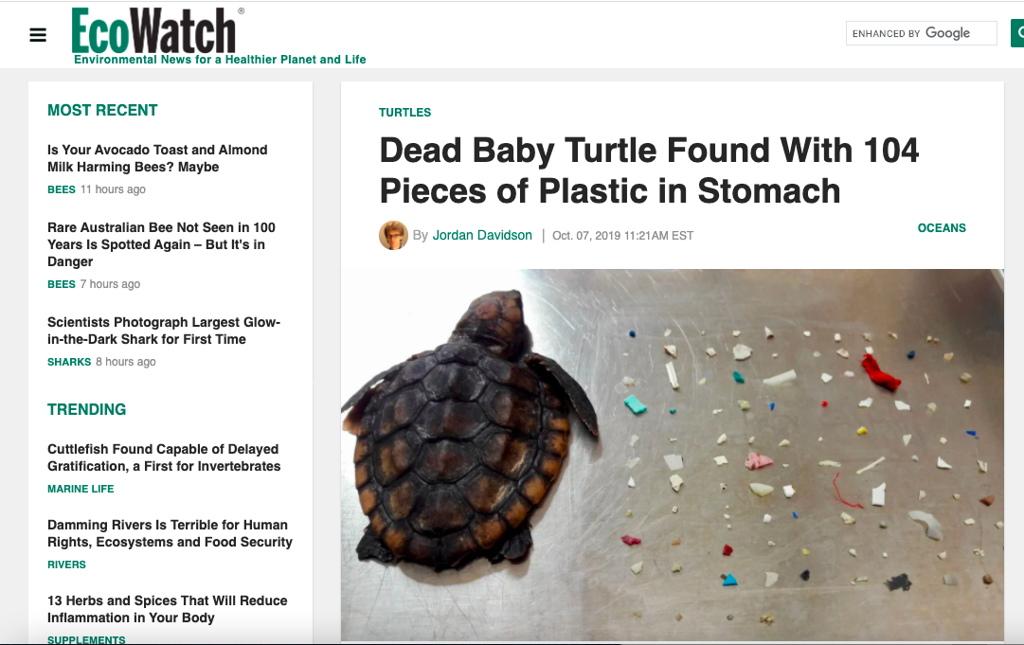
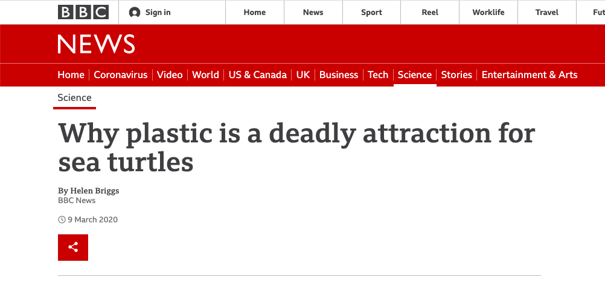

Slide 43
Topic 1
Topic 2
Conclusion

Slide 44
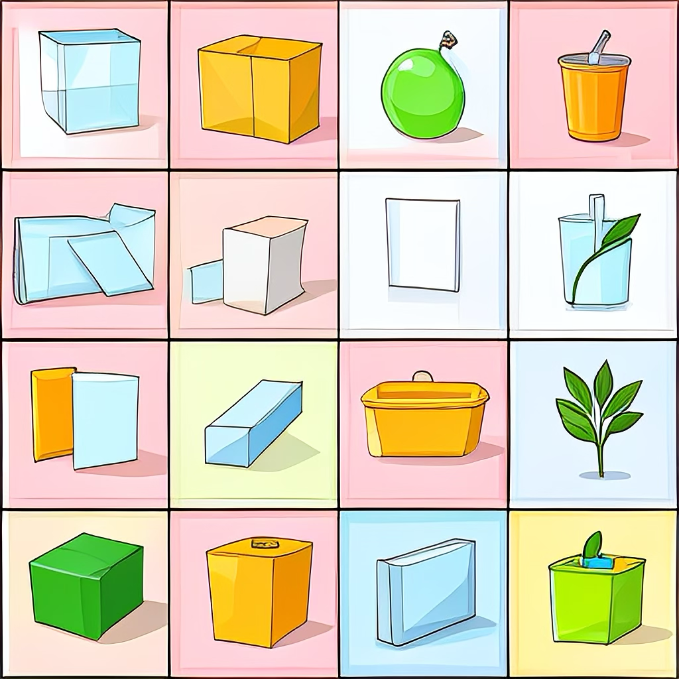
Macroplastics: What next?
Prevent plastic pollution in the environment:
Limit plastic production and consumption
Waste management
Preventing plastics from reaching the ocean
Cleaning the ocean
Notes:
Plastic pollution has huge negative impacts on our wildlife. To prevent this, we need to prevent plastic pollution in the environment, which we can do by producing and consuming less plastic and being more conscious of how we dispose of plastic.
Furthermore, the impacts of macroplastics are only the beginning. Microplastics have an even more underrecognized impact on wildlife and potentially humans. More on this in our microplastics module.

