Slide 1
Activity
Macroplastics
UNPLASTIC BIOLOGY MODULE 1
Biology - Module 1

Slide 2
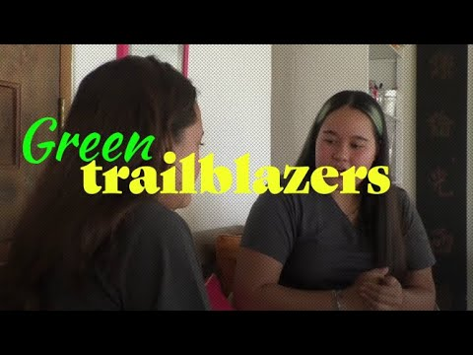
Case Study: Bye Bye Plastic Bags
Notes:
Throughout the first module, we’ve focused a lot on the issue of macroplastics.
Now, let’s look at some potential and existing solutions.
The first is Bye Bye Plastic Bags, a movement started by two sisters in Bali to eliminate plastic bags. After showing the video, you may wish to ask the students to reflect on the following questions:
Do you believe youth movements are an effective strategy to achieve change?
If you would start a movement, what issue would it address?
For more information about Bye Bye Plastic Bags, please visit their website.

Slide 3
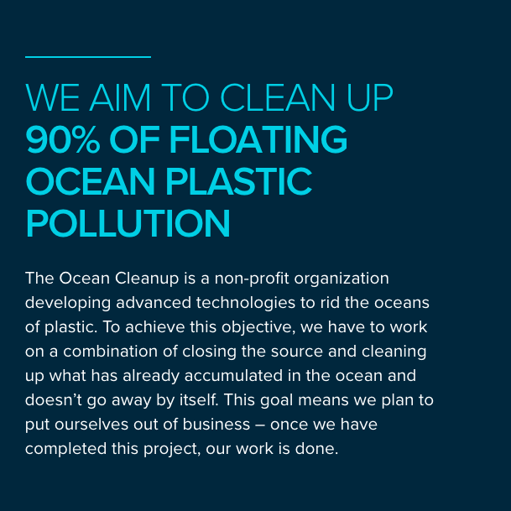
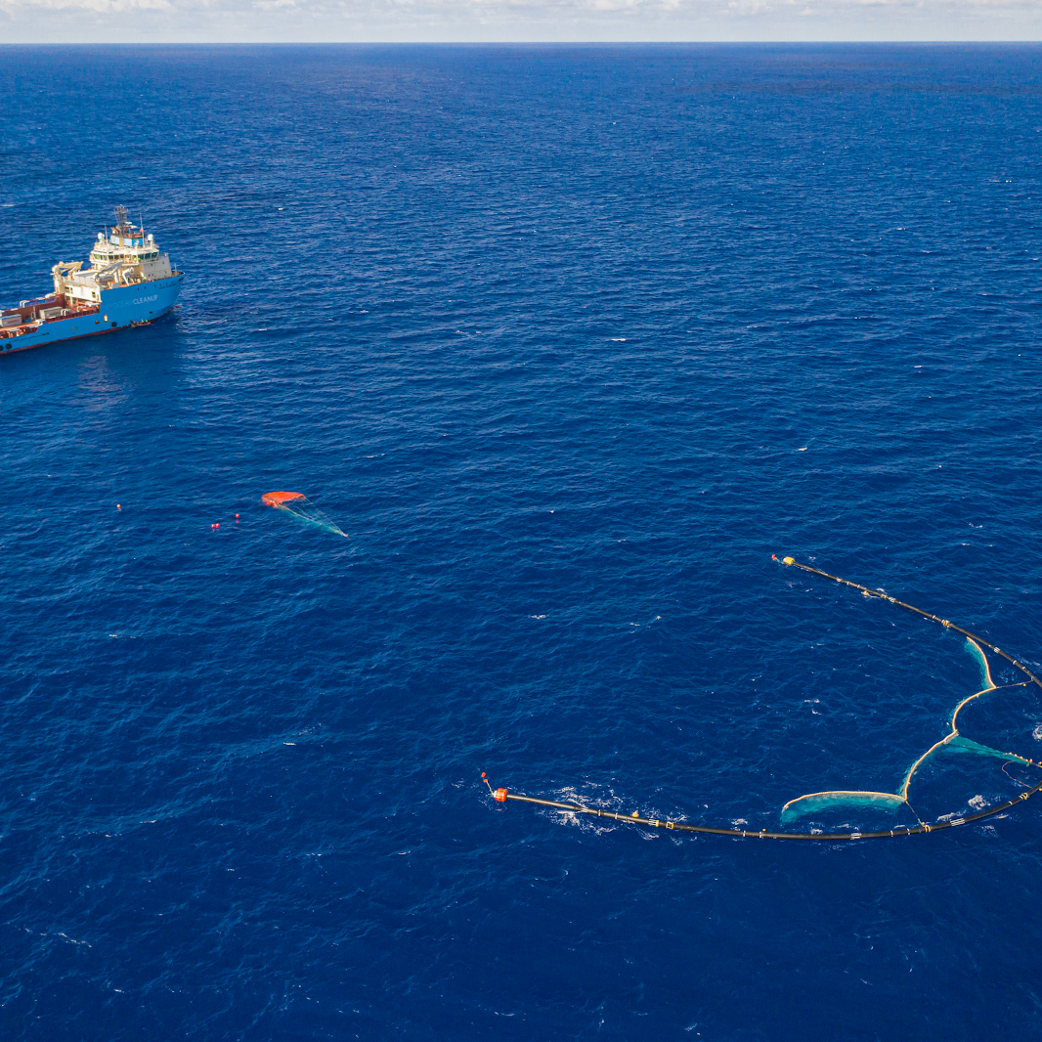
The Ocean Cleanup

Slide 4
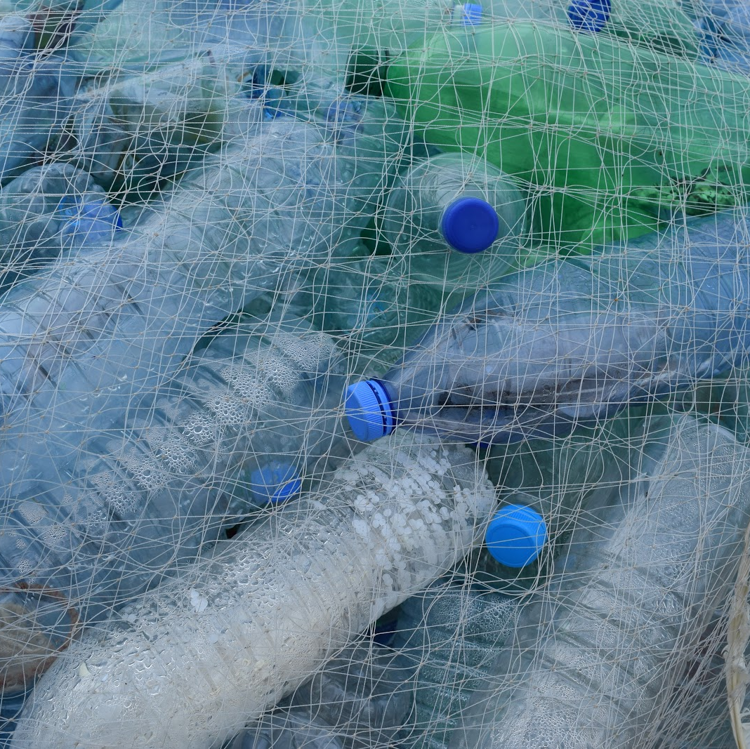
Activity: Debate
WHAT CAN WE DO?
Group division
Opening statements preparation (15 min)
Opening statements (6 min)
Rebuttals preparation (8 min)
Rebuttals (4 min)
Closing remarks (5-7 min)

Slide 5
1
Stance
Main arguments
Argument 1
Argument 2
Argument 2
Argument 3
Rebuttal notes

Slide 6
1
Stance: In Favor of the Ocean Cleanup
Main arguments
Argument 1
Argument 2
Argument 2
Argument 3
Rebuttal notes

Slide 7
1
Stance: Against the Ocean Cleanup
Main arguments
Argument 1
Argument 2
Argument 2
Argument 3
Rebuttal notes

Slide 8
Group Division
Group 1 - In favor of the Ocean Cleanup
Group 2 - Against the Ocean Cleanup

Slide 9
Helpful Resources:
The Ocean Cleanup website
“The Ocean Cleanup Successfully Collects Ocean Plastic, Aims to Scale Design”
“The Massive Plastic-Cleaning Device in the Great Pacific Garbage Patch Probably Won't Hurt Sea Creatures — But There's Still a Big Problem to Sort Out”
“The Ocean Cleanup Struggles to Prove It Will Not Harm Sea Life”
“Why So Many of Us Wanted to Believe in an Ocean Cleanup System That Just Broke”
“Ocean Cleanup Won’t Turn a Profit, But We Should Still Do It”

